Slide 1
A Long Road Ahead
Anne Cosgrove, Director
April 17, 2023
U.S. Not-for-Profit Acute Health Care: Industry Update and 2023 Outlook

Slide 2
Overview – Portfolio of Acute Care Credits
Stable
Negative
Positive
S&P’s portfolio of not-for-profit acute health care credits: ~ 430
Average rating is still around an ‘A’ despite rating actions
S&P’s acute care credit portfolio includes wide variety of acute care organizations (e.g., systems, stand-alone hospitals, children’s hospitals, specialty hospitals, rural hospitals, hospital districts, etc.) and all covered under one criteria

Slide 3
Key Take Aways For Negative Outlook For Acute Health Care Sector
Continued cash flow compression. We believe many hospitals, though not all, will be in a tighter space for credit quality given higher labor costs, inflationary expenses, and a mixed revenue outlook.
Waning unrestricted reserves. Unrestricted reserves and a generally low leveraged sector supported credit quality in 2022, however, without cash flow growth or investment rebound, the overall balance sheet could be less supportive of credit quality in 2023.
Expected negative bias in ratings and outlooks. Negative outlooks have increased through the second half of the year and we expect a continuation of that trend with more negative outlooks and downgrades in 2023, though there will continue to be affirmations for many of our credits that are well positioned at their rating, both financially and enterprise-wise.

Slide 4
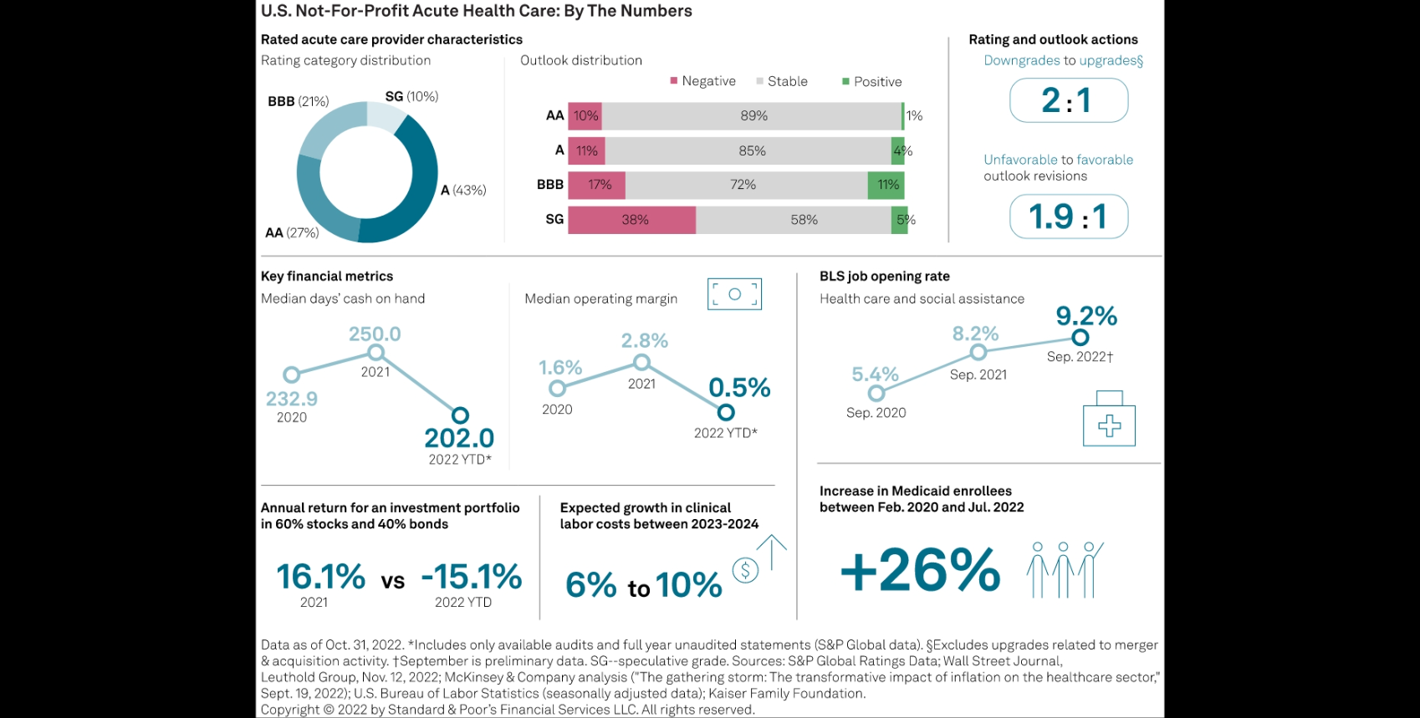
U.S. Not-For-Profit Health Care: By The Numbers

Slide 5
2022 Rating Actions
Data as of December 2022.

Slide 6
Unfavorable Bias in Rating Actions for 2022 and YTD 2023
Data represents all ratings reviewed including some with multiple rating actions. Criteria actions in 2018 and 2019 relate to "U.S. And Canadian Not-For-Profit Acute-Care Health Care Organizations" criteria, published on March 19, 2018. 2023 YTD is through February 2023.

Slide 7
What Types of Acute Care Credits Have Been Impacted?
Unfavorable rating actions/outlooks:
Systems & standalones affected, but more standalones (though may be a bias of portfolio)
Multi-notch credit rating actions are generally at BBB or lower
Some markets harder hit due to various factors incl. demographics, regulatory environment, cost of living
Certain safety net providers also overly affected as they continue to provide services even if costly to do so (vs. others that slowed down services due to labor costs/availability)
Enterprise profile may buy some time before a rating action (but could still result in outlook change)
Favorable rating actins/outlooks:
Not as many occurring but there are some
M&A has resulted in certain credits’ rating improving
Certain states have benefited from state Medicaid programs (KY, FL, etc.)
While pressures are easing, there is uncertainty on the level of improvement we will see over the next few years.

Slide 8
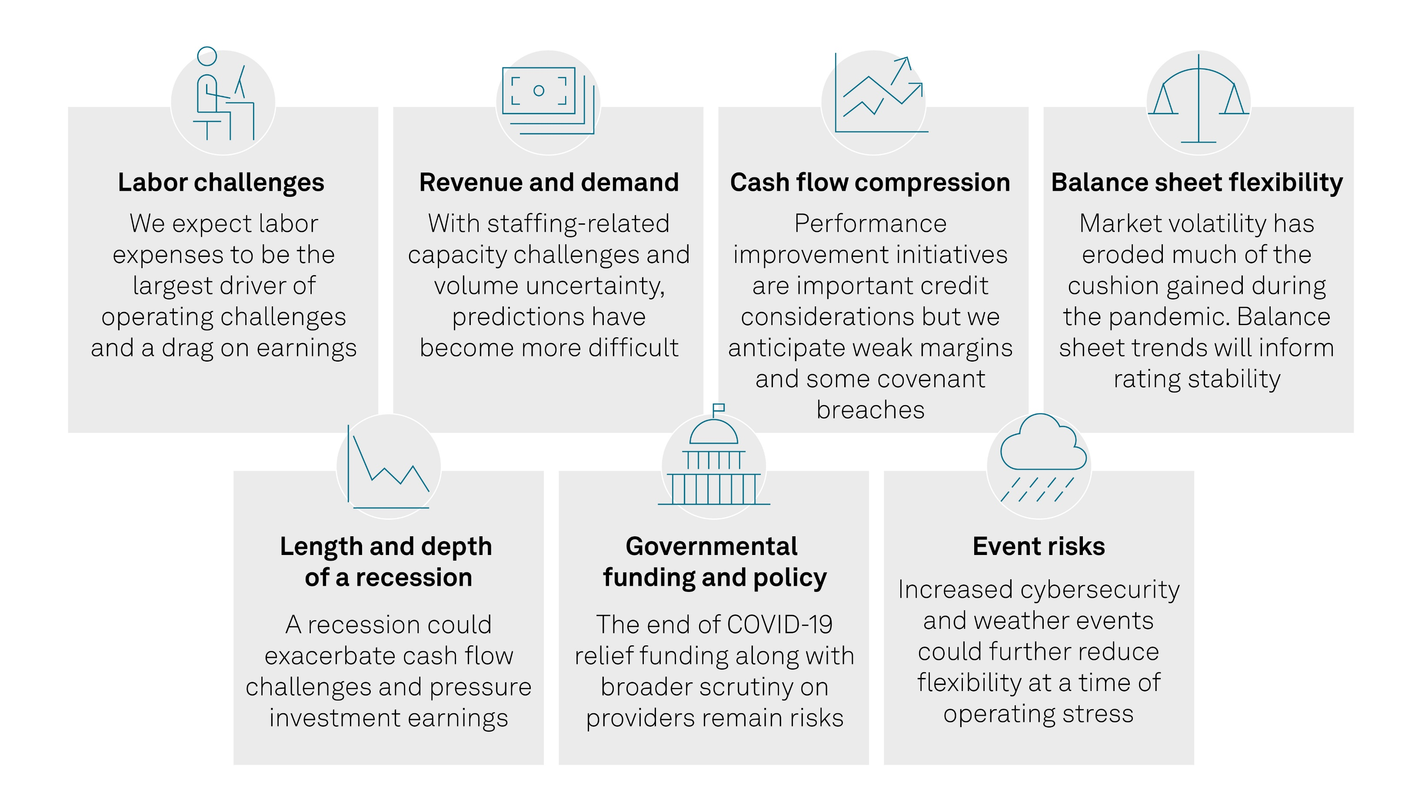
U.S Not-for-Profit Health Care: What We’re Watching

Slide 9
Labor Improving, But Not Back To Pre-Pandemic Levels
Average weekly travel rate 2/6/2023:
$2,550
Source: Vivian Health, data through October 2022 (from https://www.healthcaredive.com/news/travel-nurse-pay-high-hospitals-staffing/637412/); Aya Health Care Staffing Data

Slide 10
Additional Drivers of Margin Compression
Revenues & Demand
Volume uncertainty
Payor mix shifts & reimbursement
Migration of services to outpatient setting
Other expense considerations
Full volume recovery yet to be achieved for some
Acuity and mix of volumes could permanently shift, particularly for certain community hospitals
Demand impacted by higher cost staff and labor availability (including at SNFs)
PHE/stimulus over last few years may have masked broader trend of growing governmental payor mix
Reimbursement not keeping up with expense growth & continued push to value based reimbursement from some payors
Reduction in PHE related payments and other COVID-19 related funds
Continued growth area and access to new patients, but less profitable than inpatient
Increased competition for outpatient services from other providers and non-traditional players drives need to invest
Pharmaceuticals and supply expenses continue to grow
Recent wage adjustments and union negotiations have embedded and extended higher expenses for some providers
Recession could increase bad debt

Slide 11
2023 Federal Developments & Policy Views
- End of COVID-19 stimulus funds may leave hole in some budgets with FEMA funds more limited and uncertain
- Sequestration restarted in 2022
- 2% physician cuts in 2023
- DSH cuts to begin in 2024
- Medicaid eligibility redetermination to shift payor mix over coming year beginning in April 2023 regardless of PHE
- Removal of COVID-19 add-on payments, which has already been limited by lack of funding
- Reduction in 6.2% FMAP increase
- Medicare hospital rates slightly better than anticipated, but lower than needed and further impacted by 340B ruling
- Telehealth reimbursement extended to December 2024
- M&A could be more difficult within markets, though larger strategic plays may be okay
It’s no longer 2020/2021
End of Public Health Emergency
Other Updates

Slide 12
Some Near-Term Mitigation Strategies
Reduction in agency labor/over-time pay and management of labor
Length of stay/Access
Rationalization of care/closure or consolidation of services & hospitals (temporary or permanent)
Revenue cycle improvements
Diversification into growing markets and services/monetization of assets
Expense management (other than labor)
Optimizing supplemental funds (e.g., Medicaid Directed Payment Program)
Longer-term strategies likely to involve data/technology for care delivery redesign & efficiencies, clinical developments, M&A and affiliations, and/or broader diversification.

Slide 13
Q&A

Slide 14
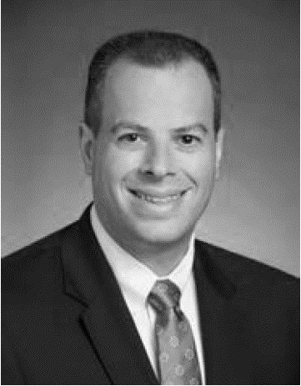
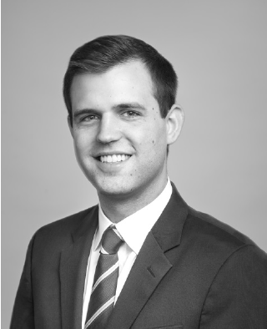
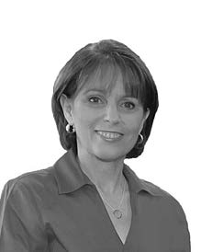
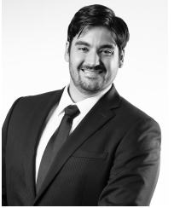
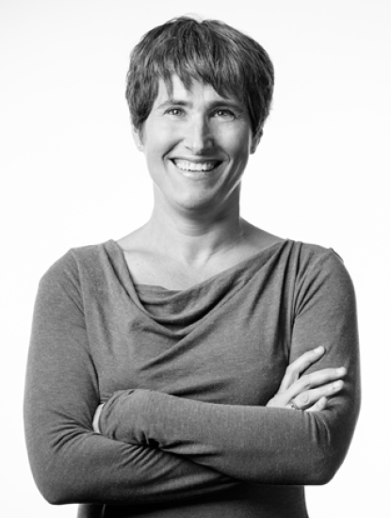
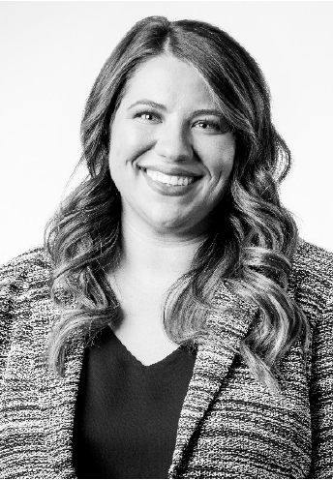
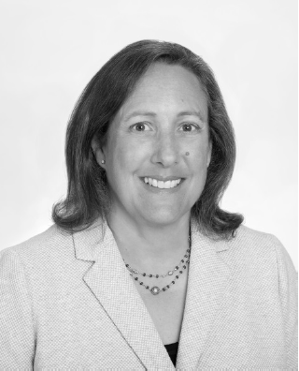
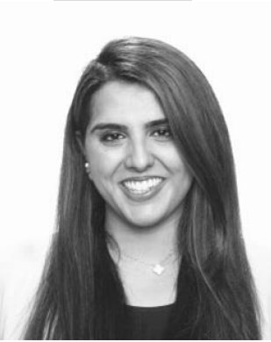
Not-for-Profit Health Care Group: Contact Information
Stephen Infranco
Senior Director, Analytical Manager
New York, NY
T: 212.438.2025
stephen.infranco@spglobal.com
Patrick Zagar
Director, Lead Analyst
Dallas, TX
T: 214.765.5883
patrick.zagar@spglobal.com
Kay Sifferman
Associate Director
New York, NY
T: 303.721.4501
alexander.nolan@spglobal.com
Concy Richards
Associate
Chicago, IL
T: 312.233.7024
concy.richards@spglobal.com
Suzie Desai
Senior Director, Sector Lead
Chicago, IL
T: 312.233.7046
Suzie.Desai@spglobal.com
Marc Bertrand
Associate Director
Chicago, IL
T: 312.233.7116
marc.bertrand@spglobal.com
Blake Fundingsland
Associate
Centennial, CO
T: 303.721.4703
blake.fundingsland@spglobal.com
Wendy Towber
Associate
Centennial, CO
T: 303.721.4230
wendy.towber@spglobal.com
Anne Cosgrove
Director, Lead Analyst
New York, NY
T: 212.438.8202
anne.cosgrove@spglobal.com
Chloe Pickett
Associate Director
Centennial, CO
T: 303.721.4122
chloe.pickett@spglobal.com
Marc Arcas
Associate
Chicago, IL
T: 312
Marc.Arcas@spglobal.com
Elsa Berisha
Credit Analyst
New York, NY
elsa.bersiha@spglobal.com
Cynthia Keller
Director, Lead Analyst
Augusta, ME
T: 212.438.2035
cynthia.keller@spglobal.com
Aamna Shah
Associate Director
San Francisco, CA
T: 630.532.7976
aamna.shah@spglobal.com
David Mares
Associate
Centennial, CO
T: 303.721.4700
david.mares@spglobal.com
Notes:
Alex

