Slide 1

2nd Quarter 2023 Investment Outlook
04-2023

Slide 2
What’s facing Institutions/Individuals Health/Higher Ed
Headwinds
Headwinds
Inflation
  Wages: 56-60% of Annual Spend
  Building and Maintenance Costs: NA -10% of Spend
  Borrowing Costs: 4-7% of Annual Spend
Lower Investment Returns
  Negative Real Yields on Most Bonds
  Bond Losses (-13% in 2022)
  Stock P/E Multiples are too High
  Earnings Falling: Labor Costs, Falling Margins, CapEx Costs,
American School and University https://www.asumag.com/research/article/20851272/38th-annual-maintenance-operations-cost-study-for-colleges CUBA_Strategic_Debt_Management_FINAL.pdf https://www.nacubo.org/Research/2022-Top-Business-Issues#:~:text=Colleges%20and%20universities%20are%20facing,and%20increasingly%20complicated%20compliance%20burdens https://www.ncbi.nlm.nih.gov/pmc/articles/PMC7326305/

Slide 3
What’s Positive?
Tailwinds
Tailwinds
Tax Exempt Financing Attractive
  Low Tax-Exempt Ratio
  Modest Yield Spread for Lower Rated Tax-Exempt Borrowers
Investing Opportunities
  Private Bonds may be Attractive
    Libor/SOFR floating rate debt goes up with Fed Funds
    Yields as high as low teens
    Senior in Capital Structure
  Forced Selling by Others may be Your Gain
    Secondary Sales of Private Equity look very cheap
Technology
  New Algorithm Identifies Wealth Transfer Gifts
American School and University https://www.asumag.com/research/article/20851272/38th-annual-maintenance-operations-cost-study-for-colleges CUBA_Strategic_Debt_Management_FINAL.pdf https://www.nacubo.org/Research/2022-Top-Business-Issues#:~:text=Colleges%20and%20universities%20are%20facing,and%20increasingly%20complicated%20compliance%20burdens https://www.ncbi.nlm.nih.gov/pmc/articles/PMC7326305/

Slide 4
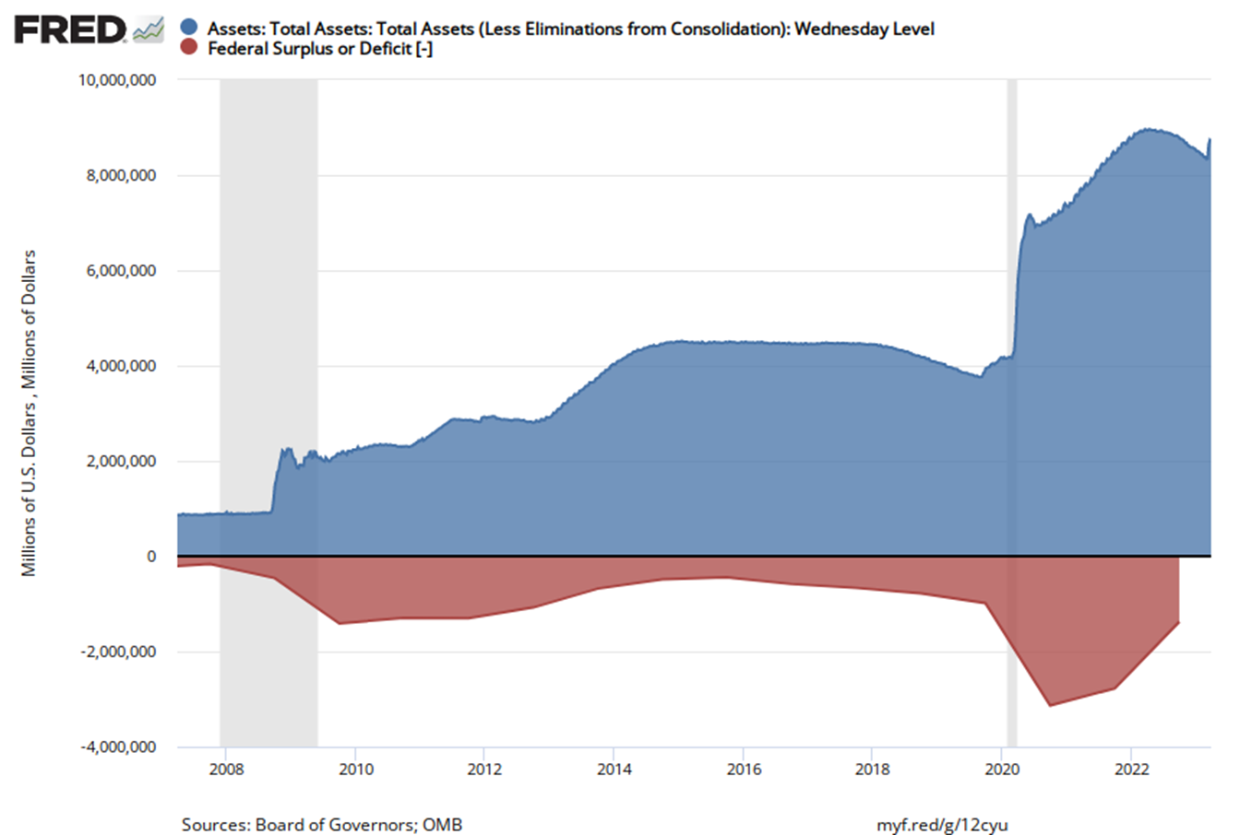
How Did We Get Here?
Inflation
The Great Financial Experiment
$8,734
3-20-23
“The balance sheet expansion is really temporary lending to banks to meet those special liquidity demands created by the recent tensions. It's not intended to directly alter the stance of monetary policy.”
—Jerome Powell (March 22, 2023)
$8,963
3-21-22
Fed Balance Sheet - Cumulative
Fiscal Deficit - Annual
U.S. Office of Management and Budget, Federal Surplus or Deficit; Board of Governors of the Federal Reserve System (US). https://fred.stlouisfed.org/series/WALCL, April 5, 2023

Slide 5
Consumer Price Index
Inflation
The Great Financial Experiment Results:
Highest Inflation since 1981
U.S. Bureau of Labor Statistics, Consumer Price Index for All Urban Consumers: All Items in U.S. City Average [CPIAUCSL], retrieved from FRED, Federal Reserve Bank of St. Louis; https://fred.stlouisfed.org/series/CPIAUCSL, April 6, 2023.
Modern Monetary Theory has created an outcome of inflation not seen since the 1970s – 1980s.

Slide 6
It’s Slow: The Lag Effect of Tightening on Inflation
Inflation
U.S. Bureau of Labor Statistics, Consumer Price Index for All Urban Consumers: All Items in U.S. City Average [CPIAUCSL], retrieved from FRED, Federal Reserve Bank of St. Louis; https://fred.stlouisfed.org/series/CPIAUCSL, April 5, 2023.
The Fed is using blunt instruments: Money Supply and Fed Funds to reduce inflation. History shows that while Tightening slows down the economy, uprooting inflation can take 2 or 3 years.

Slide 7
Components of Inflation
Inflation
BLS Relative importance of components in the Consumer Price Indexes: U.S. city average, December 2022
Housing, Food and Energy/Transportation are 75% of Inflation.

Slide 8
Housing
Inflation
Zillow Home Value Index (ZHVI) for All Homes Including Single-Family Residences, Condos, and CO-OPs in the United States of America [USAUCSFRCONDOSMSAMID], retrieved from FRED, Federal Reserve Bank of St. Louis; https://fred.stlouisfed.org/series/USAUCSFRCONDOSMSAMID, April 10, 2023.
OER, Owner Equivalent Rent, is an antiquated survey process of calling 50,000 homeowners to ask what their house would rent for. The OER is usually about 18 months behind real rent and housing values.

Slide 9
Energy
Inflation
% Year over Year Consumer Energy Costs
U.S. Bureau of Labor Statistics, Consumer Price Index for All Urban Consumers: Energy in U.S. City Average [CPIENGSL], retrieved from FRED, Federal Reserve Bank of St. Louis; https://fred.stlouisfed.org/series/CPIENGSL, April 10, 2023.
While supply chains have opened and demand slowed, OPEC just cut production to keep prices high.

Slide 10
Food
Inflation
% Year over Year Consumer Foods Costs
U.S. Bureau of Labor Statistics, Consumer Price Index for All Urban Consumers: Food in U.S. City Average [CPIUFDSL], retrieved from FRED, Federal Reserve Bank of St. Louis; https://fred.stlouisfed.org/series/CPIUFDSL, April 10, 2023.
While the Ukraine Russia war made it worse, food prices were already on the rise.

Slide 11
Wages
Inflation
https://www.atlantafed.org/chcs/wage-growth-tracker weighted overall. Data as of March 2023
Wages are sticky and may be slow to drop. Wages are currently 44% of Total U.S. GDP and a major concern of the Federal Reserve.

Slide 12
What’s Driving Wages?
Inflation
U.S. Bureau of Labor Statistics, Job Openings: Total Nonfarm [JTSJOL], retrieved from FRED, Federal Reserve Bank of St. Louis; https://fred.stlouisfed.org/series/JTSJOL, April 7, 2023.
Legal Immigration is down 500,000 from recent highs to about 700,000 a year. Approximately 7 million applications sit on desks in Washington. Immigration alone could eliminate the gap in job openings and lower wage growth.

Slide 13
Non-Profit Purchasing Power of Dollar
Inflation
PSN Informa. Data as of 12-31-2022
Purchasing Power drops more rapidly for tax-payers. This illustration assumes zero tax.

Slide 14
Inadequate Yields
Lower Investment Returns
Federal Reserve of St Louis. Latest Inflation data is as of 02-01-2023
While Rates have risen, the real return after inflation is negative, making bonds a poor solution for endowment funds and capital reserve funds which pay for buildings, scholarships and services that are inflation sensitive.

Slide 15
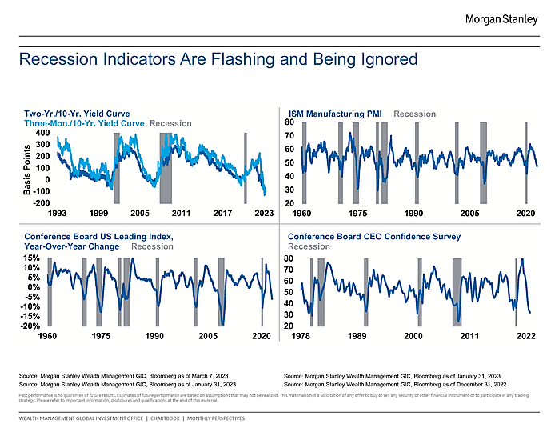
Recession Signals Flashing
Lower Investment Returns
Morgan Stanley Global Investment Office. Data as of March 2023
Most of the major recession indicators are flashing bright orange or red. It may be a question of how deep and how long.

Slide 16
Money Supply: Big Impact on Stock Market
Fed Action
Federal Reserve Bank of St. Louis, Real M2 Money Stock [M2REAL], retrieved from FRED, Federal Reserve Bank of St. Louis; https://fred.stlouisfed.org/series/M2REAL, January 22, 2023.
The Stock market is highly susceptible to large changes in the Money Supply.

Slide 17
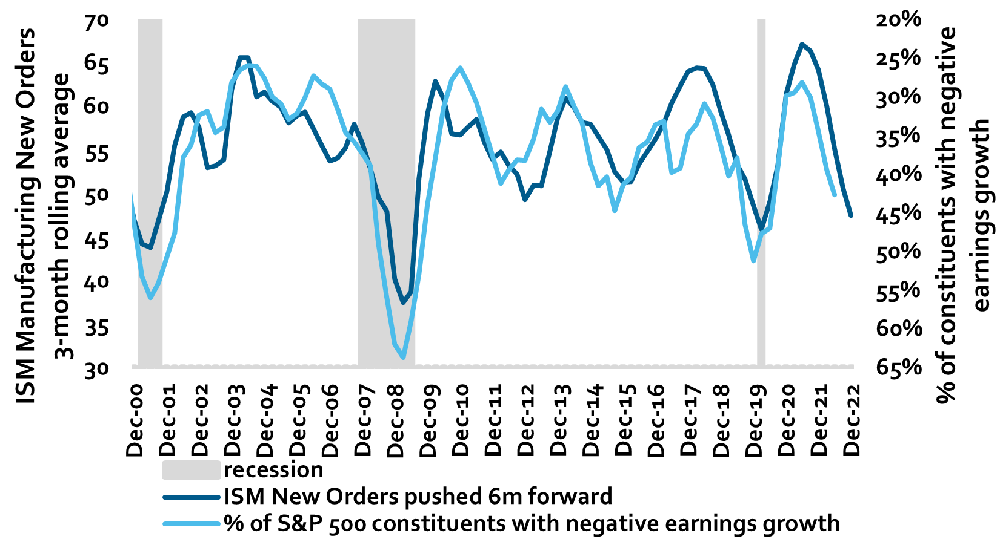
ISM is a Leading Indicator
Lower Investment Returns
Morgan Stanley Global Investment Office Portfolio Construction and Cross-Asset Strategy February 09, 2023
The Global Investment Office expects earnings of about a decline in earnings for 2023 to under $200 and a potential rebound to $241 for 2024. A median multiple of 17 could mean S&P of 3400 and 4100 respectively.

Slide 18
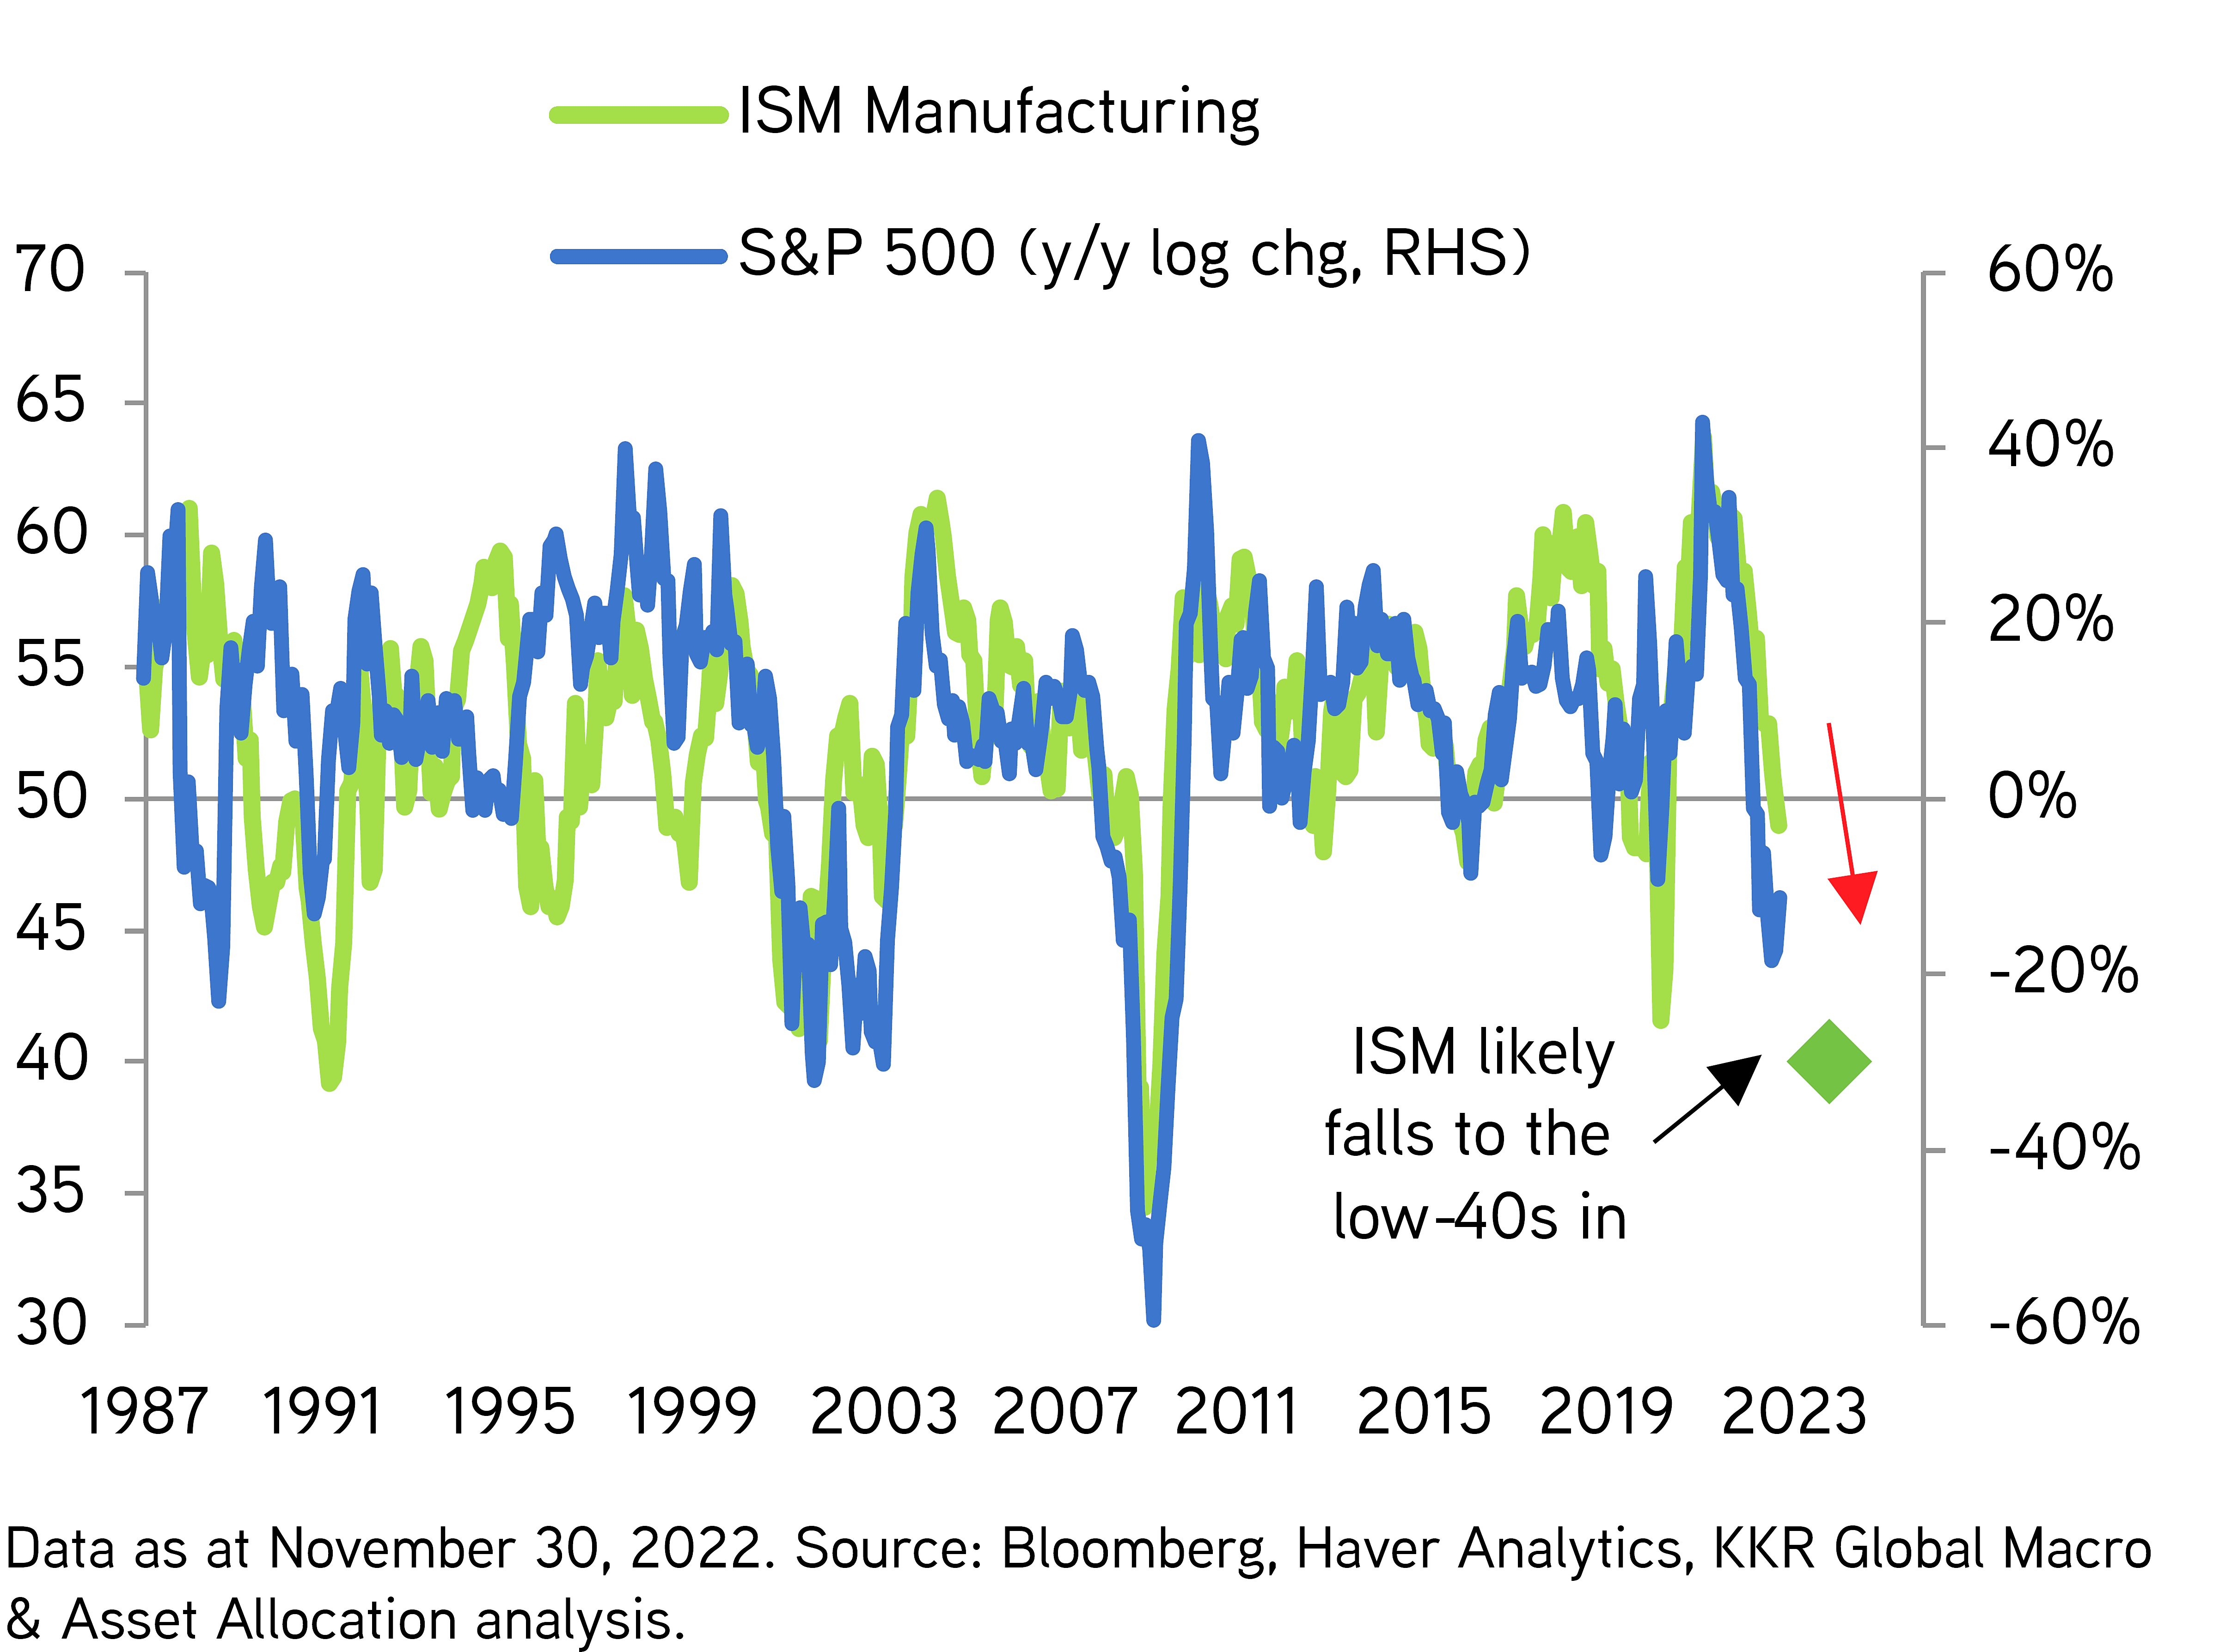
ISM Points Down
Economic Slowdown
KKR 2022-December-Outlook-for-2023-Keep-It-Simple.pdf (kkr.com)
The ISM Manufacturing Index is one of the strongest predictors of future growth and stock moves.

Slide 19
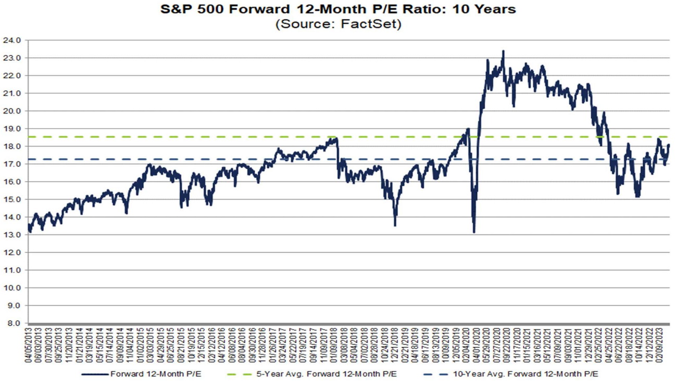
S&P P/E Multiples Above Average
Lower Investment Returns
Latest Mini Earnings Recession
Factset Earnings 04-06-2023 Street Estimates based on $221.22 for 2023 and $247.95 for 2024 S&P Earnings. These estimates have been dropping for several months.
PEs are slightly above average, but the Street is still not coming to grips with lower margins and lending restrictions. Earnings may be optimistic, and Multiples could come down a turn.

Slide 20
S&P 500 Pricing Matrix
Lower Investment Returns
December 31, 2022
.
September 30, 2022
AB Capital Market Outlook 1st Quarter 2023 Historical analysis and current forecasts do not guarantee future results
A Recession with lower margins for companies may put pressure on earnings. Unless margins stay high and multiples stay high, stocks may not advance significantly.

Slide 21
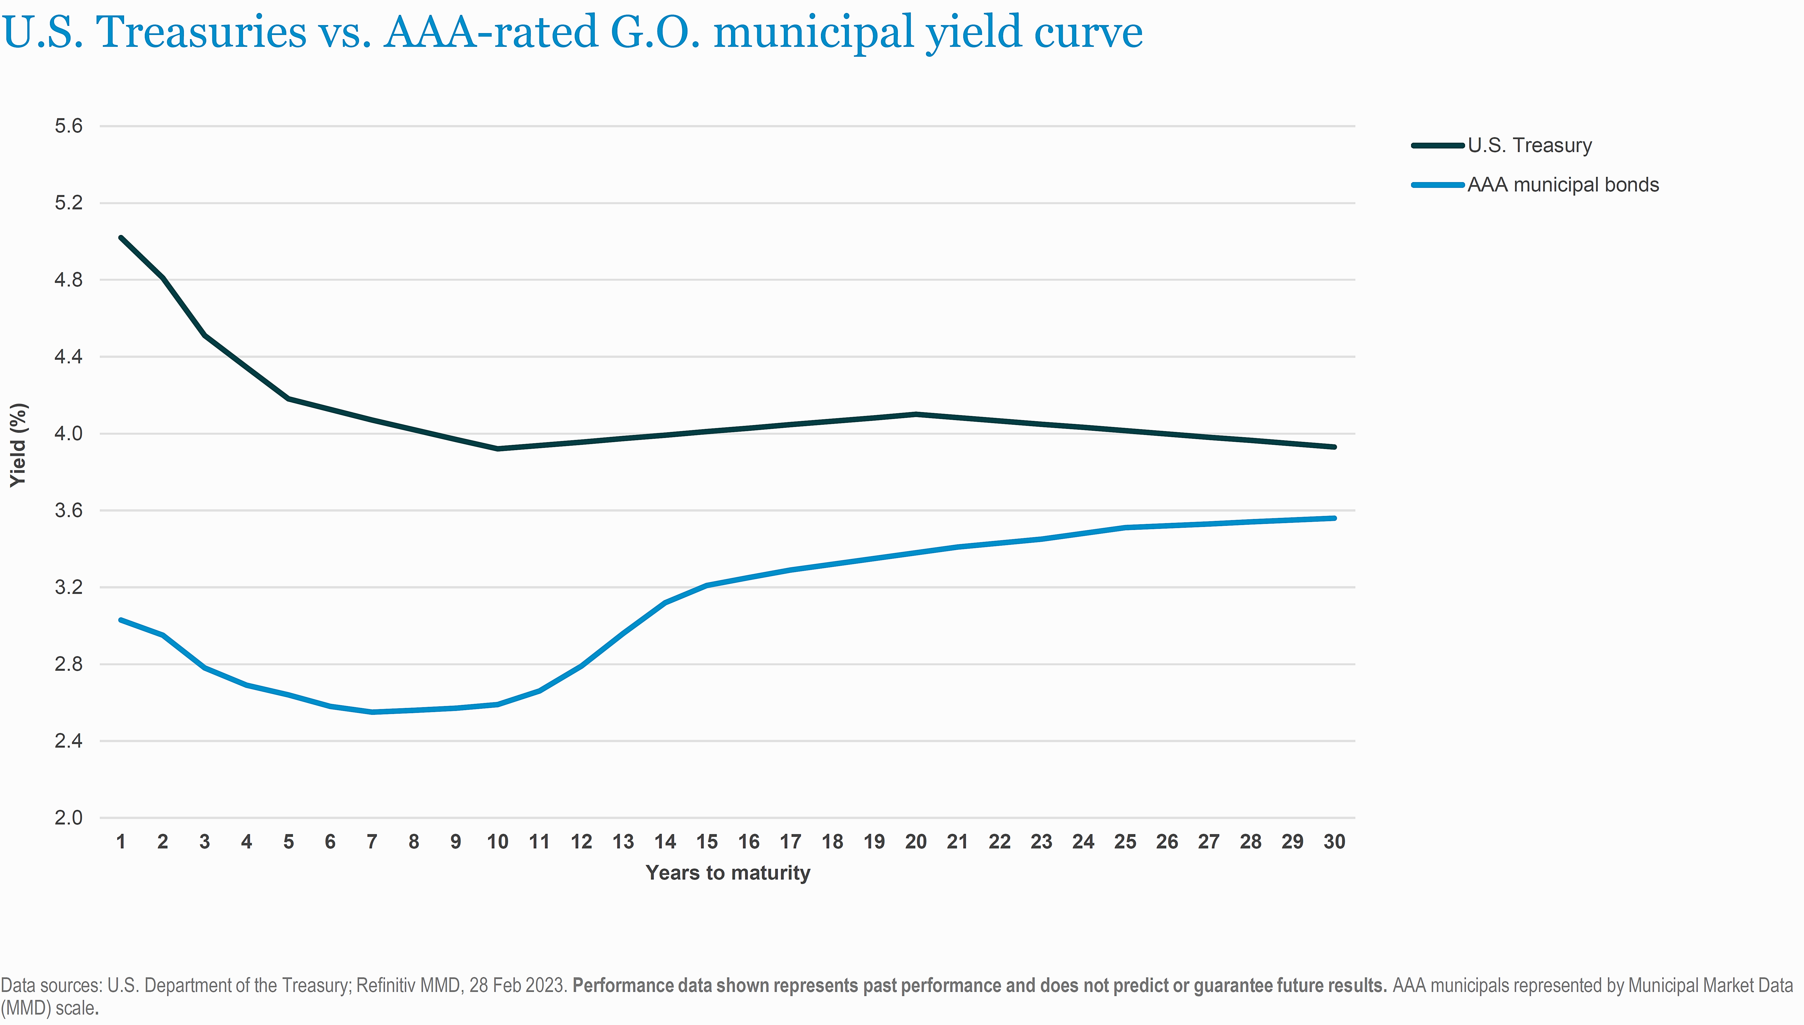
Treasury vs Tax Exempt Municipal
Attractive Financing
U.S. Treasury Curve
AAA General Obligation Muni Curve
Nuveen, Refinative MMD, Department of Treasury. Data as of February 2023
It is still very inexpensive to finance with tax exempt bonds – especially on the short end of the curve.

Slide 22
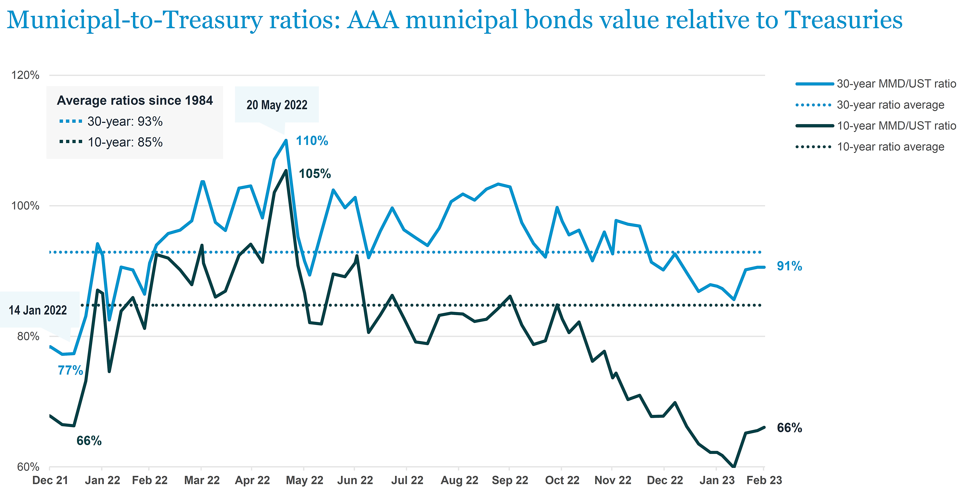
Historic Muni to Treasury Ratio
Attractive Financing
30 Year Muni to Treasury
10 Year Muni to Treasury
Nuveen Data as of February 2023
On a relative basis, it is a great time to finance with tax exempt issuance.

Slide 23
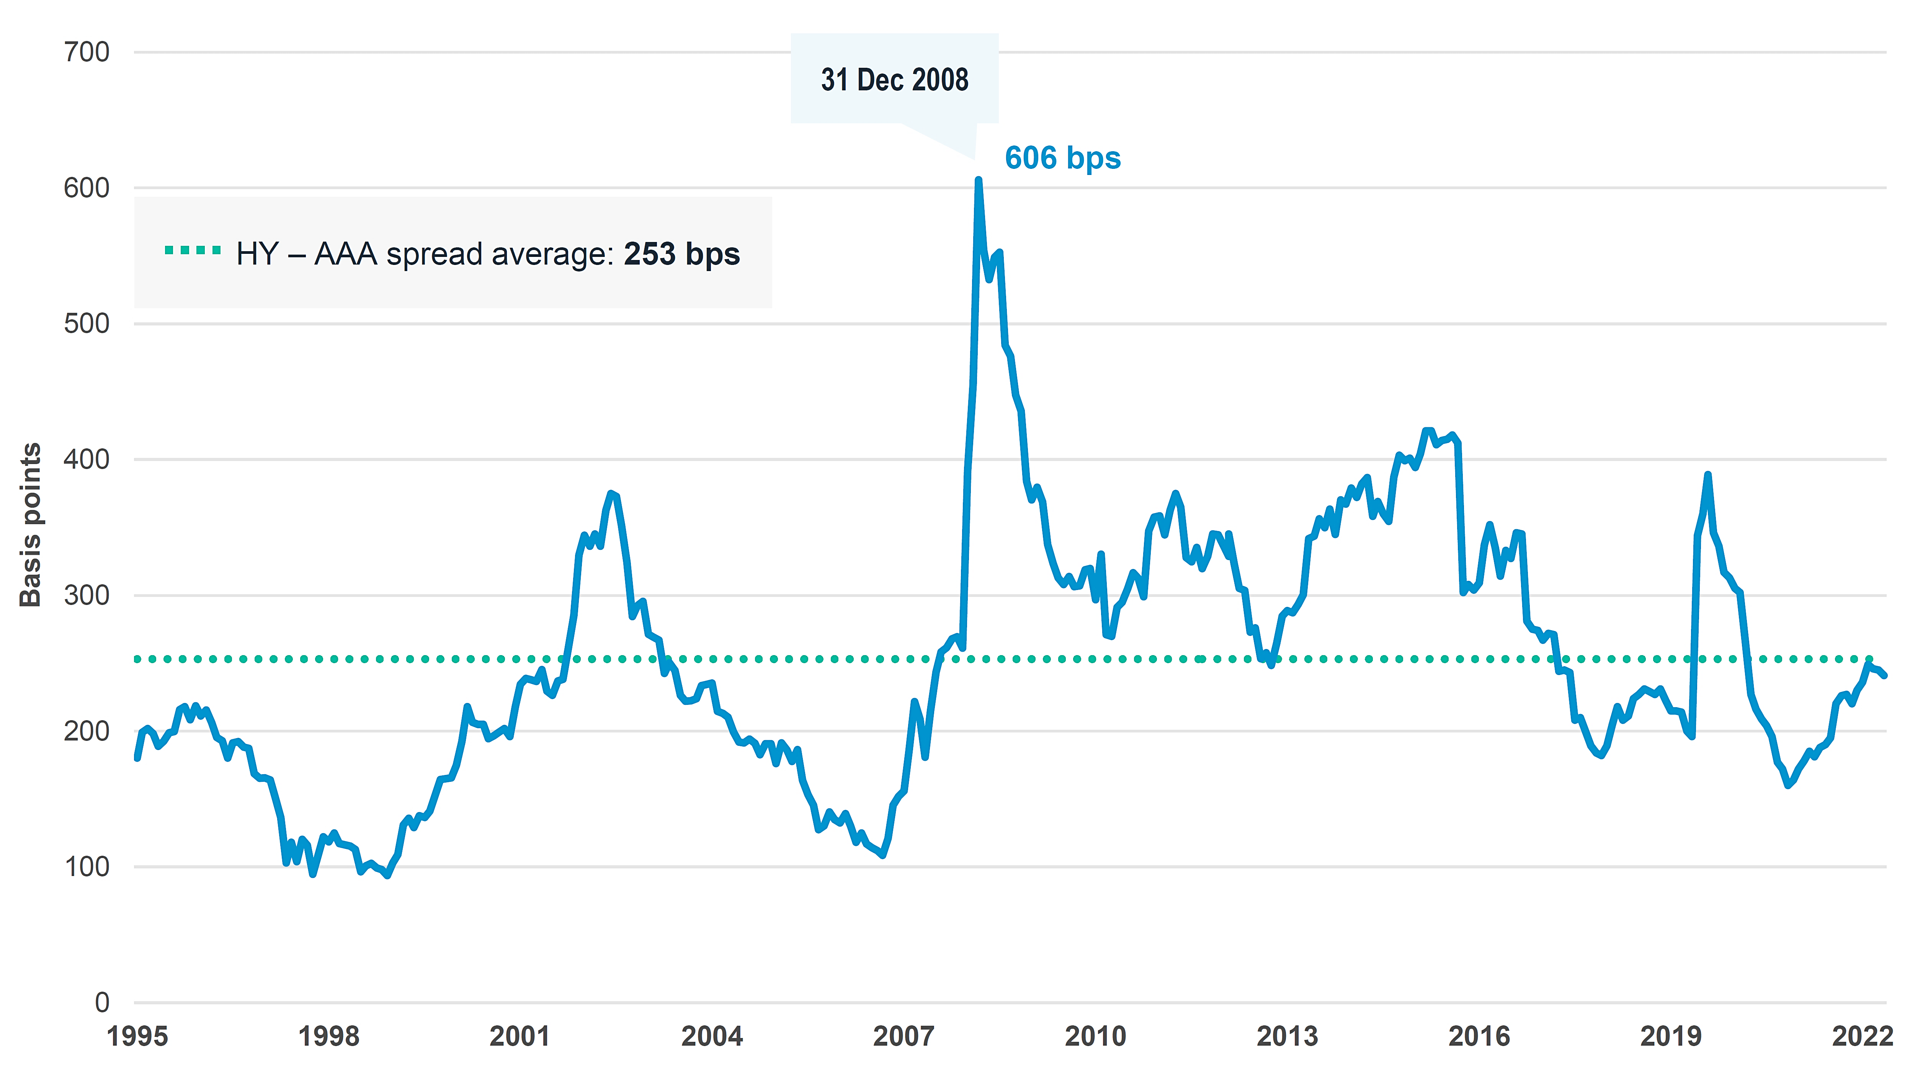
High Yield Muni vs. AAA Spread
Attractive Financing
Current Spread to AAA: 214 bps
Nuveen Data as of February 2023
Even Lower Quality Tax Exempt Issuers are in a favorable environment – relative to historic spreads.

Slide 24
Potential Opportunities
Cross Asset Opportunity Chart
Direct Lending
CLOs: Collateralized Loan Obligations
Private Secondaries - Interval
Optimize: New GIO Inputs
Use Algorithm to Uncover Wealth Transfer
For more information on these strategies contact Brad Peterson at brad.peterson@msgraystone.com

Slide 25
Cross Asset Opportunity Chart
Potential Opportunities
What might the Future Hold?
KKR 2022-December-Outlook-for-2023-Keep-It-Simple.pdf (kkr.com)
These are KKR forward looking estimates which may or may not be realized and may or may not match the opinion of Graystone or Morgan Stanley. Past performance is not a guarantee of future results.

Slide 26
1. Direct Lending
Potential Opportunities
Direct Lending Index
S&P 500
LSTA Senior Loan Index
Aggregate Bond Index
90 Day T-bill
PSN Informa Includes Bloomberg Aggregate, S&P 500, Morningstar LSTA Loan Index and Cliffwater Direct Lending index
It is impossible to invest directly into an index. Index replication strategies are easier for large liquid markets but difficult for illiquid or non tradable assets.

Slide 27
1. Direct Lending
Potential Opportunities
https://www.federalreserve.gov/data/sloos/sloos-202301.htmThe January 2023 Senior Loan Officer Opinion Survey (SLOOS) on Bank Lending Practices addressed changes in the standards and terms on, and demand for, bank loans to businesses and households over the past three months, which generally correspond to the fourth quarter of 2022.1
Banks aren’t Lending – like they were. These numbers are before Silicon Valley Bank, First Republic, Credit Suisse. Conditions are Tightening due to Mark to Market Losses, CECL Charges, Deteriorating Collateral.

Slide 28
1. Direct Lending
Potential Opportunities
PSN Informa Includes Bloomberg Aggregate, S&P 500, Morningstar LSTA Loan Index and Cliffwater Direct Lending index
Direct lending outperforms 14 out of 16 years.

Slide 29
1. Direct Lending: Yields
Potential Opportunities
Blue Owl Blue-Owl-Direct-Lending-2023-Outlook.pdf (blueowl.com)
Floors have risen, Spreads have risen, and original issue discounts have risen. Current yields provide a cushion against market fluctuation.

Slide 30
1. Direct Lending: Total Return vs Agg.
Potential Opportunities
Direct Lending Index
Aggregate Bond Index
Syndicated Loan Index
PSN Informa Includes Bloomberg Aggregate, S&P 500, Morningstar LSTA Loan Index and Cliffwater Direct Lending index
Rolling Three Year Returns favor Direct Lending except for small underperformance in GFC.

Slide 31
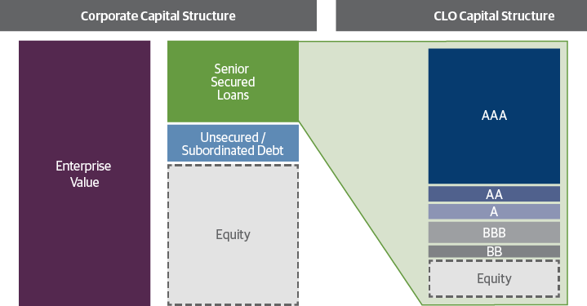
2. CLO: Collateralized Loan Obligations/ETFs
Potential Opportunities
Guggenheim https://www.guggenheiminvestments.com/perspectives/portfolio-strategy/understanding-collateralized-loan-obligations-clo
Schematic is based on 15x enterprise value ratio, 5.5x senior debt and 6.5x sub debt to represent a generic corporate single-B capital structure. CLO sizing based on typical broadly syndicated loans deal par attachment points of 36 percent for AAA, 24 percent for AA, 18 percent for A, 12 percent for BBB, and 8 percent for BB.

Slide 32
2. CLO: Collateralized Loan Obligations/ETFs
Potential Opportunities
Number of Rated Issues
Cumulative Default Rate
CLO 2.0 Default Rate
Guggenheim Investments https://www.guggenheiminvestments.com/perspectives/portfolio-strategy/understanding-collateralized-loan-obligations-clo
CLO Default Rate has been Rare in the investment grade category.

Slide 33
2. CLO: Collateralized Loan Obligations/ETFs
Potential Opportunities
Aggregate Bond Index
PSN Informa Data as of 12-31-2022. Past performance is not an indication of future results.
The NAIC (National Association of Insurance Commissioners) has given AAA CLO ETFs their highest rating designation.

Slide 34
2. CLO: Collateralized Loan Obligations/ETFs
Potential Opportunities
AAA CLO Added Corp or Treasury
AAA-A Corp 5-7
AAA CLO
50-50
50-50
5 Year Treasury
PSN Informa. Data as of 12-2022. Past performance is not a guarantee of future results.
Low Correlation between CLO floating rate and fixed rate Treasury may be a hedge against rising or falling rates.

Slide 35
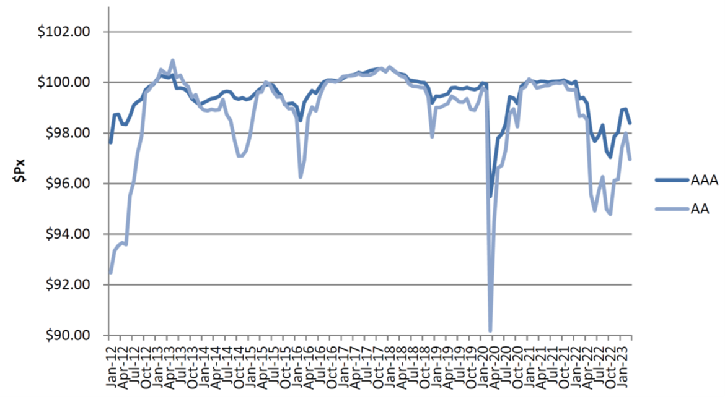
2. CLO: Collateralized Loan Obligations/ETFs
Potential Opportunities
Weighted Average Price of AAA AA CLOs
Palmer Square https://www.palmersquarecap.com/doccenter/90b7cad1c75b404e8b699e418ff6f6ae
Buying high grade CLO at a discount increases Yield to Maturity. AAA has average life of 3.4 years. AA has average life of 5.5 years. Amortizing the discount adds to the yield.

Slide 36
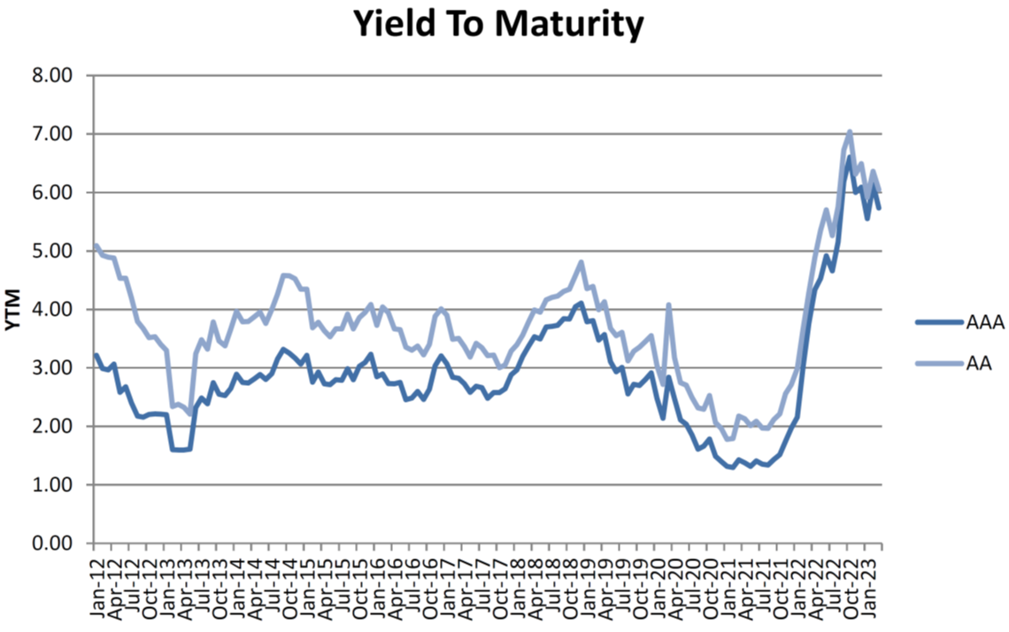
2. CLO: Collateralized Loan Obligations/ETFs
Potential Opportunities
Yield to Maturity of AAA AA CLOs
Palmer Square https://www.palmersquarecap.com/doccenter/90b7cad1c75b404e8b699e418ff6f6ae
Yields of 6% are significantly higher than a 3-Year Treasury, currently at 3.71% as of 4-12-2023.

Slide 37
3. Private Equity Secondaries - Interval
Potential Opportunities
Private Equity Excess Return to ACWI 1/88 to 10/22 Rolling 36 Month
GFC
Tech Wreck
2022
PSN Informa Data as of 09-30-2023 Past Performance is not a guarantee of future results
Private Equity has outperformed modestly in Bull Markets and significantly in Bear Markets.

Slide 38
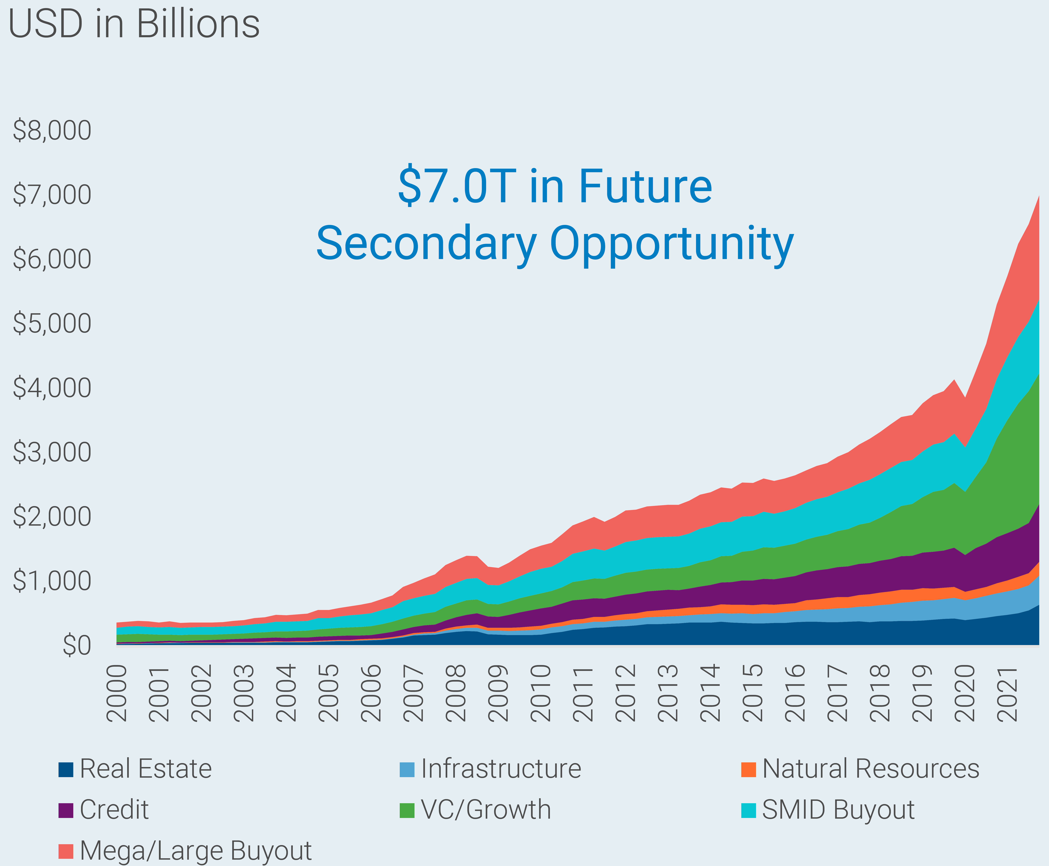
3. Private Equity Secondaries - Interval
Potential Opportunities
Hamilton Lane Trends and Opportunities in the Secondary Market August 2022 file:///M:/02%20Capital%20Markets/2023/1Q%202023/Hamilton%20Lane/Secondary-Market-Webinar-Transcript-8-31-22_1.pdf
$7 Trillion of Private Equity may need to find a source of liquidity: will it be in Secondary Trades?

Slide 39
3. Private Equity Secondaries - Interval
Potential Opportunities
$ Billions
$104
2H
21
22
% of PE Market
Sources: Jeffries, Coller, Hamilton Lane file:///M:/02%20Capital%20Markets/2023/1Q%202023/Hamilton%20Lane/Secondary-Market-Webinar-Transcript-8-31-22_1.pdf
Secondary Transactions are up 5 to 6 - fold in a little over a decade. Yet Secondaries represent less than 2% of Private Equity. Will the trend continue?

Slide 40
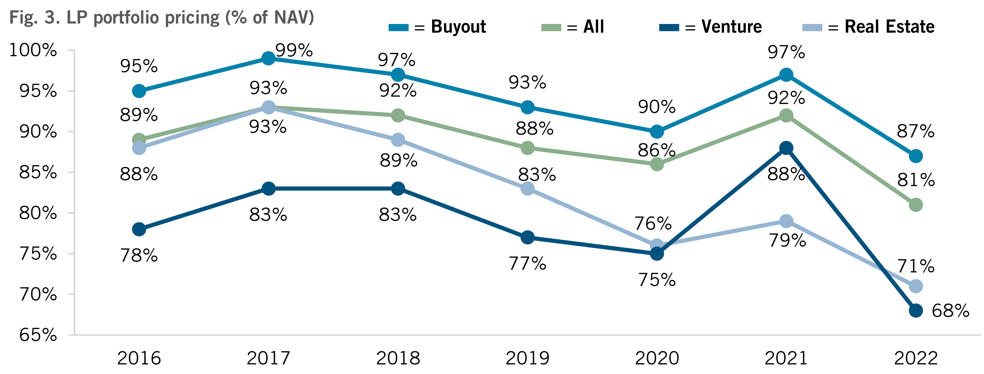
3. Private Equity Secondaries - Interval
Potential Opportunities
Motivated Sellers May offer Investors a Steep Discount to Value
Hamilton Lane/Morgan Stanley/ Jeffries https://www.jefferies.com/CMSFiles/Jefferies.com/files/IBBlast/Jefferies-Global_Secondary_Market_Review-January_2023.pdf
Secondaries are trading at historic discounts. Private Equity Secondaries mark up to par on purchase, which may mitigate the “J” curve.

Slide 41
3. Private Equity Secondaries - Interval
Potential Opportunities
IRR
TVPI
Source: Blackrock https://www.bvai.de/fileadmin/Themenschwerpunkte/Co-Investments_und_Secondaries/Statistiken_Marktperformancedaten/Private_market_secondaries_-_The_case_for_a_well-diversified_private_markets_program.pdf Spring 2020 Data Source: Cambridge Associates, Returns Report by Asset Class, as derived on 7 February 2020; returns based on median since inception to Q3 2019 net IRR across all funds (i.e. all vintage years and geographic regions for each strategy noted) in the Cambridge Associates database. Past performance is not indicative of future results.
The Typical Secondary Portfolio is a Blend of Vintages averaging between 5 and 6 years. TVPI is Total Value to Paid In: the ratio of the current value of remaining investments within a fund, plus the total value of all distributions to date, relative to the total amount of capital paid into the fund to date. IRR is Internal Rate of Return: a profitability metric that takes into consideration the time value of money.

Slide 42
3. Private Equity Secondaries - Interval
Potential Opportunities
Mutual Funds can’t own Private Equity
Semi Liquid Funds can own Private Equity
SEC disclosure: Legally, interval funds are classified as closed-end funds, but they are very different from traditional closed-end funds in that: Their shares typically do not trade on the secondary market. Instead, their shares are subject to periodic repurchase offers by the fund at a price based on net asset value. They are permitted to (and many interval funds do) continuously offer their shares at a price based on the fund’s net asset value. The appropriateness of a particular investment or strategy will depend on an investor’s individual circumstances and objectives. Principal value and return of an investment will fluctuate with changes in market conditions Investors should carefully consider the investment objectives and risks as well as charges and expenses of a mutual fund before investing. To obtain a prospectus, contact your Financial Advisor or visit the fund company’s website. The prospectus contains this and other important information about the mutual fund. Read the prospectus carefully before investing.
SEC: Securities and Exchange Commission https://www.investor.gov/introduction-investing/investing-basics/glossary/interval-fund
Interval Funds and Tender Offer Funds may offer Investors a more liquid entry into otherwise illiquid assets.

Slide 43
3. Private Equity Secondaries - Interval
Potential Opportunities
Evergreen Funds: The Next Frontier for Private Markets Investors?
SEC Registered
Low Minimum – Fully Invested
1099 - No K1 - No UBTI
High Minimum
Capital Call and Distribution
K1 – May Have UBTI
https://www.partnersgroup.com/fileadmin/user_upload/Files/Research_PDF/20220210_Partners_Group_Research_Evergreen_Funds.pdf
Investors looking to access private markets should consider the emergence of new structures, with open-ended funds providing a viable alternative – or complement – to traditional closed-end funds.

Slide 44
4: Optimize with New Inputs
Potential Opportunities
M.S. Global Investment Office
Expected Returns – Long Run
Morgan Stanley Global Investment Office Secular Expected Returns and Expected Risks.
Private Alternative Asset Volatility has been adjusted upward to reflect time series bias and late appraisal moving into potentially tighter lending and monetary policy regime.

Slide 45
4: Optimize with New Inputs
Potential Opportunities
Sample Portfolio Optimization with Future Return Inputs
NACUBO TIAA Study of Endowments 2022. Published Feb 21, 2023, Morgan Stanley Global Investment Office Capital Market Assumptions published March 2023
There is no assurance that expected returns will be realized or that future volatility or correlation will represent the past.
Update your institutions optimization utilizing Global Investment Office Expectations, Non-Profit Funds may be able to outperform institutions that are still using rear view mirror estimates of future returns.

Slide 46






5. Use New Algorithm – Uncover Major Gift
Potential Opportunities
NEW ALGORITHM UNCOVERS GIFTS
Apply Algorithm to Donor Database
Identify Pre-Sale of Business, Wealth Transfer
II. Use M.S. Banker/Buyer Database
Identify Best Buyer
$$$
III. Philanthropy Architecture: Turn Tax Dollars into Charity Dollars
The Giving Crowd Algorithm has identified Donors who are considering the sale of a large business or real estate. Graystone Morgan Stanley has Database of Investment Bankers who may be able to optimize sale. Pre-Sale tax architecture may lower taxes and open the door for a major gift.
NACUBO says using data for cost control and potential donations may be biggest solution to financial pressure.

Slide 47
Potential Opportunities Summary
Cross Asset Opportunity Chart
Direct Lending
CLOs: Collateralized Loan Obligations
Private Secondaries - Interval
Optimize: New GIO Inputs
Use Algorithm to Uncover Wealth Transfer
For more information on these strategies contact Brad Peterson at brad.peterson@msgraystone.com

Slide 48
Important Information
The views expressed herein are those of the author and do not necessarily reflect the views of Graystone or Morgan Stanley or its affiliates. All opinions are subject to change
without notice. Neither the information provided, nor any opinion expressed constitutes a solicitation for the purchase or sale of any security. Past performance is no guarantee of
future results.
This material does not provide individually tailored investment advice. It has been prepared without regard to the individual financial circumstances and objectives of persons who
review it. The strategies and/or investments discussed in this material may not be appropriate for al investors. Morgan Stanley Smith Barney LLC recommends that investors independently evaluate particular investments and strategies, and encourages investors to seek the advice of a Financial Advisor. The appropriateness of a particular investment or strategy will depend on an investor’s individual circumstances and objectives.
The information set forth was obtained from sources believed to be reliable, but we do not guarantee its accuracy or completeness. Past performance is no guarantee of future results. Actual results may vary and past performance is no guarantee of future results.
Investing in commodities entails significant risks. Commodity prices ay be affected by a variety of factors at any time, including but not limited to, (i)changes in supply and demand relationships, (ii) governmental programs and policies, (iii) national and international political and economic events, war and terrorist events, (iv) changes in interest and exchange rates, (v) trading activities I commodities and related contracts, (vi) pestilence, technological change an weather, and (vii) the price volatility of a commodity. In addition, the commodities markets are subject to temporary distortions or other disruptions due to various factors, including lack of liquidity, participation of speculators and government intervention.
As further described in the offering documents, an investment in alternative investments can be highly illiquid, are speculative and not appropriate for all investors. Investing in alternative investments is only intended for experienced and sophisticated investors who are willing to bear the high economic risks associated with such an investment. Investors should carefully review and consider potential risks before investing. Certain of these risks may include: loss of all or a substantial portion of the investment due to leveraging, short-selling, or other speculative practices; lack of liquidity in that there may be no secondary market for the fund and none is expected to develop; volatility of returns; restrictions on transferring interests in the Fund; potential lack of diversification and resulting higher risk due to concentration of trading authority when a single advisor is utilized; absence of information regarding valuations and pricing; complex tax structures and delays in tax reporting; less regulation and higher fees than mutual funds; and manager risk.
Individual funds will have specific risks related to their investment programs that will vary from fund to fund.
REITs are subject to special risk considerations similar to those associated with the direct ownership of real estate. Real estate valuations may be subject to factors such as changing general and local economic, financial, competitive, and environmental conditions. REITs may not be appropriate for every investor. Dividend income from REITs will generally not be treated as qualified dividend income and therefore will not be eligible for reduced rates of taxation.
Interest in municipal bonds is generally exempt from federal income tax. However, some bonds may be subject to the alternative minimum tax (AMT). Typically, state tax- exemption applies if securities are issued within one’s state of residence and, local tax-exemption typically applies if securities are issued within one’s city of residence.
International investing may not be appropriate for every investor and is subject to additional risks, including currency fluctuations, political factors, withholding, lack of liquidity, the absence of adequate financial information, and exchange control restrictions impacting foreign issuers. These risks may be magnified in emerging markets.
S&P 500 Index is an unmanaged, market value-weighted index of 500 stocks generally representative of the broad stock market. An investment cannot be made directly in a market index.
Russell 2000® Index measures the performance of the 2,000 smallest companies in the Russell 3000 Index, which represents approximately 8% of the total market capitalization of the Russell 3000 Index. An investment cannot be made directly in a market index. Investing in smaller companies involves greater risks than those associated with investing in more established companies, including significant stock price fluctuations and illiquidity.
The Barclays Capital U.S. Aggregate Index covers the U.S. Dollar-denominated, investment-grade, fixed-rate, taxable bond market segment of SEC-registered securities. The inde3x includes bonds from the U.S. Treasury, Government-Related Corporate, Mortgage-Backed, Asset-Backed, and Commercial Mortgage-Backed Securities sectors. An investment cannot be made directly in a market index. Bonds are affected by a number of risks, including fluctuations in interest rates, credit risk and prepayment risk. In general, as prevailing interest rates rise, fixed income securities prices will fall. Bonds face credit risk if a decline in an issuer's credit rating, or creditworthiness, causes a bond's price to decline. Finally, bonds can be subject to prepayment risk. When interest rates fall, an issuer may choose to borrow money at a lower interest rate, while paying off its previously issued bonds. As a consequence, underlying bonds will lose the interest payments from the investment and will be forced to reinvest in a market where prevailing interest rates are lower than when the initial investment was made. NOTE: High yield bonds are subject to additional risks such as increased risk of default and greater volatility because of the lower credit quality of the issues.
Barclays Capital U.S. Credit Bond Index is composed of all publicly issued, fixed-rate, non-convertible, investment-grade, domestic corporate debt (collateralized mortgage obligations are not included). Total return comprises price appreciation/deprecation and income as a percentage of the original investment. This index is rebalanced monthly by market capitalization. An investment cannot be made directly in a market index.
DISCLOSURES

Slide 49
Important Information, continued
Barclays Capital Municipal Bond Index is a broad measure of the municipal bond market with maturities of at least one year. The index has four main sectors: state and local general obligation bonds, revenue bonds, insured bonds, and pre-refunded bonds. An investment cannot be made directly in a market index.
The MSCI EAFE© Index (Europe, Australasia, Far East) is a free float-adjusted market capitalization index that is designed to measure developed market equity performance, excluding the US & Canada. As of May 2005 the MSCI EAFE Index consisted of the following 21 developed market county indices: Australia, Austria, Belgium, Denmark, Finland, France, Germany, Greece, Hong Kong, Ireland, Italy, Japan, the Netherlands, New Zealand, Norway, Portugal, Singapore, Spain, Sweden, Switzerland and the United Kingdom. An investment cannot be made directly in a market index.
The MSCI World Index is a free float-adjusted market capitalization weighted index designed to measure the equity market performance of 23 developed-country markets. An investment cannot be made directly in a market index.
HFR Indices are compiled by Hedge Fund Research, Inc. ("HFR"), an industry service provider. They are based on the performance of hedge funds in various strategies as reported by the hedge fund managers to HFR. While the HFRI Indices are frequently used, they have limitations (some of which are typical of other widely used indices). These limitations include survivorship bias (the returns of the indices may not be representative of all the hedge funds in the universe because of the tendency of lower performing funds to leave the index); heterogeneity (not all hedge funds are alike or comparable to one another, and the index may not accurately reflect the performance of a described style); and limited data (many hedge funds do not report to indices, and the index may omit funds, the inclusion of which might significantly affect the performance shown. The HFRI Indices are based on information self-reported by hedge fund managers that decide on their own, at any time, whether or not they want to provide, or continue to provide, information to HFR Asset Management, L.L.C. Results for funds that go out of business are included in the index until the date that they cease operations. Therefore, these indices may not be complete or accurate representations of the hedge fund universe, and may be biased in several ways. All data is net of all fees, denominated in U.S. dollar and equal-weighted. The information underlying the indices and the classification of the underlying funds have not been independently verified by either HFR or Morgan Stanley Smith Barney, and neither HFR nor Morgan Stanley Smith Barney make any representation as to their accuracy. Past performance does not guarantee future results. Real results may vary.
The Alerian MLP Index is a composite of the 50 most prominent energy Master Limited Partnerships (MLP)s that provides investors with an unbiased, comprehensive benchmark for this emerging asset class. The index, which is calculated using a float-adjusted, capitalization-weighted methodology, is disseminated real-time on a price-return bases. An investment cannot be made directly in a market index.
Alpha: A measure of a portfolio's time weighted return in excess of the market’s return, both adjusted for risk. A positive alpha indicates that the portfolio outperformed the market on a risk-adjusted basis, and a negative alpha indicates the portfolio did worse than the market.
© 2020 Investments and services offered through Morgan Stanley Smith Barney LLC. Member SIPC. Graystone Consulting, a business of Morgan Stanley.
This material does not provide individually tailored investment advice. It has been prepared without regard to the individual financial circumstances and objectives of persons who receive it. The strategies and/or investments discussed in this material may not be appropriate for all investors. Morgan Stanley Wealth Management recommends that investors independently evaluate particular investments and strategies, and encourages investors to seek the advice of a Financial Advisor. The appropriateness of a particular investment or strategy will depend on an investor’s individual circumstances and objectives.
Tax laws are complex and subject to change. Morgan Stanley Smith Barney LLC (“Morgan Stanley”) , its affiliates and Morgan Stanley Financial Advisors and Private Wealth Advisors do not provide tax or legal advice and are not “fiduciaries” (under the Investment Advisers Act of 1940, ERISA, the Internal Revenue Code or otherwise) with respect to the services or activities described herein except as otherwise provided in writing by Morgan Stanley and/or as described at www.morganstanley.com/disclosures/dol. Individuals are encouraged to consult their tax and legal advisors (a) before establishing a retirement plan or account, and (b) regarding any potential tax, ERISA and related consequences of any investments made under such plan or account.
DISCLOSURES

Slide 50
Important Information, continued
Morgan Stanley Wealth Management is the trade name of Morgan Stanley Smith Barney LLC, a registered broker-dealer in the United States.
The sole purpose of this material is to inform, and it in no way is intended to be an ofer or solicitation to purchase or sell any security, other investment or service, or to attract any funds or deposits. Investments mentioned may not be appropriate for all clients. Any product discussed herein may be purchased only after a client has carefully reviewed the ofering memorandum and executed the subscription documents. Morgan Stanley Wealth Management has not considered the actual or desired investment objectives, goals, strategies, guidelines, or factual circumstances of any investor in any fund(s). Before making any investment, each investor should carefully consider the risks associated with the investment, as discussed in the applicable ofering memorandum, and make a determination based upon their own particular circumstances, that the investment is consistent with their investment objectives and risk tolerance. Morgan Stanley Smith Barney LLC ofers investment program services through a variety of investment programs, which are opened pursuant to written client agreements. Each program ofers investment managers, funds and features that are not available in other programs; conversely, some investment managers, funds or investment strategies may be available in more than one program.
Morgan Stanley’s investment advisory programs may require a minimum asset level and, depending on your specifc investment objectives and fnancial position, may not be appropriate for you. Please see the Morgan Stanley Smith Barney LLC program disclosure brochure (the “Morgan Stanley ADV”) for more information in the investment advisory programs available. The Morgan Stanley ADV is available at www.morganstanley.com/ADV. Sources of Data. Information in this material in this report has been obtained from sources that we believe to be reliable, but we do not guarantee its accuracy, completeness or timeliness. Third-party data providers make no warranties or representations relating to the accuracy, completeness or timeliness of the data they provide and are not liable for any damages relating to this data. All opinions included in this material constitute the Firm’s judgment as of the date of this material and are subject to change without notice . This material was not prepared by the research departments of Morgan Stanley & Co. LLC or Morgan Stanley Smith Barney LLC. Some historical fgures may be revised due to newly identifed programs, frm restatements, etc.
Global Investment Manager Analysis (GIMA) Focus List, Approved List and Tactical Opportunities List; Watch Policy. GIMA uses two methods to evaluate investment products in applicable advisory programs: Focus (and investment products meeting this standard are described as being on the Focus List) and Approved (and investment products meeting this standard are described as being on the Approved List). In general, Focus entails a more thorough evaluation of an investment product than Approved. Sometimes an investment product may be evaluated using the Focus List process but then placed on the Approved List instead of the Focus List. Investment products may move from the Focus List to the Approved List, or vice versa. GIMA may also determine that an investment product no longer meets the criteria under either process and will no longer be recommended in investment advisory programs (in which case the investment product is given a “Not Approved” status). GIMA has a ‘Watch” policy and may describe a Focus List or Approved List investment product as being on “Watch” if GIMA identifes specifc areas that (a) merit further evaluation by GIMA and (b) may, but are not certain to, result in the investment product becoming “Not Approved.” The Watch period depends on the length of time needed for GIMA to conduct its evaluation and for the investment manager or fund to address any concerns. Certain investment products on either the Focus List or Approved List may also be recommended for the Tactical Opportunities List based in part on tactical opportunities existing at a given time. The investment products on the Tactical Opportunities List change over time. For more information on the Focus List, Approved List, Tactical Opportunities List and Watch processes, please see the applicable Form ADV Disclosure Document for Morgan Stanley Wealth Management. Your Financial Advisor or Private Wealth Advisor can also provide upon request a copy of a publication entitled “Manager Selection Process.”
The Global Investment Committee is a group of seasoned investment professionals who meet regularly to discuss the global economy and markets. The committee determines the investment outlook that guides our advice to clients. They continually monitor developing economic and market conditions, review tactical outlooks and recommend model portfolio weightings, as well as produce a suite of strategy, analysis, commentary, portfolio positioning suggestions and other reports and broadcasts.
The GIC Asset Allocation Models are not available to be directly implemented as part of an investment advisory service and should not be regarded as a recommendation of any Morgan Stanley investment advisory service. The GIC Asset Allocation Models do not represent actual trading or any type of account or any type of investment strategies and none of the fees or other expenses (e .g. commissions, mark-ups, mark-downs, advisory fees, fund expenses) associated with actual trading or accounts are refected in the GIC Asset Allocation Models which , when compounded over a period of years, would decrease returns.
Adverse Active AlphaSM 2.0 is a patented screening and scoring process designed to help identify high-quality equity and fxed income managers with characteristics that may lead to future outperformance relative to index and peers. While highly ranked managers performed well as a group in our Adverse Active Alpha model back tests, not all of the managers will outperform. Please note that this data may be derived from back-testing, which has the beneft of hindsight. In addition, highly ranked managers can have difering risk profles that might not be appropriate for all investors.
Our view is that Adverse Active Alpha is a good starting point and should be used in conjunction with other information . Morgan Stanley Wealth Management’s qualitative and quantitative investment manager due diligence process are equally important factors for investors when considering managers for use through an investment advisory program. Factors including, but not limited to, manager
DISCLOSURES

Slide 51
Important Information, continued
turnover and changes to investment process can partially or fully negate a positive Adverse Active Alpha ranking. Additionally, highly ranked managers can have difering risk profles that might not be appropriate for all investors.
The proprietary Value Score methodology considers an active investment strategies’ value proposition relative to its costs . From a historical quantitative study of several quantitative markers, Value Score measures perceived forward-looking beneft and computes (1) “fair value” expense ratios for most traditional investment managers across 40 categories and (2) managers’ perceived “excess value” by comparing the fair value expense ratios to actual expense ratios. Managers are then ranked within each category by their excess value to assign a Value Score. Our analysis suggests that greater levels of excess value have historically corresponded to attractive subsequent performance.
For more information on the ranking models, please see Adverse Active AlphaSM 2.0: Scoring Active Managers According to Potential Alpha and Value Score: Scoring Fee Efciency by Comparing Managers’ “Fair Value” and Actual Expense Ratios. The whitepapers are available from your Financial Advisor or Private Wealth Advisor. ADVERSE ACTIVE ALPHA is a registered service mark of Morgan Stanley and/or its afliates. U.S. Pat. No. 8,756,098 applies to the Adverse Active Alpha system and/or methodology.
Additionally, highly ranked managers can have difering risk profles that might not be appropriate for all investors. For more information on AAA, please see the Adverse Active Alpha Ranking Model and Selecting Managers with Adverse Active Alpha whitepapers. The whitepaper are available from your Financial Advisor or Private Wealth Advisor. ADVERSE ACTIVE ALPHA is a registered service mark of Morgan Stanley and/or its afliates. U.S. Pat. No. 8,756,098 applies to the Adverse Active Alpha system and/or methodology.
The Global Investment Manager Analysis (GIMA) Services Only Apply to Certain Investment Advisory Programs GIMA evaluates certain investment products for the purposes of some – but not all
– of Morgan Stanley Smith Barney LLC’s investment advisory programs (as described in more detail in the applicable Form ADV Disclosure Document for Morgan Stanley Wealth Management). If you do not invest through one of these investment advisory programs, Morgan Stanley Wealth Management is not obligated to provide you notice of any GIMA Status changes even though it may give notice to clients in other programs.
Strategy May Be Available as a Separately Managed Account or Mutual Fund Strategies are sometimes available in Morgan Stanley Wealth Management investment advisory programs both in the form of a separately managed account (“SMA”) and a mutual fund. These may have diferent expenses and investment minimums. Your Financial Advisor or Private Wealth Advisor can provide more information on whether any particular strategy is available in more than one form in a particular investment advisory program. Generally, investment advisory accounts are subject to an annual
asset-based fee which is payable monthly in advance (some account types may be billed diferently). (The “Fee”). In general, the Fee covers Morgan Stanley investment advisory services, custody of securities with Morgan Stanley, trade execution with or through Morgan Stanley or its afliates, as well as compensation to any Morgan Stanley Financial Advisor.
In addition, each account that is invested in a program that is eligible to purchase certain investment products, such as mutual funds, will also pay a Platform Fee (which is subject to a Platform Fee ofset) as described in the applicable ADV brochure. Accounts invested in the Select UMA program will also pay a separate Morgan Stanley Overlay Manager Fee and any applicable Sub-Manager fees. If your account is invested in mutual funds or exchange traded funds (collectively “funds”), you will pay the fees and expenses of any funds in which your account is invested. Fees and expenses are charged directly to the pool of assets the fund invests in and are refected in each fund’s share price. These fees and expenses are an additional cost to you and would not be included in the Fee amount in your account statements. Overlay Managers or Executing Sub-Managers (“managers”) in some of Morgan Stanley’s Separately Managed Account (“SMA”) programs may afect transactions through broker-dealers other than Morgan Stanley or our afliates. If your manager trades with another frm, you may be assessed costs by the other frm in addition to Morgan Stanley’s fees. Those costs will be included in the net price of the security, not separately reported on trade confrmations or account statements. Certain managers have historically directed most, if not all, of their trades to outside frms. Information provided by managers concerning trade execution away from Morgan Stanley is summarized at: www.morganstanley.com/wealth/investmentsolutions/pdfs/adv/sotresponse.pdf. For more information, please refer to the ADV Brochure for your program(s), available at www.morganstanley.com/ADV or contact your Financial Advisor/Private Wealth Advisor. For example, on an advisory account with a 2.5% annual fee, if the gross annual performance is 6.00%, the compounding efect of the fees will result in a net performance of approximately 3.38% after one year, 10.50% after three years, and 18.10% after fve years. Conficts of Interest: GIMA’s goal is to provide professional, objective evaluations in support of the Morgan Stanley Wealth Management investment advisory programs. We have policies and procedures to help us meet this goal. However, our business is subject to various conficts of interest. For example, ideas and suggestions for which investment products should be evaluated by GIMA come from a variety of sources, including our Morgan Stanley Wealth Management Financial Advisors and their direct or indirect managers, and other business persons within Morgan Stanley Wealth Management or its afliates. Such persons may have an ongoing business relationship with certain investment managers or mutual fund companies whereby they, Morgan Stanley Wealth Management or its afliates receive compensation from, or otherwise related to, those investment managers or mutual funds. For example, a Financial Advisor may suggest that GIMA evaluates an investment manager or fund in which a portion of his or her clients’ assets are already invested. While such a recommendation is permissible, GIMA is responsible for the opinions expressed by GIMA. See the conficts of interest section in the applicable Form ADV Disclosure Document for Morgan Stanley Wealth Management for a discussion of other types of conficts that may be relevant to GIMA’s evaluation of managers and funds. In addition, Morgan Stanley Wealth Management, MS & Co., managers and their afliates provide a variety of services
DISCLOSURES

Slide 52
Important Information, continued
(including research, brokerage, asset management, trading, lending and investment banking services) for each other and for various clients, including issuers of securities that may be recommended for purchase or sale by clients or are otherwise held in client accounts , and managers in various advisory programs. Morgan Stanley Wealth Management, managers, MS & Co., and their afliates receive compensation and fees in connection with these services. Morgan Stanley Wealth Management believes that the nature and range of clients to which such services are rendered is such that it would be inadvisable to exclude categorically all of these companies from an account.
Morgan Stanley charges each fund family we ofer a mutual fund support fee, also called a “revenue-sharing payment,” on client account holdings in fund families according to a tiered rate that increases along with the management fee of the fund so that lower management fee funds pay lower rates than those with higher management fees.
Consider Your Own Investment Needs: The model portfolios and strategies discussed in the material are formulated based on general client characteristics including risk tolerance . This material is not intended to be an analysis of whether particular investments or strategies are appropriate for you or a recommendation, or an ofer to participate in any investment. Therefore, clients should not use this material as the sole basis for investment decisions. They should consider all relevant information, including their existing portfolio, investment objectives, risk tolerance, liquidity needs and investment time horizon. Such a determination may lead to asset allocation results that are materially diferent from the asset allocation shown in this profle. Talk to your Financial Advisor about what would be an appropriate asset allocation for you, whether CGCM is an appropriate program for you.
No obligation to notify – Morgan Stanley Wealth Management has no obligation to notify you when the model portfolios, strategies, or any other information, in this material changes.
Please consider the investment objectives, risks, fees, and charges and expenses of mutual funds, ETFs, closed end funds, unit investment trusts, and variable insurance products carefully before investing. The prospectus contains this and other information about each fund. To obtain a prospectus, contact your Financial Advisor or Private Wealth Advisor or visit the Morgan Stanley website at www.morganstanley.com. Please read it carefully before investing.
An investment in a money market fund is not insured or guaranteed by the Federal Deposit Insurance Corporation or any other government agency. Although the Fund seeks to preserve the value of your investment at $1.00 per share, it is possible to lose money by investing in the fund.
The type of mutual funds and ETFs discussed in this presentation utilizes nontraditional or complex investment strategies and/or derivatives. Examples of these types of funds include those that utilize one or more of the below noted investment strategies or categories or which seek exposure to the following markets: (1) commodities (e .g., agricultural, energy and metals), currency, precious metals;(2) managed futures; (3) leveraged, inverse or inverse leveraged; (4) bear market, hedging, long-short equity, market neutral; (5) real estate; (6) volatility (seeking exposure to the CBOE VIX Index). Investors should keep in mind that while mutual funds and ETFs may, at times, utilize nontraditional investment options and strategies, they should not be equated with unregistered privately ofered alternative investments. Because of regulatory limitations, mutual funds and ETFs that seek alternative-like investment exposure must utilize a more limited investment universe. As a result, investment returns, and portfolio characteristics of alternative mutual funds and ETFs may vary from traditional hedge funds pursuing similar investment objectives. Moreover, traditional hedge funds have limited liquidity with long “lock-up” periods allowing them to pursue investment strategies without having to factor in the need to meet client redemptions and ETFs trade on an exchange . On the other hand, mutual funds typically must meet daily client redemptions. This difering liquidity profle can have a material impact on the investment returns generated by a mutual fund or ETF pursuing an alternative investing strategy compared with a traditional hedge fund pursuing the same strategy.
Nontraditional investment options and strategies are often employed by a portfolio manager to further a fund’s investment objective and to help ofset market risks . However, these features may be complex, making it more difcult to understand the fund’s essential characteristics and risks, and how it will perform in diferent market environments and over various periods of time. They may also expose the fund to increased volatility and unanticipated risks particularly when used in complex combinations and/or accompanied by the use of borrowing or “leverage.”
The Morgan Stanley Digital Vault ("Digital Vault") is accessible to clients with dedicated Financial Advisors . Documents shared via the Digital Vault should be limited to those relevant to your Morgan Stanley account relationship. Uploading a document to the Digital Vault does not obligate us to review or take any action on it, and we will not be liable for any failure to act upon the contents of such document. Please contact your Financial Advisor or Branch Management to discuss the appropriate process for providing the document to us for review. If you maintain a Trust or entity account with us, only our certifcation form will govern our obligations for such account. Please refer to the Morgan Stanley Digital Vault terms and conditions for more information.
Information related to your external accounts is provided for informational purposes only. It is provided by third parties, including the fnancial institutions where your external accounts are held. Morgan Stanley does not verify that the information is accurate and makes no representation or warranty as to its accuracy, timeliness, or completeness. Additional information about the features and services offered through Total Wealth View are available on the Total Wealth View site on Morgan Stanley Online and also in the Total Wealth View Terms and Conditions of Use .
DISCLOSURES

Slide 53
Important Information, continued
Mobile check deposits are subject to certain terms and conditions. Checks must be drawn on a U.S. Bank.
Send Money with Zelle® is available on the Morgan Stanley Mobile App for iPhone and Android and on Morgan Stanley Online. Enrollment is required and dollar and frequency limits may apply. Domestic fund transfers must be made from an eligible account at Morgan Stanley Smith Barney LLC (Morgan Stanley) to a US-based account at another fnancial institution. Morgan Stanley maintains arrangements with JP Morgan Chase Bank, N.A. and UMB Bank, N.A. as NACHA-participating depository fnancial institutions for the processing of transfers on Zelle®. Data connection required, and message and data rates may apply, including those from your communications service provider. Must have an eligible account in the U.S. to use Zelle®. Transactions typically occur in minutes when the recipient’s email address or U.S. mobile number is already enrolled with Zelle. See the Morgan Stanley Send Money with Zelle® terms for details.
Zelle and the Zelle related marks are wholly owned by Early Warning Services, LLC and are used herein under license. Morgan Stanley is not afliated with Zelle®.
Electronic payments arrive to the payee within 1-2 business days, check payments arrive to the payee within 5 business days. Same-day and overnight payments are available for an additional fee within the available payment timeframes.
KEY ASSET CLASS CONSIDERATIONS AND OTHER RISKS
Investing in the markets entails the risk of market volatility. The value of all types of investments, including stocks, mutual funds, exchange-traded funds (“ETFs”), closed-end funds, and unit investment trusts, may increase or decrease over varying time periods. To the extent the investments depicted herein represent international securities, you should be aware that there may be additional risks associated with international investing, including foreign economic, political, monetary and/or legal factors, changing currency exchange rates, foreign taxes, and diferences in fnancial and accounting standards. These risks may be magnifed in emerging markets and frontier markets. Small- and mid-capitalization companies may lack the fnancial resources, product diversifcation and competitive strengths of larger companies. In addition, the securities of small- and mid-capitalization companies may not trade as readily as, and be subject to higher volatility than, those of larger, more established companies. The value of fxed income securities will fuctuate and, upon a sale, may be worth more or less than their original cost or maturity value. Bonds are subject to interest rate risk, call risk, reinvestment risk, liquidity risk, and credit risk of the issuer. High yield bonds are subject to additional risks such as increased risk of default and greater volatility because of the lower credit quality of the issues. In the case of municipal bonds, income is generally exempt from federal income taxes. Some income may be subject to state and local taxes and to the federal alternative minimum tax. Capital gains, if any, are subject to tax. Treasury Infation Protection Securities’ (TIPS) coupon payments and underlying principal are automatically increased to compensate for infation by tracking the consumer price index (CPI). While the real rate of return is guaranteed, TIPS tend to ofer a low return. Because the return of TIPS is linked to infation, TIPS may signifcantly underperform versus conventional U.S. Treasuries in times of low infation. There is no guarantee that investors will receive par if TIPS are sold prior to maturity. The returns on a portfolio consisting primarily of environmental, social, and governance-aware investments (“ESG”) may be lower or higher than a portfolio that is more diversifed or where decisions are based solely on investment considerations. Because ESG criteria exclude some investments, investors may not be able to take advantage of the same opportunities or market trends as investors that do not use such criteria. The companies identifed and investment examples are for illustrative purposes only and should not be deemed a recommendation to purchase, hold or sell any securities or investment products. They are intended to demonstrate the approaches taken by managers who focus on ESG criteria in their investment strategy. There can be no guarantee that a client's account will be managed as described herein. Options and margin trading involve substantial risk and are not appropriate for all investors. Besides the general investment risk of holding securities that may decline in value and the possible loss of principal invested, closed-end funds may have additional risks related to declining market prices relative to net asset values (NAVs), active manager underperformance and potential leverage. Closed-end funds, unlike open-end funds, are not continuously ofered. There is a one-time public ofering and once issued, shares of closed-end funds are sold in the open market through a stock exchange. Shares of closed-end funds frequently trade at a discount from their NAV which may increase investors’ risk of loss. The risk of loss due to this discount may be greater for investors expecting to sell their shares in a relatively short period after completion of the public ofering. This characteristic is a risk separate and distinct from the risk that a closed-end fund’s net asset value may decrease as a result of investment activities. NAV is total assets less total liabilities divided by the number of shares outstanding. At the time an investor purchases or sells shares of a closed-end fund, shares may have a market price that is above or below NAV. Portfolios that invest a large percentage of assets in only one industry sector (or in only a few sectors) are more vulnerable to price fuctuation than those that diversify among a broad range of sectors.
Alternative investments often are speculative and include a high degree of risk. Investors could lose all or a substantial amount of their investment. Alternative investments are appropriate only for eligible, long-term investors who are willing to forgo liquidity and put capital at risk for an indefnite period of time. They may be highly illiquid and can engage in leverage and other speculative practices that may increase the volatility and risk of loss. Alternative Investments typically have higher fees than traditional investments. Investors should carefully review and consider potential risks before investing. Certain of these risks may include but are not limited to: Loss of all or a substantial portion of the investment due to leveraging, short-selling, or other speculative practices; Lack of liquidity in that there may be no secondary market for a fund; Volatility of returns; Restrictions on transferring interests in a fund; Potential lack of diversification and resulting higher risk due to
DISCLOSURES

Slide 54
Important Information, continued
concentration of trading authority when a single advisor is utilized; Absence of information regarding valuations and pricing; Complex tax structures and delays in tax reporting; Less regulation and higher fees than mutual funds; Risks associated with the operations, personnel, and processes of the manager; and Risks associated with cybersecurity. As a diversifed global fnancial services frm, Morgan Stanley Wealth Management engages in a broad spectrum of activities including fnancial advisory services, investment management activities, sponsoring and managing private investment funds, engaging in broker-dealer transactions and principal securities, commodities and foreign exchange transactions, research publication, and other activities. In the ordinary course of its business, Morgan Stanley Wealth Management therefore engages in activities where Morgan Stanley Wealth Management’s interests may confict with the interests of its clients , including the private investment funds it manages. Morgan Stanley Wealth Management can give no assurance that conficts of interest will be resolved in favor of its clients or any such fund. All expressions of opinion are subject to change without notice and are not intended to be a forecast of future events or results. Further, opinions expressed herein may difer from the opinions expressed by Morgan Stanley Wealth Management and/or other businesses/afliates of Morgan Stanley Wealth Management. This is not a "research report" as defned by FINRA Rule 2241 or a "debt research report" as defned by FINRA Rule 2242 and was not prepared by the Research Departments of Morgan Stanley Smith Barney LLC or Morgan Stanley & Co. LLC or its afliates. Certain information contained herein may constitute forward-looking statements. Due to various risks and uncertainties, actual events, results or the performance of a fund may difer materially from those refected or contemplated in such
forward-looking statements. Clients should carefully consider the investment objectives, risks, charges, and expenses of a fund before investing. While the HFRI indices are frequently used, they have limitations (some of which are typical of other widely used indices). These limitations include survivorship bias (the returns of the indices may not be representative of all the hedge funds in the universe because of the tendency of lower performing funds to leave the index); heterogeneity (not all hedge funds are alike or comparable to one another, and the index may not accurately refect the performance of a described style); and limited data (many hedge funds do not report to indices, and the index may omit funds, the inclusion of which might signifcantly afect the performance shown. The HFRI indices are based on information self-reported by hedge fund managers that decide on their own, at any time, whether or not they want to provide, or continue to provide, information to HFR Asset Management, L.L.C. Results for funds that go out of business are included in the index until the date that they cease operations . Therefore, these indices may not be complete or accurate representations of the hedge fund universe, and may be biased in several ways. Composite index results are shown for illustrative purposes and do not represent the performance of a specifc investment. Individual funds have specifc tax risks related to their investment programs that will vary from fund to fund. Clients should consult their own tax and legal advisors as Morgan Stanley Wealth Management does not provide tax or legal advice. Interests in alternative investment products are ofered pursuant to the terms of the applicable ofering memorandum , are distributed by Morgan Stanley Wealth Management and certain of its afliates, and (1) are not FDIC-insured, (2) are not deposits or other obligations of Morgan Stanley Wealth Management or any of its afliates, (3) are not guaranteed by Morgan Stanley Wealth Management and its afliates, and (4) involve investment risks, including possible loss of principal. Morgan Stanley Wealth Management is a registered broker-dealer, not a bank. This material is not to be reproduced or distributed to any other persons (other than professional advisors of the investors or prospective investors , as applicable, receiving this material) and is intended solely for the use of the persons to whom it has been delivered. This material is not for distribution to the general public. Past performance is no guarantee of future results. Actual results may vary. SIPC insurance does not apply to precious metals, other commodities, or traditional alternative investments. In Consulting Group’s advisory programs, alternative investments are limited to US-registered mutual funds, separate account strategies and exchange-traded funds (ETFs) that seek to pursue alternative investment strategies or returns utilizing publicly traded securities. Investment products in this category may employ various investment strategies and techniques for both hedging and more speculative purposes such as short -selling, leverage, derivatives and options, which can increase volatility and the risk of investment loss. Alternative investments are not appropriate for all investors. As a diversifed global fnancial services frm, Morgan Stanley Wealth Management engages in a broad spectrum of activities including fnancial advisory services, investment management activities, sponsoring and managing private investment funds, engaging in broker-dealer transactions and principal securities, commodities and foreign exchange transactions, research publication, and other activities. In the ordinary course of its business, Morgan Stanley Wealth Management therefore engages in activities where Morgan Stanley Wealth Management’s interests may confict with the interests of its clients , including the private investment funds it manages. Morgan Stanley Wealth Management can give no assurance that conficts of interest will be resolved in favor of its clients or any such fund. Alternative investments involve complex tax structures, tax inefcient investing, and delays in distributing important tax information. Individual funds have specifc risks related to their investment programs that will vary from fund to fund.
Clients should consult their own tax and legal advisors as Morgan Stanley Wealth Management does not provide tax or legal advice.
A majority of Alternative Investment managers reviewed and selected by GIMA pay or cause to be paid an ongoing fee for distribution from their management fees to Morgan Stanley Wealth Management in connection with Morgan Stanley Wealth Management clients that purchase an interest in an Alternative Investment and in some instances pay these fees on the investments held by investments held by brokerage clients. Morgan Stanley Wealth Management has a confict of interest in ofering alternative investments because Morgan Stanley Wealth Management or our afliates, in most instances, earn more money in your account from your investments in alternative investments than from other investment options.
It should be noted that the majority of hedge fund indexes are comprised of hedge fund manager returns. This is in contrast to traditional indexes, which are comprised of individual securities in the various market segments they represent and ofer complete transparency as to membership and construction methodology . As such, some believe that hedge fund index returns have certain biases that are not present in traditional indexes. Some of these biases infate index performance, while others may skew performance negatively. However, many studies indicate that overall hedge fund index performance has been biased to the upside. Some studies suggest performance has been infated by up to 260 basis points or more annually depending on the types of biases included and the time period studied. Although there are numerous potential biases that could affect hedge fund returns, we identify some of the more common ones throughout this paper.
DISCLOSURES

Slide 55
Important Information, continued
Self-selection bias results when certain manager returns are not included in the index returns and may result in performance being skewed up or down. Because hedge funds are private placements, hedge fund managers are able to decide which fund returns they want to report and are able to opt out of reporting to the various databases. Certain hedge fund managers may choose only to report returns for funds with strong returns and opt out of reporting returns for weak performers. Other hedge funds that close may decide to stop reporting in order to retain secrecy, which may cause a downward bias in returns.
Survivorship bias results when certain constituents are removed from an index. This often results from the closure of funds due to poor performance, “blow ups,” or other such events. As such, this bias typically results in performance being skewed higher. As noted, hedge fund index performance biases can result in positive or negative skew. However, it would appear that the skew is more often positive. While it is difcult to quantify the efects precisely, investors should be aware that idiosyncratic factors may be giving hedge fund index returns an artifcial “lift” or upwards bias.
Hedge Funds of Funds and many funds of funds are private investment vehicles restricted to certain qualifed private and institutional investors . They are often speculative and include a high degree of risk. Investors can lose all or a substantial amount of their investment. They may be highly illiquid, can engage in leverage and other speculative practices that may increase volatility and the risk of loss, and may be subject to large investment minimums and initial lockups. They involve complex tax structures, tax-inefcient investing and delays in distributing important tax information. Categorically, hedge funds and funds of funds have higher fees and expenses than traditional investments, and such fees and expenses can lower the returns achieved by investors. Funds of funds have an additional layer of fees over and above hedge fund fees that will ofset returns. An investment in an exchange-traded fund involves risks similar to those of investing in a broadly based portfolio of equity securities traded on an exchange in the relevant securities market, such as market fuctuations caused by such factors as economic and political developments, changes in interest rates and perceived trends in stock and bond prices. An investment in a target date portfolio is subject to the risks attendant to the underlying funds in which it invests, in these portfolios the funds are the Consulting Group Capital Market funds. A target date portfolio is geared to investors who will retire and/or require income at an approximate year. The portfolio is managed to meet the investor’s goals by the
pre-established year or “target date.” A target date portfolio will transition its invested assets from a more aggressive portfolio to a more conservative portfolio as the target date draws closer . An investment in the target date portfolio is not guaranteed at any time, including, before or after the target date is reached. Managed futures investments are speculative, involve a high degree of risk, use signifcant leverage, are generally illiquid, have substantial charges, subject investors to conficts of interest, and are appropriate only for the risk capital portion of an investor’s portfolio. Managed futures investments do not replace equities or bonds but rather may act as a complement in a well diversifed portfolio. Managed Futures are complex and not appropriate for all investors. Rebalancing does not protect against a loss in declining fnancial markets. There may be a potential tax implication with a rebalancing strategy.
Buying, selling, and transacting in Bitcoin or other digital assets, and related funds and products, is highly speculative and may result in a loss of the entire investment. Risks and considerations include but are not limited to:
Bitcoin and other digital assets have only been in existence for a short period of time and historical trading prices for Bitcoin and other digital assets have been highly volatile . The price of Bitcoin and other digital assets could decline rapidly, and investors could lose their entire investment.
Certain digital asset funds and products, including Bitcoin funds and products, allow investors to invest on a more frequent basis than investors may withdraw from the fund or product, and interests in such funds or products are generally not freely transferrable. This means that, particularly given the volatility of digital assets, including Bitcoin, an investor will have to bear any losses with respect to its investment for an extended period of time and will not be able to react to changes in the price of the digital asset once invested (for example , by seeking to withdraw) as quickly as when making the decision to invest. Such digital asset funds and products, including Bitcoin funds and products, are intended only for persons who are able to bear the economic risk of investment and who do not need liquidity with respect to their investments.
Given the volatility in the price of Bitcoin and other digital assets, the net asset value of a fund or product that invests in such assets at the time an investor’s subscription for interests in the fund or product is accepted may be signifcantly below or above the net asset value of the product or fund at the time the investor submitted subscription materials .
Certain digital assets, apart from Bitcoin, are not intended to function as currencies but are intended to have other use cases. These other digital assets may be subject to some or all of the risks and considerations set forth herein, as well as additional risks applicable to such other digital assets. Buyers, sellers and users of such other digital assets should thoroughly familiarize themselves with such risks and considerations before transacting in such other digital assets.
The value of Bitcoin and other digital assets may be negatively impacted by future legal and regulatory developments, including but not limited to increased regulation of Bitcoin or such other digital assets. Any such developments may make Bitcoin or such other digital assets less valuable, impose additional burdens and expenses on a fund or product investing in such assets or impact the ability
DISCLOSURES

Slide 56
Important Information, continued
of such a fund or product to continue to operate, which may materially decrease the value of an investment therein.
Due to the new and evolving nature of digital currencies and the absence of comprehensive guidance, many signifcant aspects of the tax treatment of digital assets including Bitcoin are uncertain. Prospective investors should consult their own tax advisors concerning the tax consequences to them of the purchase, ownership and disposition of Bitcoin and other digital assets, directly or indirectly through a fund or product, under U.S. federal income tax law, as well as the tax law of any relevant state, local or other jurisdiction.
Over the past several years, certain Bitcoin exchanges have experienced failures or interruptions in service due to fraud, security breaches, operational problems or business failure. Such events in the future could impact any fund’s or product’s ability to transact in Bitcoin if the fund or product relies on an impacted exchange and may also materially decrease the price of Bitcoin , thereby impacting the value of your investment, regardless of whether the fund or product relies on such an impacted exchange.
Although any digital asset product, including a Bitcoin-related product, and its service providers have in place signifcant safeguards against loss, theft, destruction and inaccessibility, there is nonetheless a risk that some or all of a product’s digital asset, including Bitcoin, could be permanently lost, stolen, destroyed or inaccessible by virtue of, among other things, the loss or theft of the “private keys” necessary to access a product’s digital asset, including Bitcoin.
Investors in funds or products investing or transacting in Bitcoin and/or other digital assets may not beneft to the same extent (or at all) from “airdrops” with respect to, or “forks” in, the Bitcoin (or other relevant digital asset’s) blockchain, compared to investors who hold Bitcoin (or such other relevant digital asset) directly instead of through a fund or product. Additionally, a “fork” in the Bitcoin blockchain could materially decrease the price of Bitcoin.
Digital assets such as Bitcoin or other digital asset product is/are not legal tender, and is not backed by any government, corporation or other identifed body, other than with respect to certain digital currencies that certain governments are or may be developing now or in the future (of which Bitcoin is not one). No law requires companies or individuals to accept digital currency as a form of payment (except, potentially, with respect to digital currencies developed by certain governments where such acceptance may be mandated). Instead, other than as described in the preceding sentences, Bitcoin’s and other digital asset products’ use is limited to businesses and individuals that are willing to accept them . If no one were to accept digital currencies, Bitcoin and other virtual currency products would very likely become worthless.
Platforms that buy and sell Bitcoin or other digital assets can be hacked, and some have failed. In addition, like the platforms themselves, digital wallets can be hacked, and are subject to theft and fraud. As a result, like other investors have, you can lose some or all of your holdings of digital assets, including Bitcoin.
Unlike US banks and credit unions that provide certain guarantees of safety to depositors, there are no such safeguards provided to digital assets, such as Bitcoin, held in digital wallets by their providers or by regulators.
Due to the anonymity Bitcoin and other digital assets ofer, it has known use in illegal activity, including drug dealing, money laundering, human trafcking, sanction evasion and other forms of illegal commerce. Abuses could impact legitimate consumers and speculators; for instance, law enforcement agencies could shut down or restrict the use of platforms and exchanges, limiting or shutting of entirely the ability to use or trade Bitcoin or other digital asset products.
Bitcoin and other digital assets may not have an established track record of credibility and trust. Further, any performance data relating to Bitcoin, Bitcoin-related products or other digital asset products may not be verifable as pricing models are not uniform.
Investors should be aware of the potentially increased risks of transacting in digital assets, including Bitcoin, relating to the risks and considerations, including fraud, theft, and lack of legitimacy, and other aspects and qualities of digital assets, before transacting in such assets.
The exchange rate of Bitcoin or other virtual currency products versus the USD historically has been very volatile and the exchange rate could drastically decline. For example, the exchange rate of Bitcoin versus the USD has in the past dropped more than 50% in a single day. Bitcoin may be afected by such volatility as well.
Digital asset exchanges have limited operating and performance histories and are not regulated with the same controls or customer protections available to more traditional exchanges transacting equity, debt, and other assets and securities. There is no assurance that a person/exchange who currently accepts a digital asset as payment will continue to do so in the future.
DISCLOSURES

Slide 57
Important Information, continued
The regulatory framework of digital assets is evolving, and in some cases uncertain, and digital assets themselves may not be governed and protected by applicable securities regulators and securities laws, including, but not limited to, Securities Investor Protection Corporation coverage, or other regulatory regimes.
Morgan Stanley Smith Barney LLC or its afliates (collectively, “Morgan Stanley”) may currently, or in the future, ofer or invest in digital asset products, services or platforms. The proprietary interests of Morgan Stanley may confict with your interests.
The foregoing list of considerations and risks are not and do not purport to be a complete enumeration or explanation of the risks involved in an investment in the any product or fund investing or trading in Bitcoin and/or other digital assets.
Asset allocation and diversifcation do not assure a proft or protect against loss in declining fnancial markets. Past performance is no guarantee of future results. Actual results may vary.
Tax laws are complex and subject to change. Morgan Stanley Smith Barney LLC (“Morgan Stanley”), its afliates and Morgan Stanley Financial Advisors and Private Wealth Advisors do not provide tax or legal advice and are not “fduciaries” (under ERISA, the Internal Revenue Code or otherwise) with respect to the services or activities described herein except as otherwise provided in writing by Morgan Stanley and/or as described at www.morganstanley.com/disclosures/dol. Individuals are encouraged to consult their tax and legal advisors (a) before establishing a retirement plan or account, and (b) regarding any potential tax, ERISA and related consequences of any investments made under such plan or account.
Annuities and insurance products are ofered in conjunction with Morgan Stanley Smith Barney LLC’s licensed insurance agency afliates.
Indices are unmanaged and investors cannot directly invest in them. They are not subject to expenses or fees and are often comprised of securities and other investment instruments the liquidity of which is not restricted. A particular investment product may consist of securities signifcantly diferent than those in any index referred to herein. Composite index results are shown for illustrative purposes only, generally do not represent the performance of a specifc investment, may not, for a variety of reasons, be an appropriate comparison or benchmark for a particular investment and may not necessarily refect the actual investment strategy or objective of a particular investment. Consequently, comparing an investment to a particular index may be of limited use.
This material is not a fnancial plan and does not create an investment advisory relationship between you and your Morgan Stanley Financial Advisor . We are not your fduciary either under the Employee Retirement Income Security Act of 1974 (ERISA) or the Internal Revenue Code of 1986, and any information in this report is not intended to form the primary basis for any investment decision by you, or an investment advice or recommendation for either ERISA or Internal Revenue Code purposes. Morgan Stanley Private Wealth Management will only prepare a fnancial plan at your specifc request using Private Wealth Management approved fnancial planning signature.
We may act in the capacity of a broker or that of an advisor. As your broker, we are not your fduciary and our interests may not always be identical to yours. Please consult with your Private Wealth Advisor to discuss our obligations to disclose to you any conficts we may from time to time have and our duty to act in your best interest. We may be paid both by you and by others who compensate us based on what you buy. Our compensation, including that of your Private Wealth Advisor, may vary by product and over time.
Investment and services ofered through Morgan Stanley Private Wealth Management, a division of Morgan Stanley Smith Barney LLC, Member SIPC. For index, indicator and survey defnitions referenced in this report please visit the following: https://www.morganstanley.com/wealth-investmentsolutions/wmir-defnitions GLOBAL INVESTMENT COMMITTEE (GIC) ASSET ALLOCATION MODELS: The Asset Allocation Models are created by Morgan Stanley Wealth Management’s GIC.
HYPOTHETICAL MODEL PERFORMANCE (GROSS): Hypothetical model performance results do not refect the investment or performance of an actual portfolio following a GIC Strategy, but simply refect actual historical performance of selected indices on a real-time basis over the specifed period of time representing the GIC’s strategic and tactical allocations as of the date of this report . The past performance shown here is simulated performance based on benchmark indices, not investment results from an actual portfolio or actual trading. There can be large diferences between hypothetical and actual performance results achieved by a particular asset allocation or trading strategy. Hypothetical performance results do not represent actual trading and are generally designed with the beneft of hindsight. Actual performance results of accounts vary due to, for example, market factors (such as liquidity) and client-specifc factors (such as investment vehicle selection, timing of contributions and withdrawals, restrictions and rebalancing schedules). Clients would not necessarily have obtained the performance results shown here if they had invested in accordance with any
DISCLOSURES

Slide 58
Important Information, continued
GIC Asset Allocation Model for the periods indicated. Despite the limitations of hypothetical performance, these hypothetical performance results allow clients and Financial Advisors to obtain a sense of the risk/return trade-of of diferent asset allocation constructs. The hypothetical performance results in this report are calculated using the returns of benchmark indices for the asset classes, and not the returns of securities, fund or other investment products. Models may contain allocations to Hedge Funds, Private Equity and Private Real Estate. The benchmark indices for these asset classes are not issued on a daily basis. When calculating model performance on a day for which no benchmark index data is issued, we have assumed straight line growth between the index levels issued before and after that date.
FEES REDUCE THE PERFORMANCE OF ACTUAL ACCOUNTS: None of the fees or other expenses (e.g. commissions, mark-ups, mark-downs, fees) associated with actual trading or accounts are refected in the GIC Asset Allocation Models. The GIC Asset Allocation Models and any model performance included in this presentation are intended as educational materials. Were a client to use these models in connection with investing, any investment decisions made would be subject to transaction and other costs which, when compounded over a period of years, would decrease returns.
Information regarding Morgan Stanley’s standard advisory fees is available in the Form ADV Part 2, which is available at www.morganstanley.com/adv. The following hypothetical illustrates the compound efect fees have on investment returns: For example, if a portfolio’s annual rate of return is 15% for 5 years and the account pays 50 basis points in fees per annum, the gross cumulative fve-year return would be 101.1% and the fve-year return net of fees would be 96.8%. Fees and/or expenses would apply to clients who invest in investments in an account based on these asset allocations, and would reduce clients’ returns. The impact of fees and/or expenses can be material.
Variable annuities are long-term investments designed for retirement purposes and may be subject to market fuctuations, investment risk, and possible loss of principal. All guarantees, including optional benefts, are based on the fnancial strength and claims-paying ability of the issuing insurance company and do not apply to the underlying investment options. Optional riders may not be able to be purchased in combination and are available at an additional cost. Some optional riders must be elected at time of purchase. Optional riders may be subject to specifc limitations, restrictions, holding periods, costs, and expenses as specifed by the insurance company in the annuity contract. If you are investing in a variable annuity through a tax-advantaged retirement plan such as an IRA, you will get no additional tax advantage from the variable annuity. Under these circumstances, you should only consider buying a variable annuity because of its other features, such as lifetime income payments and death benefts protection. Taxable distributions (and certain deemed distributions) are subject to ordinary income tax and, if taken prior to age 59½, may be subject to a 10% federal income tax penalty. Early withdrawals will reduce the death beneft and cash surrender value.
Equity securities may fuctuate in response to news on companies, industries, market conditions and general economic environment. Ultrashort-term fxed income asset class is comprised of fxed income securities with high quality, very short maturities. They are therefore subject to the risks associated with debt securities such as credit and interest rate risk .
Master Limited Partnerships (MLPs) are limited partnerships or limited liability companies that are taxed as partnerships and whose interests (limited partnership units or limited liability company units) are traded on securities exchanges like shares of common stock. Currently, most MLPs operate in the energy, natural resources or real estate sectors. Investments in MLP interests are subject to the risks generally applicable to companies in the energy and natural resources sectors, including commodity pricing risk, supply and demand risk, depletion risk and exploration risk. Individual MLPs are publicly traded partnerships that have unique risks related to their structure. These include, but are not limited to, their reliance on the capital markets to fund growth, adverse ruling on the current tax treatment of distributions (typically mostly tax deferred), and commodity volume risk. The potential tax benefts from investing in MLPs depend on their being treated as partnerships for federal income tax purposes and, if the MLP is deemed to be a corporation, then its income would be subject to federal taxation at the entity level, reducing the amount of cash available for distribution to the fund which could result in a reduction of the fund’s value. MLPs carry interest rate risk and may underperform in a rising interest rate environment. MLP funds accrue deferred income taxes for future tax liabilities associated with the portion of MLP distributions considered to be a tax-deferred return of capital and for any net operating gains as well as capital appreciation of its investments; this deferred tax liability is refected in the daily NAV, and, as a result, the MLP fund’s after-tax performance could difer signifcantly from the underlying assets even if the pre-tax performance is closely tracked.
Investing in commodities entails signifcant risks. Commodity prices may be afected by a variety of factors at any time, including but not limited to, (i) changes in supply and demand relationships, (ii) governmental programs and policies, (iii) national and international political and economic events, war and terrorist events, (iv) changes in interest and exchange rates, (v) trading activities in commodities and related contracts, (vi) pestilence, technological change and weather, and (vii) the price volatility of a commodity. In addition, the commodities markets are subject to temporary distortions or other disruptions due to various factors, including lack of liquidity, participation of speculators and government intervention. Physical precious metals are non-regulated products.
Precious metals are speculative investments, which may experience short-term and long term price volatility. The value of precious metals investments may fuctuate and may appreciate or decline, depending on market conditions. Unlike bonds and stocks, precious metals do not make interest or dividend payments. Therefore, precious metals may not be appropriate for investors who require current income. Precious metals are commodities that should be safely stored, which may impose additional costs on the investor.
REITs investing risks are similar to those associated with direct investments in real estate: property value fuctuations, lack of liquidity, limited diversifcation and sensitivity to economic factors such as
DISCLOSURES

Slide 59
Important Information, continued
interest rate changes and market recessions. Risks of private real estate include: illiquidity; a long-term investment horizon with a limited or nonexistent secondary market; lack of transparency; volatility (risk of loss); and leverage. Principal is returned on a monthly basis over the life of a mortgage-backed security. Principal prepayment can signifcantly afect the monthly income stream and the maturity of any type of MBS, including standard MBS, CMOs and Lottery Bonds. Asset-backed securities generally decrease in value as a result of interest rate increases, but may beneft less than other fxed-income securities from declining interest rates, principally because of prepayments.
Yields are subject to change with economic conditions. Yield is only one factor that should be considered when making an investment decision. Credit ratings are subject to change. Duration, the most commonly used measure of bond risk, quantifes the efect of changes in interest rates on the price of a bond or bond portfolio. The longer the duration, the more sensitive the bond or portfolio would be to changes in interest rates. The majority of $25 and $1000 par preferred securities are “callable” meaning that the issuer may retire the securities at specifc prices and dates prior to maturity. Interest/dividend payments on certain preferred issues may be deferred by the issuer for periods of up to 5 to 10 years, depending on the particular issue. The investor would still have income tax liability even though payments would not have been received. Price quoted is per $25 or $1,000 share, unless otherwise specifed. Current yield is calculated by multiplying the coupon by par value divided by the market price. The initial interest rate on a foating-rate security may be lower than that of a fxed-rate security of the same maturity because investors expect to receive additional income due to future increases in the foating security’s underlying reference rate. The reference rate could be an index or an interest rate. However, there can be no assurance that the reference rate will increase. Some foating-rate securities may be subject to call risk. The market value of convertible bonds and the underlying common stock(s) will fuctuate and after purchase may be worth more or less than original cost. If sold prior to maturity, investors may receive more or less than their original purchase price or maturity value, depending on market conditions. Callable bonds may be redeemed by the issuer prior to maturity. Additional call features may exist that could afect yield. Some $25 or $1000 par preferred securities are QDI (Qualifed Dividend Income) eligible. Information on QDI eligibility is obtained from third party sources. The dividend income on QDI eligible preferreds qualifes for a reduced tax rate. Many traditional ‘dividend paying’ perpetual preferred securities (traditional preferreds with no maturity date) are QDI eligible. In order to qualify for the preferential tax treatment all qualifying preferred securities must be held by investors for a minimum period – 91 days during a 180 day window period, beginning 90 days before the ex-dividend date.
Companies paying dividends can reduce or cut payouts at any time.
Nondiversifcation: For a portfolio that holds a concentrated or limited number of securities, a decline in the value of these investments would cause the portfolio’s overall value to decline to a greater degree than a less concentrated portfolio. The indices selected by Morgan Stanley Wealth Management to measure performance are representative of broad asset classes. Morgan Stanley Wealth Management retains the right to change representative indices at any time. Because of their narrow focus, sector investments tend to be more volatile than investments that diversify across many sectors and companies.
Growth investing does not guarantee a proft or eliminate risk. The stocks of these companies can have relatively high valuations. Because of these high valuations, an investment in a growth stock can be more risky than an investment in a company with more modest growth expectations. Value investing does not guarantee a proft or eliminate risk. Not all companies whose stocks are considered to be value stocks are able to turn their business around or successfully employ corrective strategies which would result in stock prices that do not rise as initially expected .
Any type of continuous or periodic investment plan does not assure a proft and does not protect against loss in declining markets. Since such a plan involves continuous investment in securities regardless of fuctuating price levels of such securities, the investor should consider his fnancial ability to continue his purchases through periods of low price levels.
This material is disseminated in the United States of America by Morgan Stanley Smith Barney LLC. Morgan Stanley Wealth Management is not acting as a municipal advisor to any municipal entity or obligated person within the meaning of Section 15B of the Securities Exchange Act (the “Municipal Advisor Rule”) and the opinions or views contained herein are not intended to be , and do not constitute, advice within the meaning of the Municipal Advisor Rule. This material, or any portion thereof, may not be reprinted, sold or redistributed without the written consent of Morgan Stanley Smith Barney LLC.
© 2021 Morgan Stanley Smith Barney LLC. Member SIPC.
DISCLOSURES

Slide 60
Important Notes About Performance
The performance data in this report is historical. Past performance does not guarantee future results.
GROSS PERFORMANCE
The past performance and statistics for investment managers in this report are calculated based on gross performance and do not reflect the deduction of investment management fees and expenses (including Morgan Stanley program fees) that would apply if you invest with any of these managers. The past performance for funds in this report is, and statistics calculated use, gross performance. Returns reflect the funds’ internal fees and expenses (such as the funds’ management fees and 12b-1 fees), but do not reflect any Morgan Stanley program fees (nor any sales charge or brokerage commission that might apply if you purchased fund shares outside of our investment advisory programs). If you engaged any investment manager or invested in any fund, fees and other expenses would reduce your returns.
NET PERFORMANCE
See the accompanying investment manager profiles for each investment manager in this report for net performance information on the manager. See the accompanying Morningstar profiles for each fund in the report for standardized fund performance (i.e. returns net of any maximum sales charges that apply if you purchase the fund outside of our investment advisory programs) and also returns net of the maximum annual investment advisory fees that apply if you purchase the fund in one of our investment advisory programs. You should carefully read the manager/fund profiles, which may contain more up-to-date performance information than in this report.
NOTE ABOUT ETF PERFORMANCE
For ETFs, performance shown may be based on net asset value (NAV), market price (MKT) or both. The Morningstar profile that must accompany this report shows performance based on both NAV and market price.
COMPOUNDING EFFECT OF FEES AND EXPENSES
The impact of fees and expenses can be material. In most Morgan Stanley investment advisory accounts, fees are deducted quarterly and have a compounding effect on performance. For example, on an account with a 1% annual fee, if the gross annual performance is 6%, the compounding effect of the fees will result in a net performance of approximately 4.94% after one year, 4.81% after three years and 4.66% after five years.
The investment return and principal value of an investment will fluctuate so that an investor’s shares in a fund, when redeemed, may be worth more or less than their original cost, and investments in separately managed accounts may be worth more or less than the original amount. Current performance may be lower or higher than the performance quoted. For performance data for a fund current to the most recent month end, please either contact the fund (at the
toll-free number or website address specified in that fund’s profile given to you with this report) or call your Financial Advisor or Private Wealth Advisor at the toll-free number on the cover page of this report.
You would not necessarily have obtained the performance results shown in this report if you had invested with these managers or funds for the periods indicated. Actual performance results of accounts vary due to factors such as the timing of contributions and withdrawals, client restrictions, rebalancing schedules, and fees and costs. THE SELECTION OF MANAGERS/FUNDS IN THIS REPORT MAY REFLECT THE BENEFIT OF HINDSIGHT BASED ON HISTORICAL RATES OF RETURN.
In this report, all performance returns for periods of more than one year are annualized returns and for periods of less than one year are not annualized.
See the applicable Morgan Stanley ADV brochure for an explanation of the fees and charges that would apply if you invest with an investment manager or in a fund through a Morgan Stanley investment advisory program. See “Important Notes About This Report” for information on the sources of performance information in this report.
Additional Disclosures for Blend Reports
The performance data designated as “Custom Manager Blend” below [and on the following pages] is provided at your specific request, and represents what the return of a portfolio would have been had you been invested in the investment products recommended in this Proposal, in the percentages recommended, over the time periods shown. While this data does not represent the actual performance of any specific portfolio, it has been derived from the actual performance of each investment product as set forth in publicly available disclosure documents prepared by the fund companies or the performance information provided by any investment sub-managers included in this Proposal. This performance is presented for illustrative purposes only. With respect to separately managed accounts, the performance information is based on other accounts of the investment sub-manager that operated with substantially similar investment objectives and policies during the time periods indicated. The data designed as “Custom Index Blend” is derived from the stated benchmark of each investment product included in the weightings set forth in our recommendation. Past performance does not guarantee or predict future results. It is important to note that the performance set forth below does not take into account the fees that would be charged to the account. As illustrated in the Performance Disclosures at the end of this Proposal, if an account had been in existence for the time periods shown, its performance would be lower than that shown by an amount that is directly proportionate to the fee charged. Please see the fee schedule for an illustration of the impact of fees on account performance.
DISCLOSURES

Slide 61
Important Notes About Performance Continued
GENERAL DISCLOSURE
Manager and Fund Designations
Managers shown in this report may be approved managers offered in some or all of Morgan Stanley's Consulting and Evaluation Services program, Fiduciary Services program or Select UMA program. Please ask your Financial Advisor or Private Wealth Advisor about availability in particular programs. See "Important Notes About This Report" for more information on how Morgan Stanley approves managers for these programs.
Any strategies designated with "GIS" in this report are managed in the Global Investment Solutions program by a team of portfolio managers employed by Morgan Stanley or third party subadvisors.
For managers in Morgan Stanley's investment advisory programs, the following terms have the following meanings:
(F) Manager participates in the Fiduciary Services program
(C) Manager participates in the Consulting and Evaluation Services program
The "Inception Date" is, for separately managed accounts, the date when the investment manager began managing the applicable investment discipline and, for funds, the date the fund was established. In either case, this date may be before the investment discipline or fund became available in any applicable Morgan Stanley investment advisory program.
PAST PERFORMANCE DOES NOT GUARANTEE FUTURE RESULTS. ACTUAL INDIVIDUAL ACCOUNT RESULTS WILL DIFFER FROM THE PERFORMANCE SHOWN IN THIS REPORT.
INVESTMENT DECISIONS: Do not use this report as the sole basis for investment decisions. Do not select an allocation, investment disciplines or investment managers/funds based on performance alone. Consider, in addition to performance results, other relevant information about each investment manager or fund, as well as matters such as your investment objectives, risk tolerance and investment time horizon.
SOURCE OF PERFORMANCE INFORMATION FOR INVESTMENT MANAGERS AVAILABLE IN CONSULTING AND EVALUATION SERVICES, FIDUCIARY SERVICES OR
SELECT UMA: Each investment manager included in this report that participates in one or more of the Consulting and Evaluation Services, Fiduciary Services or Select UMA programs ("Programs") has a track record of investing assets in the relevant investment discipline. The investment manager's gross performance track record shown in this report consists of its gross performance in either the Morgan Stanley or the Smith Barney form of the Fiduciary Services program (if that investment manager is in the Fiduciary Services program) for periods for which sufficient data is available. If the strategy or similar strategies are available in both the Morgan Stanley and Smith Barney forms of the program, this profile presents the composite for the strategy that is closest to the strategy currently offered in the Fiduciary Services program. If both strategies are equally close, the profile shows the longer of the two composites. For other periods, the gross performance track record is provided by the investment manager and consists of accounts managed by the investment manager in the same or a similar investment discipline, whether at Morgan Stanley or elsewhere (and may include institutional accounts, retail accounts and/or pooled investment vehicles such as mutual funds).
There may be differences between the performance in the different forms of the Fiduciary Services program, in different Programs, and between the performance in Programs and performance outside the Programs, due to, among other things, investment and operational differences. For example:
Institutional accounts included in related performance may hold more securities than the Program accounts, participate in initial public offerings (IPOs) and invest directly in foreign securities (rather than in ADRs).
Mutual funds included in related performance may hold more securities than the Program accounts, may participate in IPOs, may engage in options and futures transactions, and are subject to certain regulatory limitations.
Performance results in Select UMA accounts could differ from that in Fiduciary Services accounts because Select UMA accounts may hold fewer securities, and have automatic rebalancing, wash sale loss and tax harvesting features.
You should read the investment manager profile accompanying this report for each investment manager. The investment manager profile gives further details on the sources of performance information for a particular investment manager, as well as other calculations of the manager's performance returns (such as performance net of fees and expenses).
DISCLOSURES

Slide 62
Important Notes About This Report
SOURCE OF PERFORMANCE INFORMATION FOR GLOBAL INVESTMENT SOLUTION STRATEGIES: In the Global Investment Solutions program, dedicated portfolio managers employed by Morgan Stanley or third party subadvisors make day-to-day investment decisions for clients' accounts invested in various investment strategies. The track record shown in this report for Global Investment Solutions strategies consists of the portfolio management team's gross performance in that strategy in the Global Investment Solutions program (or a predecessor program).
SOURCE OF PERFORMANCE INFORMATION FOR OTHER INVESTMENT MANAGERS: For any investment managers shown in this report that are not available in the Consulting and Evaluation Services, Fiduciary Services or Select UMA programs, the performance data is obtained from databases maintained by parties outside Morgan Stanley. This data has been included for your information, and has not been verified by Morgan Stanley in any way. See “Sources of Information” below. The gross performance shown in this report for these managers could differ materially from their gross performance in investment advisory programs offered by firms other than Morgan Stanley. If you have invested with any such manager through another firm, we recommend that you seek information from that firm on the manager’s gross and net performance in its programs.
SOURCE OF PERFORMANCE INFORMATION FOR FUNDS: For any fund shown in this report, the performance data is obtained from databases maintained by parties outside Morgan Stanley. This data has been included for your information, and has not been verified by Morgan Stanley in any way. See “Sources of Information” below.
BENCHMARK INDICES: Depending on the composition of your account and your investment objectives, the indices shown in this report may not be appropriate measures for comparison purposes and are therefore presented for illustration only. The indices used in this report may not be the same indices used for comparative purposes in the profile for each investment manager, mutual fund and/or ETF that accompanies this report. Indices are unmanaged. They do not reflect any management, custody, transaction or other expenses, and generally assume reinvestment of dividends, accrued income and capital gains. Performance of selected indices may be more or less volatile than that of any investment manager/fund shown in this report. Past performance of indices does not guarantee future results. You cannot invest directly in an index.
MANAGERS AND FUNDS APPROVED IN MORGAN STANLEY WEALTH MANAGEMENT PROGRAMS: Morgan Stanley Wealth Management approves certain managers and funds offered in its investment advisory programs:
Real Estate: Real estate investments are subject to special risks, including interest rate and property value fluctuations as well as risks related to general and local conditions.
Small and Mid Cap: Investments in small-to medium-sized corporations are generally more vulnerable to financial risks and other risks than larger corporations and may involve a higher degree of price volatility than investments in the broad equity market.
Hedged and Alternatives Strategies: In most Consulting Group investment advisory program, alternative investments are limited to US registered open-end mutual funds, separate account strategies, and ETFs that seek to pursue alternative investment strategies or returns utilizing publicly traded securities. Investment products in this category may employ various investment strategies and techniques for both hedging and more speculative purposes such as short selling, leverage, derivatives, and options, which can increase volatility and the risk of investment loss. Alternative Investments are not suitable for all investors.
Managed Futures: Involve a high degree of risk, often involve leveraging and other speculative investment practices that may increase the risk of investment loss, can be highly illiquid, are not required to provide periodic pricing or valuation information to investors, may involve complex tax structures and delays in distributing important tax information, are not subject to the same regulatory requirements as mutual funds, often charge high fees which may offset any trading profits, and in many cases the underlying investments are not transparent and are known only to the investment manager.
Master Limited Partnerships (MLPs) are limited partnerships or limited liability companies whose interests (limited partnership or limited liability company units) are generally traded on securities exchanges like shares of common stock. Investment in MLPs entails different risks, including tax risks, than is the case for other types of investments. Currently, most MLPs operate in the energy, natural resources or real estate sectors and are subject to the risks generally applicable to companies in those sectors, including commodity pricing risk, supply and demand risk, depletion risk and exploration risk. Depending on the ownership vehicle, MLP interests are subject to varying tax treatment.
ALPHA: Synonym of 'value added', linearly similar to the way beta is computed, alpha is the incremental return on a portfolio when the market is stationary. In other words, it is the extra expected return due to non-market factors. This risk-adjusted measurement takes into account both the performance of the market as a whole and the volatility of the portfolio. A positive alpha indicates that a portfolio has produced returns above the expected level at that level of risk, and vice versa for a negative alpha.
DISCLOSURES

Slide 63
Important Notes About This Report Continued
ANNUALIZED RETURN: The constant rate of return that, compounded annually, would yield the same overall return for a period of more than one year as the actual return observed for that period.
ANNUALIZED EXCESS RETURN: Excess return represents the difference between the manager’s return and the return of a benchmark for that manager. Annualized excess return is calculated by taking the annualized return of the original series and forming the difference between the two. A positive annualized excess return implies that the manager outperformed the benchmark over the time period shown.
BEST AND WORST PERIOD RETURNS: The best period return for a time window is simply the maximum of the returns for that period inside this window. Similarly, the worst period return for a time window is the minimum of the returns for that period inside this window. To calculate the best one-year return for a return series, the program moves a one- year time window along the series and calculates the compound return for each of these windows. The best one-year return is the maximum of the returns thus found. Similarly, the worst one-year return is the minimum of the returns thus found. Therefore, best and worst one-year returns do not refer to calendar years.
BETA: The measure of a portfolio's risk in relation to the market (for example, the S&P 500) or to an alternative benchmark or factors. Roughly speaking, a portfolio with a beta of
1.5 will have moved, on average, 1.5 times the market return. According to asset pricing theory, beta represents the type of risk, systematic risk, which cannot be diversified away. When using beta, there are a number of issues that you need to be aware of: (1) betas may change through time; (2) betas may be different depending on the direction of the market (i.e. betas may be greater for down moves in the market rather than up moves); (3) the estimated beta will be biased if the portfolio does not frequently trade; and (4) the beta is not necessarily a complete measure of risk (you may need multiple betas). Also, note that the beta is a measure of co movement, not volatility. It is possible for a security to have a zero beta and higher volatility than the market.
Morgan Stanley Wealth Management's Global Investment Manager Analysis (“GIMA") team approves managers and funds offered in Consulting and Evaluation Services, Fiduciary Services, and Select UMA.
Managers and funds offered in Institutional Consulting Group and Graystone Consulting programs may be approved by GIMA, approved by Morgan Stanley Wealth Management using another process, or not approved by Morgan Stanley Wealth Management.
Morgan Stanley Wealth Management does not approve managers in the Investment Management Services consulting program.
Managers in the Global Investment Solutions (GIS) program are not evaluated by GIMA.
If you invest in a manager or fund that is not approved by Morgan Stanley Wealth Management, you are responsible for selecting and/or retaining that manager or fund, and Morgan Stanley Wealth Management does not recommend or monitor that manager or fund. For more information on the approval process in any program, see the applicable ADV brochure, available at www.MorganStanley.com/ADV or from your Financial Advisor or Private Wealth Advisor. If you have any questions about whether or how Morgan Stanley Wealth Management has approved a manager or fund shown in this report, please ask our Financial Advisor or Private Wealth Advisor.SHARE CLASSES OF FUNDS SHOWN IN THIS REPORT: The share class of a fund shown in this report may differ from the share class available in any Morgan Stanley Wealth Management investment advisory program in which you invest. The performance of the share class in which you invest may differ from that of the share class shown in this report.
REINVESTMENT: The performance results shown in this report assume that all dividends, accrued income and capital gains were reinvested.
SOURCES OF INFORMATION: Although the statements of fact in this report have been obtained from, and are based on, sources that Morgan Stanley believes to be reliable, Morgan Stanley makes no representation as to the accuracy or completeness of the information from sources outside Morgan Stanley. Any such information may be incomplete and you should not use it as the sole basis for investment decisions.
It is important to consider a fund's investment objectives, risks, charges and expenses carefully before investing. The prospectus contains this and other information about the fund. A copy of the prospectus may be obtained from your Financial Advisor or Private Wealth Advisor. Please read the prospectus carefully before investing in the fund.
KEY ASSET CLASS RISK CONSIDERATIONS: Investing in securities entails risk including the risk of losing principal. There is no assurance that the investment disciplines and investment managers/funds selected will meet their intended objectives.
DISCLOSURES

Slide 64
Important Information, continued
Commodities – Diversified: The commodities markets may fluctuate widely based on a variety of factors including changes in supply and demand relationships; governmental programs and policies; national and international political and economic events; war and terrorist events; changes in interest and exchange rates; trading activities in commodities and related contracts; pestilence; weather; technological change; and the price volatility of a commodity. In addition to commodity risk, commodity-linked notes may be subject to special risks, such as risk of loss of interest and principal, lack of a secondary market and risk of greater volatility that do not affect traditional equity and debt securities.
Commodities - Precious Metals: The prices of Commodities - Precious Metals tend to fluctuate widely and in an unpredictable manner, and have historically experienced extended periods of flat or declining prices. The prices of Commodities - Precious Metals are affected by several factors, including global supply and demand, investors' expectations with respect to the rate of inflation, currency exchange rates, interest rates, investment and trading activities of hedge funds and commodity funds, and global or regional political, economic or financial events and situations.
Fixed Income: Fixed income securities are subject to certain inherent risks such as credit risk, reinvestment risk, call risk, and interest rate risk. Fixed income securities are sensitive to changes in prevailing interest rates. When interest rates rise, the value of fixed income securities generally declines. Accordingly, managers or funds that invest in fixed income securities are subject to interest rate risk and portfolio values can decline in value as interest rates rise and an investor can lose principal.
High Yield Fixed Income: As well as being subject to risks relating to fixed income generally (see “Fixed Income”), high yield or "junk" bonds are considered speculative, have significantly higher credit and default risks (including loss of principal), and may be less liquid and more volatile than investment grade bonds. Clients should only invest in high yield strategies if this is consistent with their risk tolerance, and high yield investments should comprise only a limited part of a balanced portfolio.
International/Emerging Market: International investing (including investing in particular countries or groups of countries) should be considered only one component of a complete and diversified investment program. Investing in foreign markets may entail greater risks than those normally associated with domestic markets, such as foreign political, currency, economic and market risks. In addition, the securities markets of many emerging markets are substantially smaller, less developed, less liquid and more volatile than the securities markets of the U.S. and other more developed countries. Further, a portfolio that focuses on a single country may be subject to higher volatility than one that is more diversified.
Preferred Securities: Preferred securities are generally subject to the same risks as apply to fixed income securities. (See “Fixed Income.”) However, preferred securities (especially equity preferred securities) may rank below traditional forms of debt for the purposes of repayment in the event of bankruptcy. Many preferred securities are “callable” meaning that the issuer may retire the securities at specific prices and dates prior to maturity. If a preferred security is called, the investor bears the risk of reinvesting proceeds at a potentially lower return. Investors may not receive regular distributions on preferred securities. For example, dividends on equity preferred securities may only be declarable in the discretion of the issuer's board and may not be cumulative. Similarly, interest payments on certain debt preferred securities may be deferred by the issuer for periods of up to 10 years or more, in which case the investor would still have income tax liability even though payments would not have been received.
DISCLOSURES

Slide 65
Glossary (Cont’d)
CORRELATION: Statistical method to measure how closely related the variances of two series are. Assets that are highly correlated would be expected to react in similar ways to changing market conditions.
CUMULATIVE RETURN: The total return on an investment over a specified time period.
CUMULATIVE EXCESS RETURN: Excess return represents the difference between the manager’s return and the return of a benchmark for that manager. Cumulative excess return is calculated by taking the cumulative return of the original series and forming the difference between the two. A positive cumulative excess return implies that the manager outperformed the benchmark over the time period shown.
DOWNSIDE CAPTURE RATIO: For each portfolio, this is calculated by (1) identifying the calendar quarters in which the portfolio’s benchmark index had negative returns and then (2) for those quarters, dividing the portfolio’s annualized net performance by the benchmark index’s performance. For investors, the lower the downside capture ratio, the better. For example, a downside capture ratio of 90% means that the portfolio’s losses were only 90% of the market’s losses (as represented by the benchmark index).
DOWNSIDE DEVIATION: Similar to Standard Deviation, but Downside Deviation captures the range of expected returns only on the down side [when the returns fall below the minimum acceptable return (MAR)].
DRAWDOWN (MAXIMUM DRAWDOWN): The Maximum loss (compounded, not annualized) that the manager incurred during any sub-period of the time period shown.
DRAWDOWN BEGIN DATE: the first date of the sub-period used to calculate the maximum drawdown DRAWDOWN END DATE: The last date of the sub period used to calculate the maximum drawdown
DRAWDOWN LENGTH: The number of periods (months or quarters depending on the periodicity of the data) the sub-period used to calculate the maximum drawdown DRAWDOWN RECOVERY DATE: Date at which the compounded returns regain the peak level that was reached before the drawdown began
DRAWDOWN RECOVERY LENGTH: Number of periods it takes to reach the recovery level from maximum drawdown end date
EXCESS RETURN: The difference between the returns of two portfolios. Usually excess return is the difference between a portfolio's return and the return of a benchmark for that portfolio.
GAIN TO LOSS RATIO: Divides the average gain in an up period by the average loss in a down period. A higher Gain to Loss Ratio is more favorable. HIGH WATER MARK: The High Water Mark represents the peak level of the manager’s return, as represented by the peak of the cumulative return series. HIGH WATER MARK DATE: The date which the High Water Mark was reached.
UNDER WATER LOSS: Loss incurred between the high water mark date and the end of the period analyzed
UNDER WATER LENGTH: Length of the time interval that begins with the high water mark and ends with the analysis period
TO HIGH WATER MARK: The percentage of gain that the manager/fund needs to regain the peak level of the cumulative return series
INFORMATION RATIO: Measures the active return of the manager divided by the manager's active risk. Active return is the annualized differences of the manager and the benchmark index, while active risk is measured by tracking error. The higher the information ratio, the better. An information ratio of 0 implies that a manager/fund (or benchmark index, if applicable) has provided a return that is equivalent to the risk of the benchmark return.
MAR: Stands for “Minimum Acceptable Return.” This represents the lowest return possible that could be considered a successful result of the investment. In most cases, the MAR will either be defined as 0 (meaning no negative return) or as the return of a cash benchmark (meaning the investment had a higher return that simply keeping the investment amount in the relatively safe investment of money market funds). Please refer to the specific chart/statistic to see the specific MAR used in the illustration.
CORRELATION: Statistical method to measure how closely related the variances of two series are. Assets that are highly correlated would be expected to react in similar ways to changing market conditions.
CUMULATIVE RETURN: The total return on an investment over a specified time period.
CUMULATIVE EXCESS RETURN: Excess return represents the difference between the manager’s return and the return of a benchmark for that manager. Cumulative excess return is calculated by taking the cumulative return of the original series and forming the difference between the two. A positive cumulative excess return implies that the manager outperformed the benchmark over the time period shown.
DOWNSIDE CAPTURE RATIO: For each portfolio, this is calculated by (1) identifying the calendar quarters in which the portfolio’s benchmark index had negative returns and then (2) for those quarters, dividing the portfolio’s annualized net performance by the benchmark index’s performance. For investors, the lower the downside capture ratio, the better. For example, a downside capture ratio of 90% means that the portfolio’s losses were only 90% of the market’s losses (as represented by the benchmark index).
DOWNSIDE DEVIATION: Similar to Standard Deviation, but Downside Deviation captures the range of expected returns only on the down side [when the returns fall below the minimum acceptable return (MAR)].
DRAWDOWN (MAXIMUM DRAWDOWN): The Maximum loss (compounded, not annualized) that the manager incurred during any sub-period of the time period shown.
DRAWDOWN BEGIN DATE: the first date of the sub-period used to calculate the maximum drawdown DRAWDOWN END DATE: The last date of the sub period used to calculate the maximum drawdown
DRAWDOWN LENGTH: The number of periods (months or quarters depending on the periodicity of the data) the sub-period used to calculate the maximum drawdown DRAWDOWN RECOVERY DATE: Date at which the compounded returns regain the peak level that was reached before the drawdown began
DRAWDOWN RECOVERY LENGTH: Number of periods it takes to reach the recovery level from maximum drawdown end date
EXCESS RETURN: The difference between the returns of two portfolios. Usually excess return is the difference between a portfolio's return and the return of a benchmark for that portfolio.

Slide 66
Glossary (Cont’d)
GAIN TO LOSS RATIO: Divides the average gain in an up period by the average loss in a down period. A higher Gain to Loss Ratio is more favorable. HIGH WATER MARK: The High Water Mark represents the peak level of the manager’s return, as represented by the peak of the cumulative return series. HIGH WATER MARK DATE: The date which the High Water Mark was reached.
UNDER WATER LOSS: Loss incurred between the high water mark date and the end of the period analyzed
UNDER WATER LENGTH: Length of the time interval that begins with the high water mark and ends with the analysis period
TO HIGH WATER MARK: The percentage of gain that the manager/fund needs to regain the peak level of the cumulative return series
INFORMATION RATIO: Measures the active return of the manager divided by the manager's active risk. Active return is the annualized differences of the manager and the benchmark index, while active risk is measured by tracking error. The higher the information ratio, the better. An information ratio of 0 implies that a manager/fund (or benchmark index, if applicable) has provided a return that is equivalent to the risk of the benchmark return.
MAR: Stands for “Minimum Acceptable Return.” This represents the lowest return possible that could be considered a successful result of the investment. In most cases, the MAR will either be defined as 0 (meaning no negative return) or as the return of a cash benchmark (meaning the investment had a higher return that simply keeping the investment amount in the relatively safe investment of money market funds). Please refer to the specific chart/statistic to see the specific MAR used in the illustration.
CORRELATION: Statistical method to measure how closely related the variances of two series are. Assets that are highly correlated would be expected to react in similar ways to changing market conditions.
CUMULATIVE RETURN: The total return on an investment over a specified time period.
CUMULATIVE EXCESS RETURN: Excess return represents the difference between the manager’s return and the return of a benchmark for that manager. Cumulative excess return is calculated by taking the cumulative return of the original series and forming the difference between the two. A positive cumulative excess return implies that the manager outperformed the benchmark over the time period shown.
DOWNSIDE CAPTURE RATIO: For each portfolio, this is calculated by (1) identifying the calendar quarters in which the portfolio’s benchmark index had negative returns and then (2) for those quarters, dividing the portfolio’s annualized net performance by the benchmark index’s performance. For investors, the lower the downside capture ratio, the better. For example, a downside capture ratio of 90% means that the portfolio’s losses were only 90% of the market’s losses (as represented by the benchmark index).
DOWNSIDE DEVIATION: Similar to Standard Deviation, but Downside Deviation captures the range of expected returns only on the down side [when the returns fall below the minimum acceptable return (MAR)].
DRAWDOWN (MAXIMUM DRAWDOWN): The Maximum loss (compounded, not annualized) that the manager incurred during any sub-period of the time period shown.
DRAWDOWN BEGIN DATE: the first date of the sub-period used to calculate the maximum drawdown DRAWDOWN END DATE: The last date of the sub period used to calculate the maximum drawdown
DRAWDOWN LENGTH: The number of periods (months or quarters depending on the periodicity of the data) the sub-period used to calculate the maximum drawdown DRAWDOWN RECOVERY DATE: Date at which the compounded returns regain the peak level that was reached before the drawdown began
DRAWDOWN RECOVERY LENGTH: Number of periods it takes to reach the recovery level from maximum drawdown end date
EXCESS RETURN: The difference between the returns of two portfolios. Usually excess return is the difference between a portfolio's return and the return of a benchmark for that portfolio.
GAIN TO LOSS RATIO: Divides the average gain in an up period by the average loss in a down period. A higher Gain to Loss Ratio is more favorable. HIGH WATER MARK: The High Water Mark represents the peak level of the manager’s return, as represented by the peak of the cumulative return series. HIGH WATER MARK DATE: The date which the High Water Mark was reached.
UNDER WATER LOSS: Loss incurred between the high water mark date and the end of the period analyzed
UNDER WATER LENGTH: Length of the time interval that begins with the high water mark and ends with the analysis period
TO HIGH WATER MARK: The percentage of gain that the manager/fund needs to regain the peak level of the cumulative return series
INFORMATION RATIO: Measures the active return of the manager divided by the manager's active risk. Active return is the annualized differences of the manager and the benchmark index, while active risk is measured by tracking error. The higher the information ratio, the better. An information ratio of 0 implies that a manager/fund (or benchmark index, if applicable) has provided a return that is equivalent to the risk of the benchmark return.
MAR: Stands for “Minimum Acceptable Return.” This represents the lowest return possible that could be considered a successful result of the investment. In most cases, the MAR will either be defined as 0 (meaning no negative return) or as the return of a cash benchmark (meaning the investment had a higher return that simply keeping the investment amount in the relatively safe investment of money market funds). Please refer to the specific chart/statistic to see the specific MAR used in the illustration.

Slide 67
Glossary (Cont’d)
The returns on a portfolio consisting primarily of Environmental, Social and Governance (“ESG”) aware investments may be lower or higher than a portfolio that is more diversified or where decisions are based solely on investment considerations. Because ESG criteria exclude some investments, investors may not be able to take advantage of the same opportunities or market trends as investors that do not use such criteria.
Real estate investments are subject to special risks, including interest rate and property value fluctuations, as well as risks related to general and economic conditions.
Risks of private real estate include: illiquidity; a long-term investment with a limited or nonexistent secondary market; lack of transparency; volatility (risk of loss); and leverage.
For index, indicator and survey definitions referenced in this report please visit the following:
https://www.morganstanley.com/wealth-investmentsolutions/wmir-definitions
CRC 5627225 4 / 23

