Slide 1
September 10, 2021

Slide 2
Overview
Policy, Policy, Policy
Monetary policy will remain markets’ primary driver
Fiscal policy grows with infrastructure and reconciliation bill
Pandemic
Uneven global vaccination – new variants
Pricing
Well into 2022
Geo-Politics
Xi’s China

Slide 3
Global Stimulus
Feb 2020 – May 2021 36% of global GDP
U.S. 57% of GDP
Infrastructure $1 trillion
Budget spending $4.5 trillion
Source: Cornerstone Macro

Slide 4
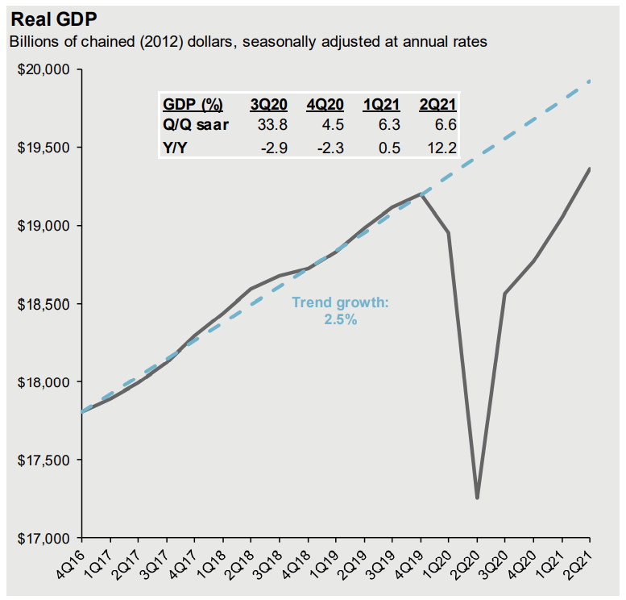
U.S. Economic Growth
$2 trillion pandemic hole
Over 6% growth in 2021
2023 back on trend
Hard close not likely
Source: BEA, JPMorgan Asset Management

Slide 5
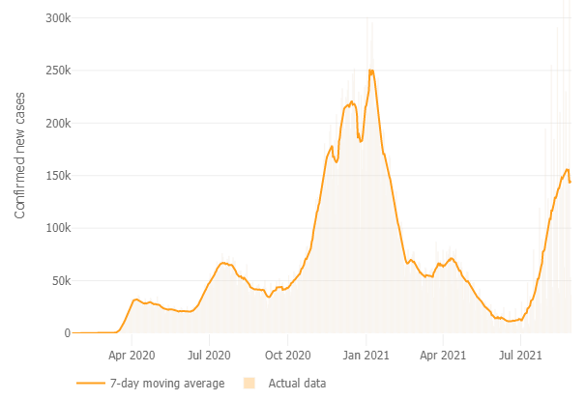
U.S. Covid-19 Cases (7-day avg.)
Over 217 million cases globally
4.5 million confirmed deaths
5.3 billion vaccines given
Source: Johns Hopkins University of Medicine 8/31/21
Notes:
Delta 15-30 seconds vs 15-30 minutes for Alpha R not is 6-7 vs 2-3
Unvaccinated 17x more likely to be hospitalized

Slide 6
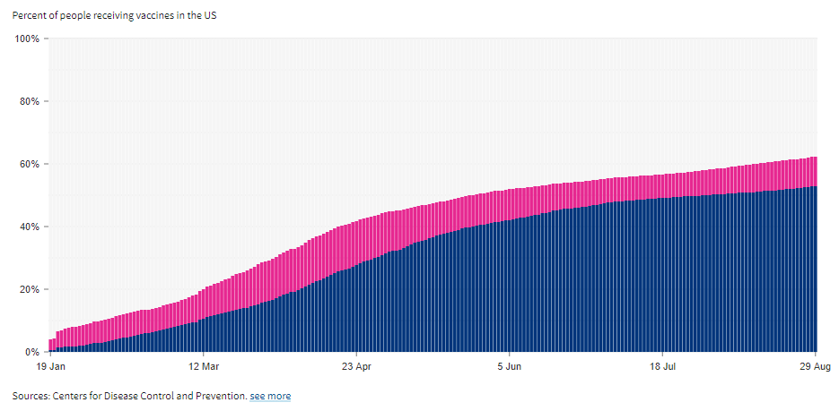
U.S. Vaccinations
Blue – fully vaccinated, magenta - partially
Over 85% age 65 or older
Moderate increase in vaccination rates
Notes:
Less than 50% of kids 12-15 vaccinated so spread increase with school opening – look at TN infextions
Open heart surgery post stroke 8 hospitals to get a bed
Delta 10% to almost 100% from 5/23 to 8/31
Because the delta is so contagious should get to 95% either have it or vaccinated within 12-18 mos

Slide 7
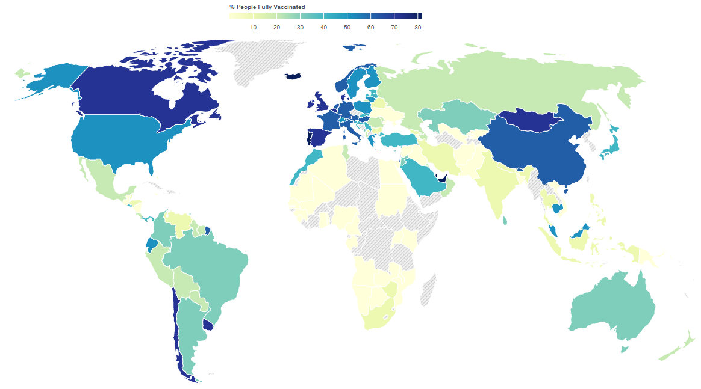
Global Vaccinations – Risk Remains
Source: Johns Hopkins University of Medicine 8/31/21
Notes:
Mu and C.2.1 are examples new variant would have to be more contagious to Delta to crowd it out which would complicate the situation further
Variants are becoming less diverse as Delta crowds out

Slide 8
Why Growth Will Continue
Source: BlackRock, Bloomberg 8/1/21
Manufacturers and Services orders are well ahead of production
Fixed investment represents confidence and an increase in productivity

Slide 9
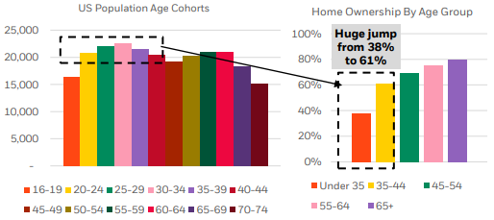
Strength In Housing
Prices are up and so is affordability
Plenty of demand from Millennials and older Z’s
Housing has a multiplier effect on economic growth
Source: BlackRock, Census Bureau 7/27/21 8/1/21

Slide 10
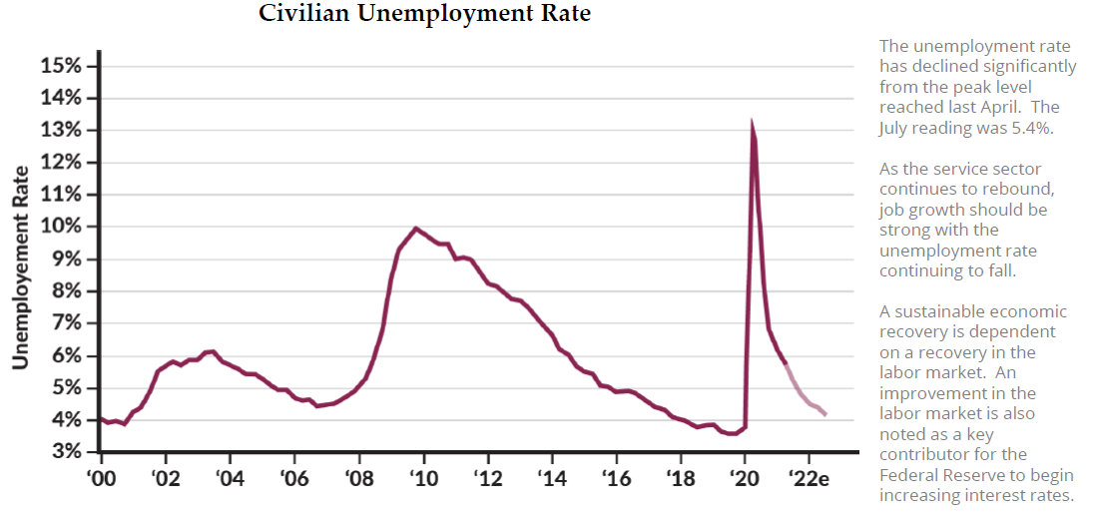
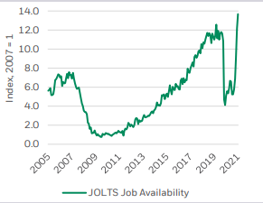
Employment Picture
Unemployment Rate
Source: Bloomberg 7/31/2021; BlackRock; BLS 6/30/21

Slide 11
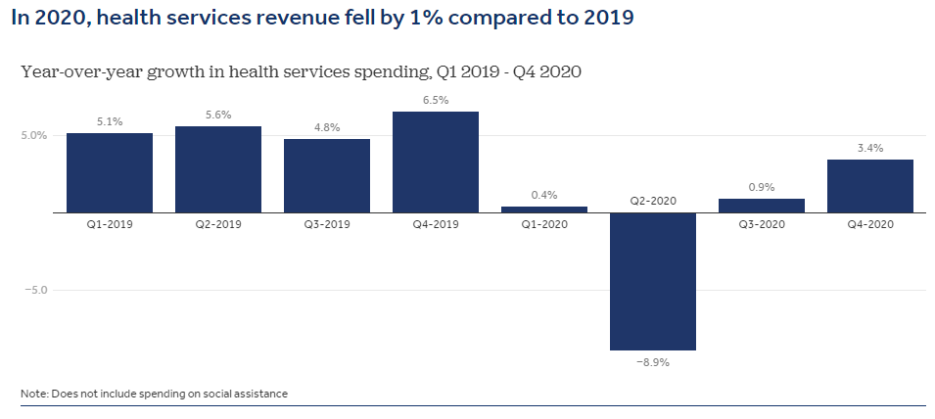
Healthcare Trends
Over 28 million elective surgeries cancelled
Delta variant prolongs recovery in revenues
Decline in investment spending
Source: Peterson-KFF

Slide 12
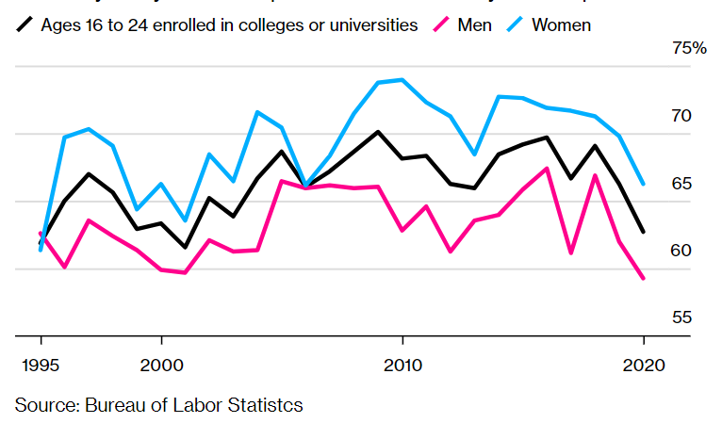
Education Trends
2020 enrollment hit 2-decade low; 2021 3.5% lower
Delta variant moves freshmen closer to home
Growth in online may strain real estate investment
22% aged 25-34 living at home

Slide 13
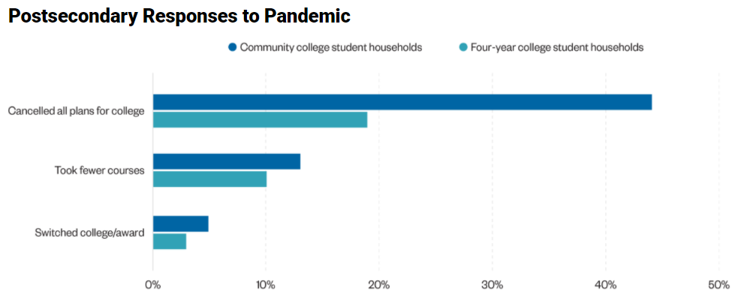
Education Trends
Source: CCRC 11/20

Slide 14
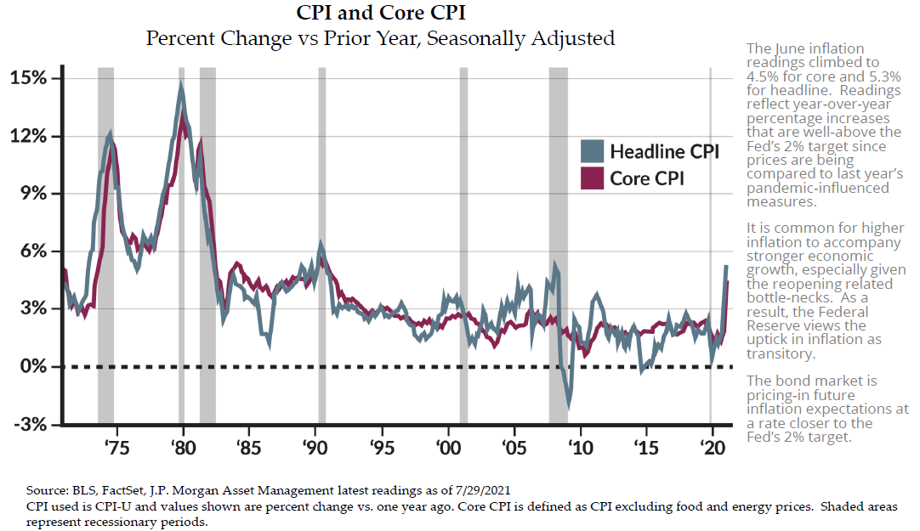
Inflation Picture

Slide 15
Is Inflation “Transitory”
Yes and no
Supply chain issues are real
Commodity prices have already peaked
Labor costs will rise until mismatch is resolved
Source: Cornerstone Macro

Slide 16
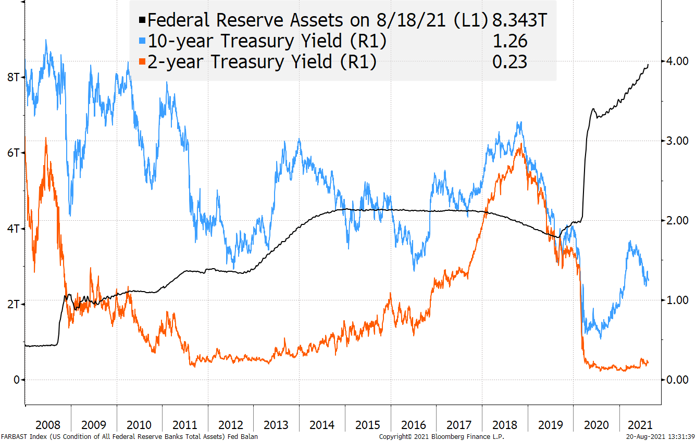
Tapering’s Past – First Hike
Source: Bloomberg

Slide 17
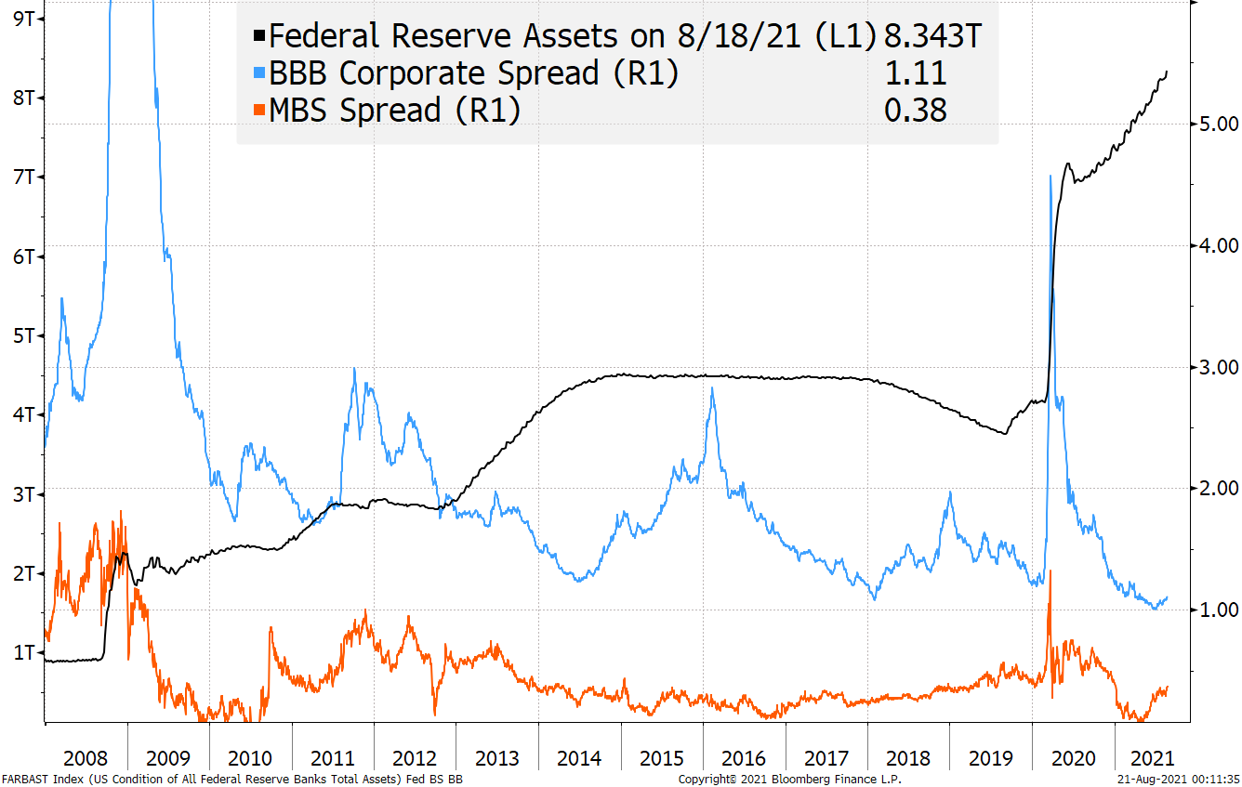
Tapering’s Past – Yield Spreads
Source: Bloomberg

Slide 18
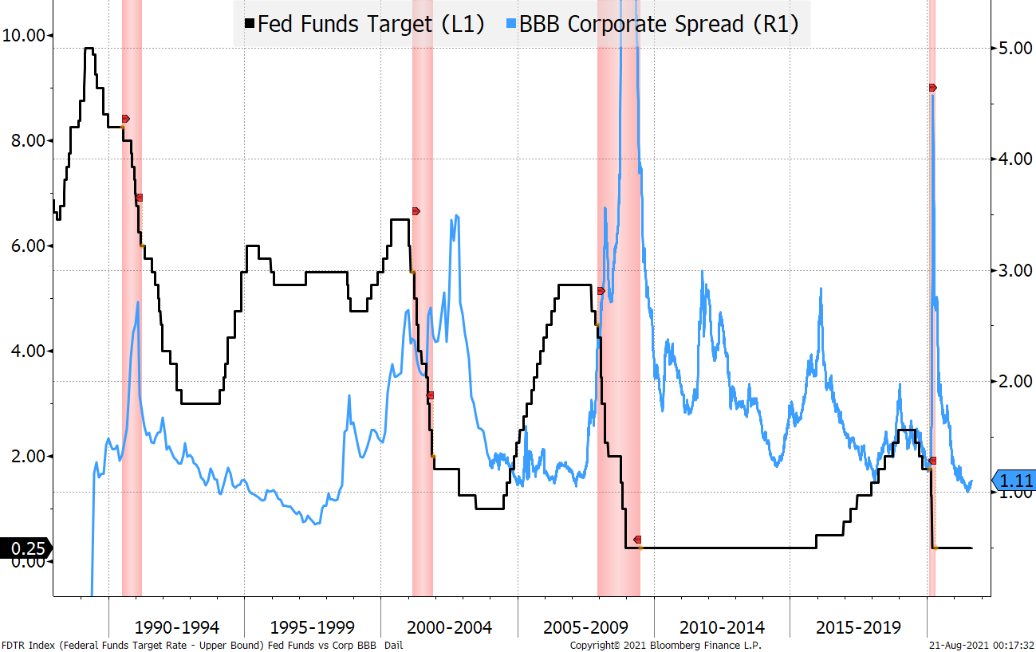
Tapering’s Past – FFs/Corp. BBBs
Source: Bloomberg

Slide 19
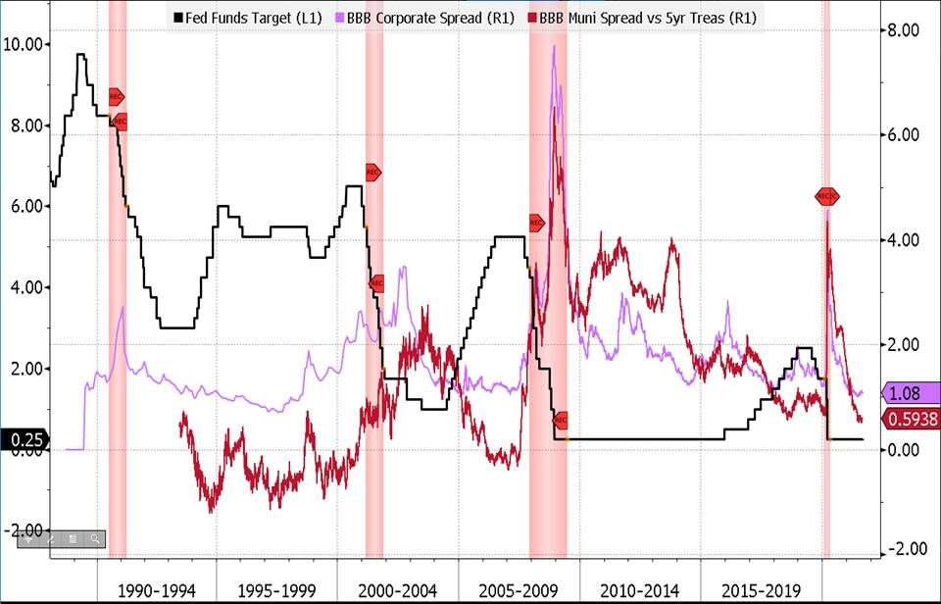
Tapering’s Past – FFs/Muni BBBs
Source: Bloomberg

Slide 20
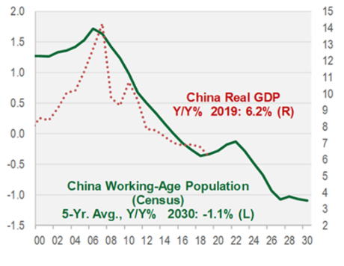
China’s Challenge
Aging workforce
Re-education of younger workers
Tech 2027
Belt and Road investments
Source: Cornerstone Macro

Slide 21
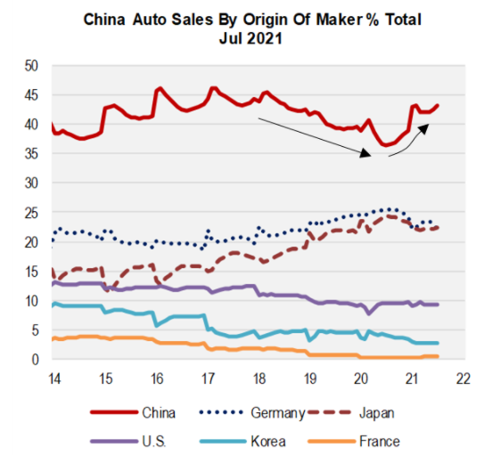
China’s Consumer
Reduce foreign investment
Create consumption
New driver of growth
Autos example
Source: Cornerstone Macro

Slide 22
Conclusions
Policy drives markets for some time
Pandemic will continue to produce uneven global growth and China no longer primary EM driver
Inflation will run high into 2023 then return nearer long-term trend
Interest rates will remain low well into future
Geo-Politics will produce winners and losers in global economic growth

Slide 23
Disclosure
This content is for informational purposes only and is not to be taken as advice or a recommendation to buy or sell any investment. Forecasts, figures, opinions or statements of market trends are subject to change without prior notice. All information presented is considered accurate at the time of publication, but no warranty of accuracy is given and no liability with respect to any error or omission is accepted. Charts and graphs, in and of themselves, should not be used as a basis for investment decisions. Past performance is not a guarantee of future results.
Johnson Financial Group is a privately-held financial services company and marketing name for its subsidiaries, Johnson Bank, Johnson Wealth Inc., and Johnson Insurance Services, LLC.

