Slide 1
Post Issuance Compliance: Whose Responsibility, the Issuer or the Borrower?
Presented by:
Kim Mooers, Executive Director, RI-RIHEBC
Donna Murr, Executive Director, WA-WHCFA
Dennis Reilly, Executive Director, WI-WHEFA
Moderator:
Dana M. Lach, Of Counsel, Foley & Lardner LLP

Slide 2
Perspectives from Three Conduit Issuers
WHCFA
WHEFA
RIHEBC

Slide 3
Pre and Post Issuance Tax Compliance Overview
IRS Forms 8038 and 8038G were changed in 2011 to require conduit issuers to indicate whether or not they have procedures in place to ensure post-issuance compliance with tax requirements

Slide 5
IRS Oversight Tax Compliance
Conduit issuers are considered the “taxpayer” with respect to their bonds and have specific tax compliance responsibilities including (but not limited to):
Responding to an IRS examination of a bond issue
Submitting a voluntary closing agreement (VCAP) request to the IRS
Implementing a remedial action upon the change of use of bond-finance property, including, where necessary, filing a Form 8038 and filing a notice of defeasance
Executing a ‘hedge identification’
The IRS has provided guidance: https://www.irs.gov/pub/irs-pdf/p5005.pdf
Conduit Issuer should consider whether to designate one or more officials to be responsible for its tax compliance responsibilities.
Conduit Issuers may also consider requiring a conduit borrower to identify a particular official to assist the conduit issuer in these actions

Slide 6
IRS Oversight Post Issuance Procedures
Both the SEC and the IRS emphasize that issuers should have written procedures relating to matters of disclosure and compliance with respect to federal income tax law, respectively. This should be discussed with issuer’s counsel, but a conduit issuer may consider:
Designating conduit issuer officials to assist in post-issuance compliance
Requiring conduit borrowers to identify officials for assisting with post issuance compliance monitoring
Provide training and ongoing education to designated officials of the conduit issuer and the conduit borrower
Requiring the conduit borrower to demonstrate that it has adopted written post-issuance compliance procedures before the approval of a bond issue
Designating time intervals within which the conduit issuer and conduit borrower will complete compliance monitoring activities
Timely completing remedial actions to correct (including VCAP requests) or otherwise resolve identified noncompliance
Requiring conduit borrowers to notify the conduit issuer of the completion of post-issuance compliance monitoring activities

Slide 7
IRS Oversight and Audits
Why should Issuers care about the IRS post-issuance compliance initiative?
Failure to comply with the federal tax requirements may cause conduit bonds to be declared taxable.
Interest earnings would be taxable to individual bondholders.
Litigation would be costly and creates a risk to Issuers.
Costs of responding to an IRS audit can be substantial.
Settlements with Bondholders can be costly (and the Issuer runs the risk that the Borrower cannot pay)
Best way to avoid risk: Pre and Post-Issuance Compliance

Slide 8
Whose Responsibility Is It?
Questions for Conduit Issuers:
How involved do you want to be in monitoring:
Rebate and yield restriction compliance
Expenditure of bond proceeds
Qualified use of bond financed facilities and noncompliant use
Change of use
Remedial actions
Recordkeeping

Slide 9
Whose Responsibility Is It?
Questions for Conduit Issuers:
Do you want:
No involvement
Passive involvement
Active involvement

Slide 10
Whose Responsibility Is It?
No Issuer Involvement – is it wise?
Borrower agrees to certain covenants as a condition of borrowing
Borrower is on their own to manage compliance
No active Issuer monitoring of compliance
Risks: Although the potential obligations of an Issuer are passed through to the Borrower, the Issuer may be liable to purchasers of Bonds declared taxable via judicial action. The issuer not only runs this litigation risk, but also risk that the borrower be unable to pay.

Slide 11
Whose Responsibility Is It?
Passive Issuer Involvement
Responsibility for compliance is passed on to the Borrower
Issuer provides Borrower with certain tools to aid in compliance
No active Issuer monitoring of Borrower compliance

Slide 12
Whose Responsibility Is It?
Active Issuer Involvement
Responsibility for compliance is passed on to or shared with the Borrower
Issuer provides Borrower with certain tools to aid in compliance
Issuer requires annual certification for certain compliance items

Slide 13
Post Issuance Compliance in Wisconsin, Washington & Rhode Island

Slide 14
As a conduit issuer, WHCFA does not have direct control over:
the use of the bond proceeds or
the facilities that are financed with such proceeds
and therefore places the responsibility for post issuance compliance on the borrower. However, we have established written procedures that are followed in all transactions.
Post Issuance Compliance Procedures
Engage nationally recognized bond counsel to conduct due diligence
Require bond trustee/depository bank to maintain all records of investments and disbursement of bond proceeds
Require bond trustee/depository bank to engage or determining that the borrower has engaged rebate consultant

Slide 15
Post Issuance Compliance Procedures
Require the borrower, in the tax certificate, to agree
to the following:
Identifying a management-level employee with primary responsibility for post issuance compliance
Monitoring the use of bond proceeds and the use of bond-financed assets throughout the term of the bonds to ensure tax compliance
Maintaining records identifying the assets that are financed with bond proceeds
Consulting with bond counsel and other legal counsel in the review of any contracts or arrangements involving use of bond-financed assets to ensure compliance with all covenants and restrictions set forth in the tax certificate

Slide 16
Post Issuance Compliance Procedures
Maintaining records for any contracts or arrangements involving
the use of bond-financed assets
Conferring at least annually with personnel responsible for bond-financed assets to identify and discuss any existing or planned use of bond-financed assets, to ensure that those uses are consistent with all covenants and restrictions set forth in the tax certificate
If the borrower discovers that any applicable tax restrictions regarding use of bond proceeds and bond-financed assets will or may be violated, they must consult with bond counsel and other legal counsel to determine a course of action to remediate all nonqualified bonds, if such counsel advises that a remedial action is necessary. In addition, the borrower will, upon discovery of any violation or potential violation, promptly notify WHCFA’s Executive Director

Slide 17
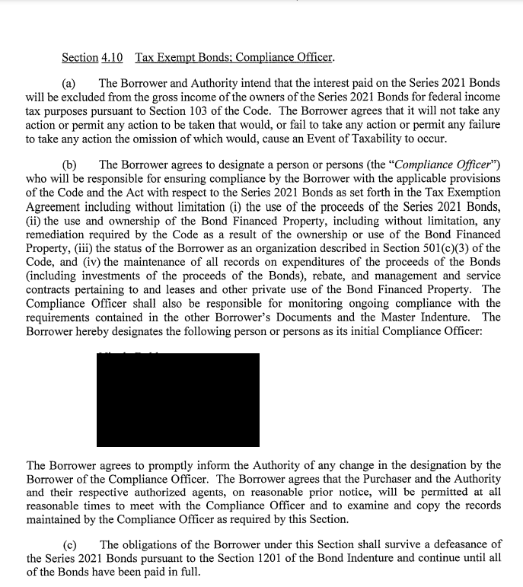
Compliance and Bond Documents
Wisconsin & Washington: Compliance Officer concept in bond documents.
WHEFA – Loan Agreement
WCHFA – Tax Agreement
Rhode Island: Borrower Post-Issuance Compliance Letter and Certificate
Loan and Security Agreement and Tax Agreement both detail post-issuance compliance obligation of the borrower
As further emphasis of a borrower’s PIC obligations, a separate certificate summarizes these obligations and requires them to name the person responsible for tracking compliance, among other things.
This document is signed as part of the closing documents.

Slide 18
How WHEFA Helps Educate Borrowers:
WHEFA includes post issuance compliance reminders in each issue of its newsletter
Annual Workshop Sessions

Slide 19
How WHCFA Helps Educate Borrowers:
Maintain a database of all outstanding bond issues and the required compliance documents to be delivered by the borrower to WHCFA, which is the responsibility of it’s compliance officer.
Engage a rebate consultant for certain small, nonhospital bond transactions to complete rebate review at no cost to the borrower
Conduct periodic customer education seminars
Circulate NAHEFFA Quarterly Newsletters to all borrowers
Extend invitation to all borrowers to attend NAHEFFA conferences

Slide 20
Continuing Disclosure Requirements
POST-CLOSING REQUIREMENTS OF A BOND ISSUE: Investor/Rating Agency/Bank Relations
Investor Relations – Generally - In addition to the baseline financial and reporting covenants and the SEC’s continuing disclosure obligations, a borrower may wish to be proactive in communicating with its investors. For example, the borrower might provide notice of the following:
• Incurrence of additional debt. • Changes in the members of the obligated group.
• Changes in key management. • Change in auditor.
• Update to the Management Discussion and Analysis originally provided in Appendix A to the bond offering document.
Reporting Bank Placements - In cases where a borrower has both a direct bank placement and public bonds outstanding, the public bond investors and bond rating agencies are interested in the key terms found in the bank placement documents. Bond rating agencies will request copies of the borrower’s key agreements with the bank, to assess the overall capital plan and identify any material risks imposed by the direct placement documents. Consistent with the investor relation practices outlined above, it is considered “best practice” to post to EMMA a summary of the key terms or a copy of the bank documents.
Avoid Selective Disclosure

Slide 21
Questions

