Slide 1
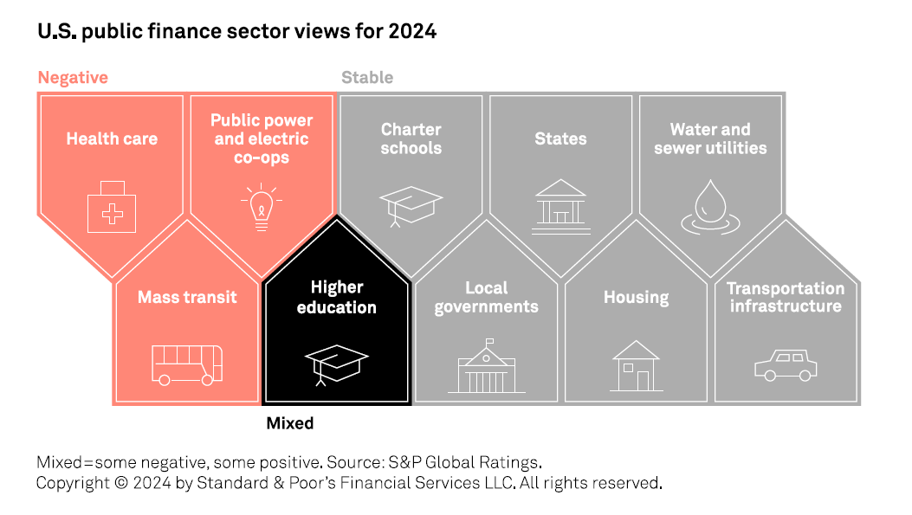
2024 Outlook For U.S. Public Finance: A Mixed Credit Picture

Slide 2
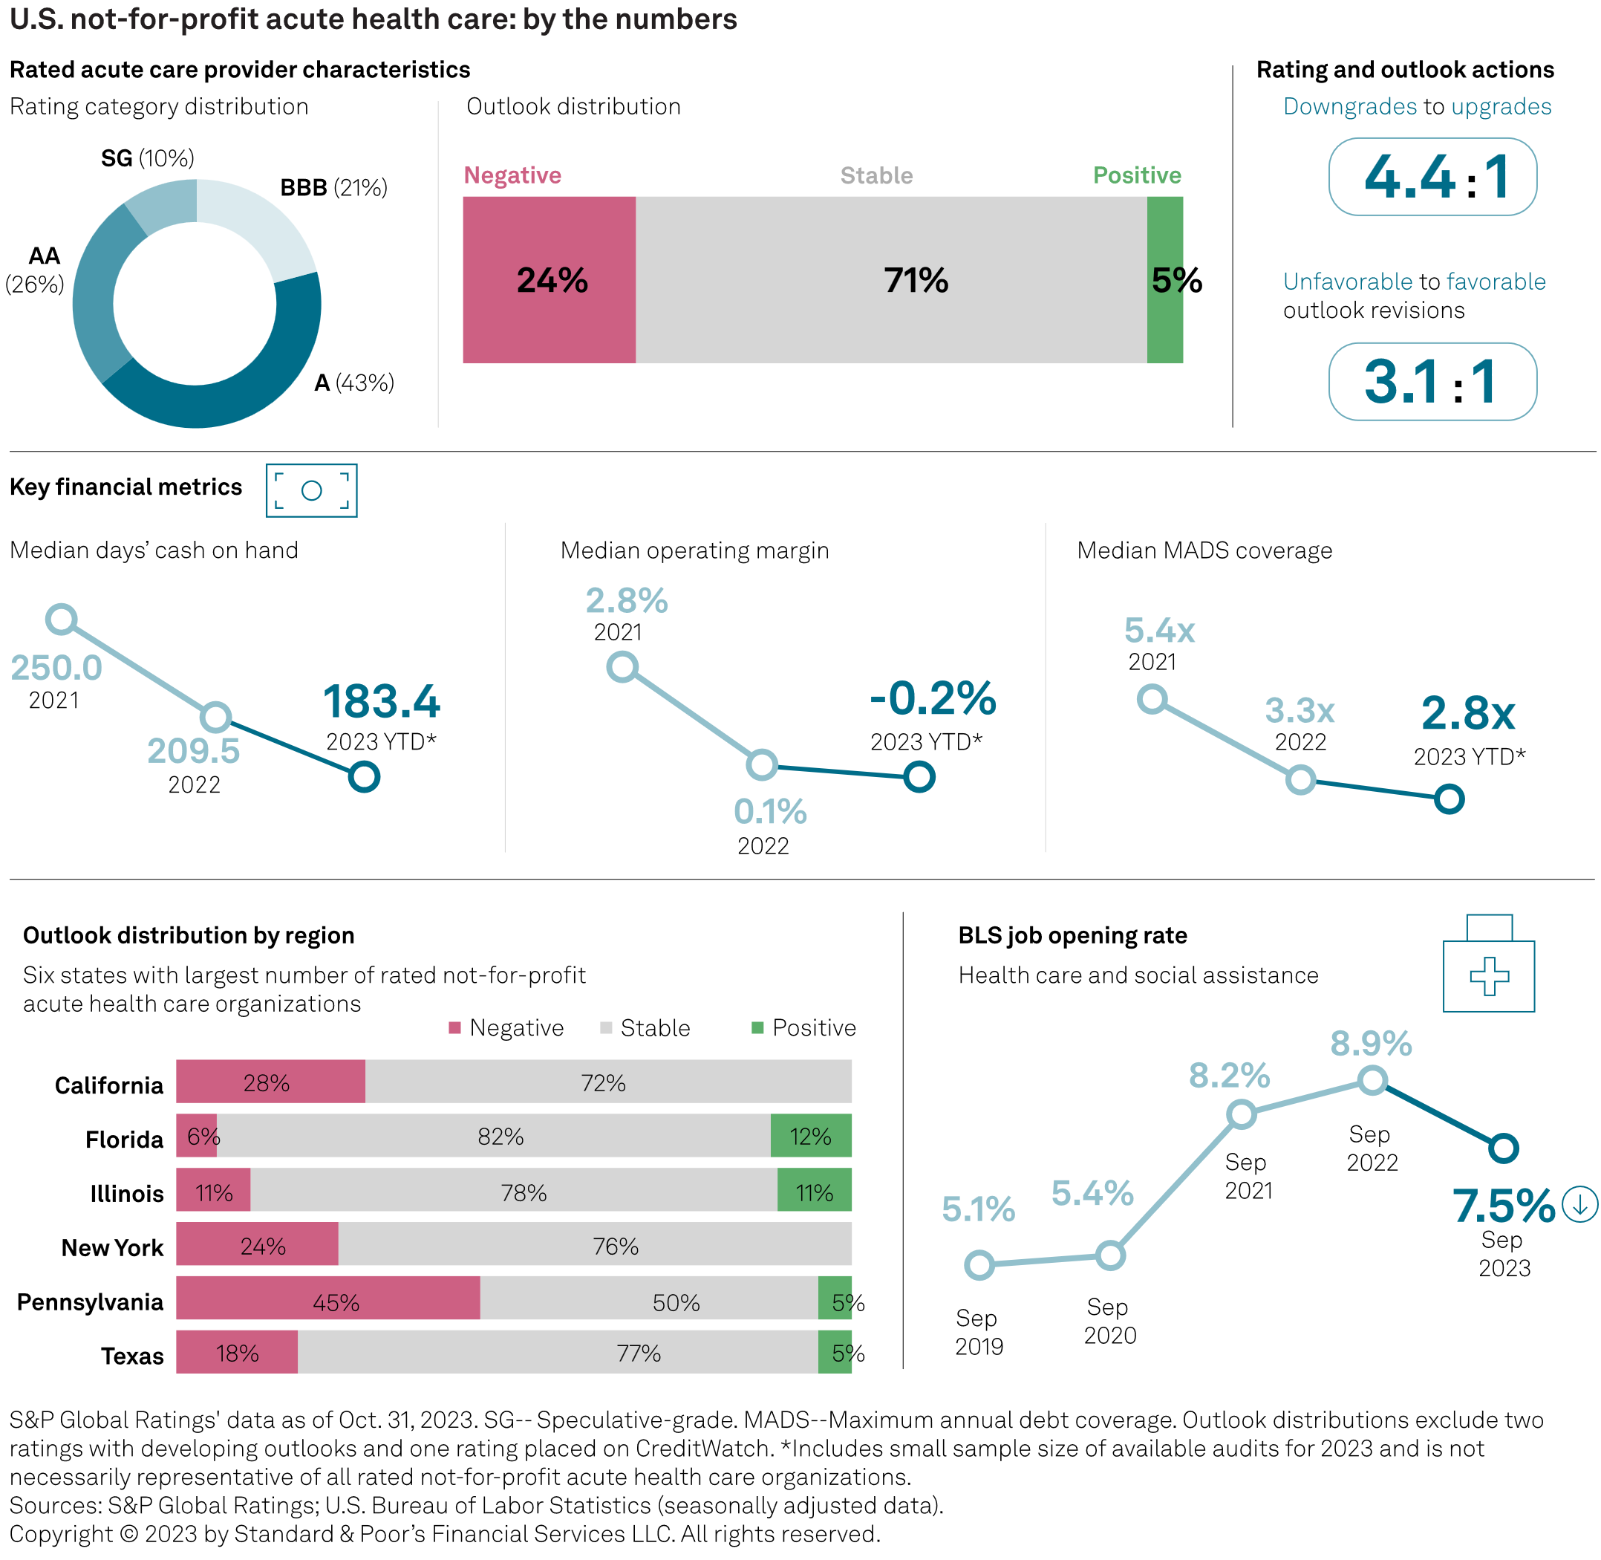
U.S. Not-For-Profit Acute Health Care | By the Numbers
Ratings distribution largely unchanged since beginning of 2020
Negative outlooks at highest percentage in past 10 years
Preliminary 2023 audits showing continued lighter financial profiles, although these are June FYEs
Labor expenses easing, but not in the clear
Credits in different geographies may trend differently
S&P Global Ratings' data as of Oct. 31, 2023. SG-- Speculative-grade. MADS--Maximum annual debt coverage. Outlook distributions exclude two ratings with developing outlooks and one rating placed on CreditWatch. *Includes small sample size of available audits for 2023 and is not necessarily representative of all rated not-for-profit acute health care organizations. Sources: S&P Global Ratings; U.S. Bureau of Labor Statistics (seasonally adjusted data).

Slide 3
U.S. Not-For-Profit Acute Health Care | Key Takeaways for Negative View
Constrained operating environment continuing into 2024
Labor expense pressures have eased from extreme challenges of 2022, but labor and other expense pressures remain and are not yet fully offset by the favorable demand and revenue growth.
Unrestricted reserves with more limited growth
Balance sheets remain broadly stable, but have not improved materially over the last year. At the same time, management teams are considering capital needs and funding those needs after several years of reduced spending.
Negative outlooks for health systems and stand-alone hospitals skew higher
Rating actions and negative outlooks highlighting the credit quality trends of the sector with 24% of all our acute health care credits on a negative outlook.

Slide 4
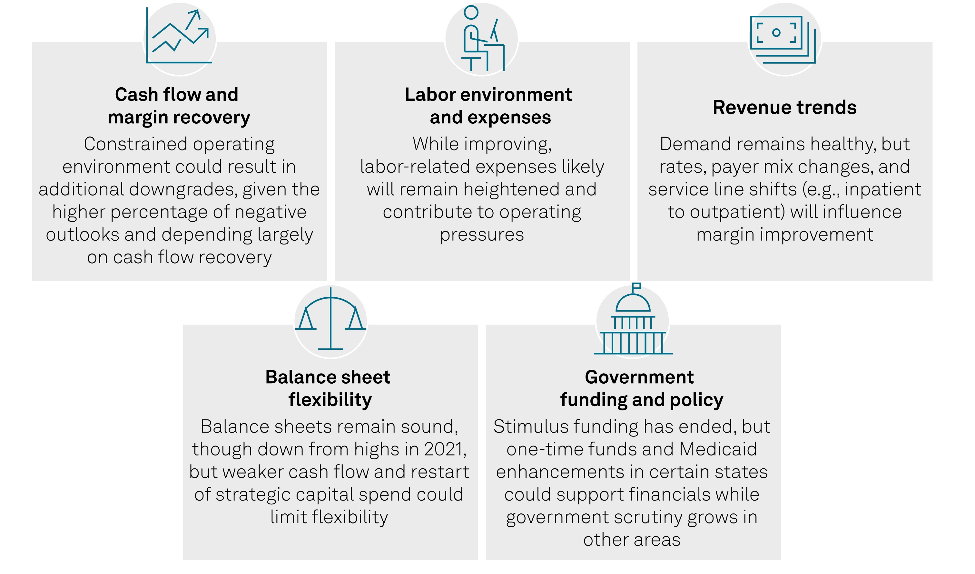
U.S. Not-For-Profit Acute Health Care | What We’re Watching

Slide 5
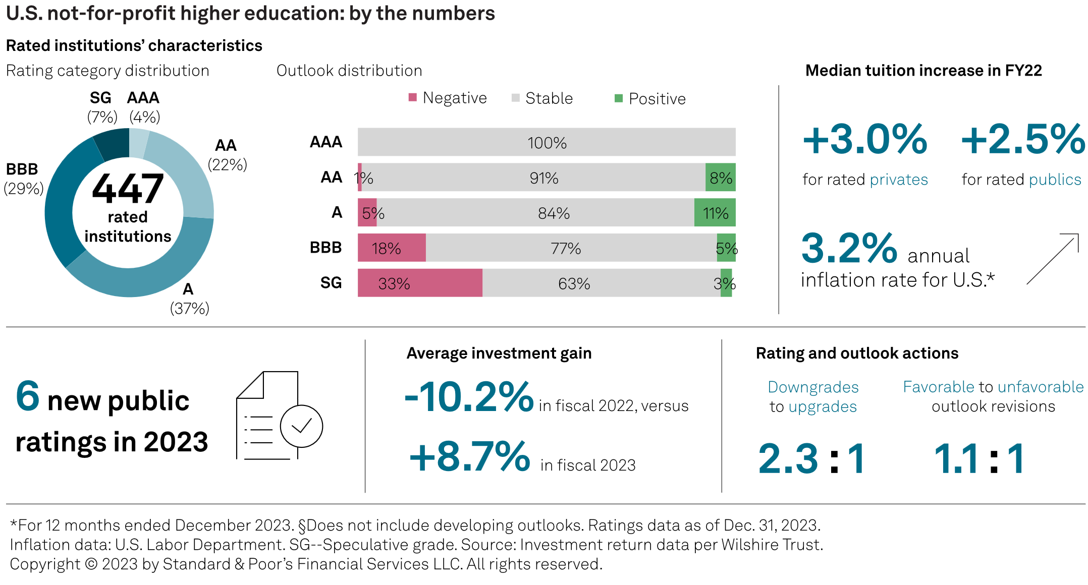
U.S. Higher Education | By The Numbers
Notes:
Downgrades to upgrades needs updating; 4 downgrades in Q4 (digital design)

Slide 6
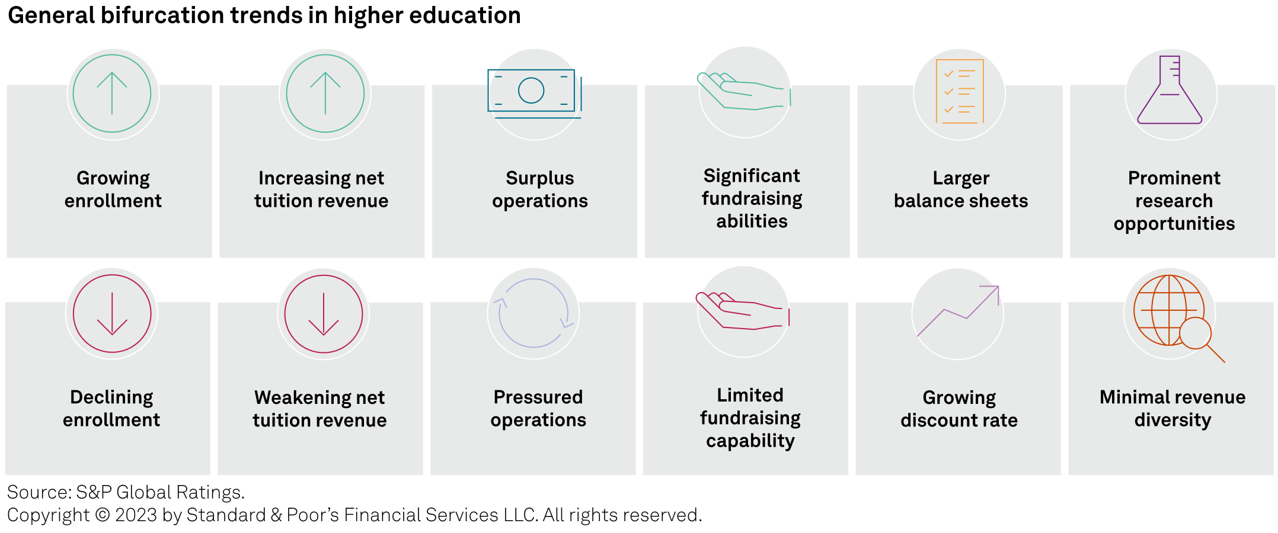
U.S. Higher Education | Bifurcated Sector View For 2024
Our view of the sector in the U.S. remains mixed. Competition for students is intensifying,
operating expenses are rising, and schools are facing budget pressures, but these hurdles
aren't affecting all colleges and universities equally.

Slide 7
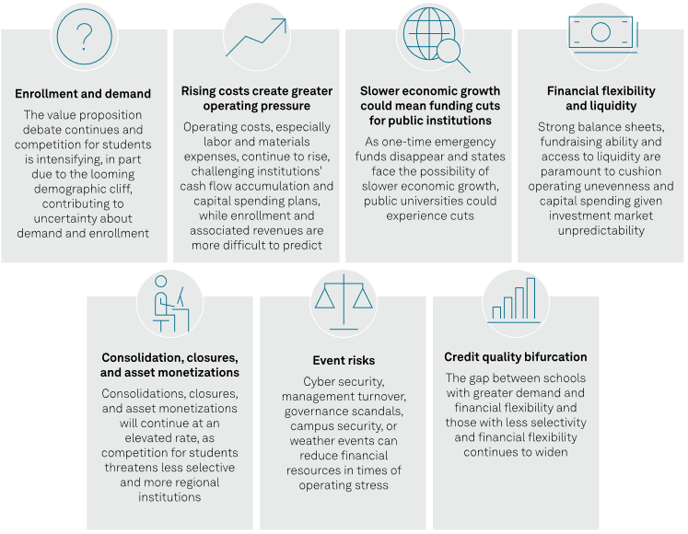
What We’re Watching | Not-for-Profit Higher Education

Slide 8
U.S. Economic Forecast Update: A Sturdy Job Market Keeps Growth Going

Slide 9
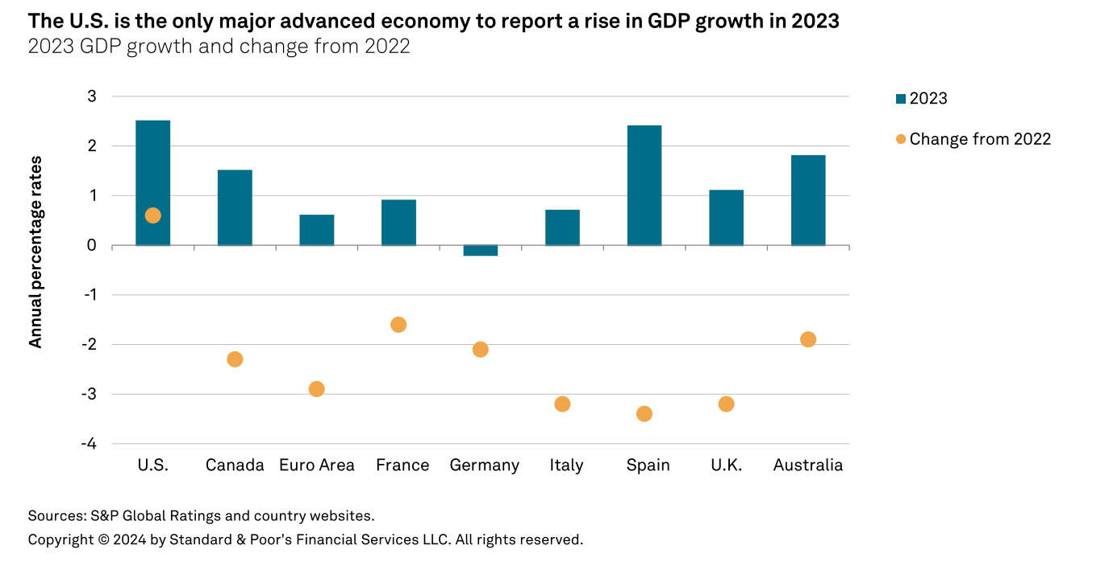
U.S. Economic Forecast Update: A Sturdy Job Market Keeps Growth Going

