Slide 1
COVID Today
Post COVID-19 Challenges
Capital Access Today

Slide 2
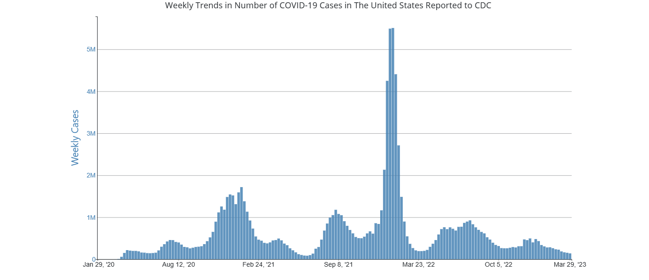
COVID-19 Today
According to CDC cases are down to 139,000 per week and dropping
COVID has dropped to a level where Johns Hopkins, the first major tracker of the virus, stopped colleting data in early March
Hospitals today have protocols and procedures such that COVID-19 is not the disrupter to operations as it was previously

Slide 3
COVID-19 Today
Covid-1 still has regional flare ups, but is manageable in all but the smallest provider settings

Slide 4
Post COVID-19 Challenges

Slide 5
Many Significant Operational Challenges Persist in a Post-COVID Landscape
Workforce shortages, exacerbated by the pandemic, have resulted in increased reliance on contract labor
Patients are sicker and require more intensive treatment, due largely to pandemic-driven deferred care
Shortages of critical supplies (e.g., contrast dye)
Commercial health plans’ policies compromise patient safety and raise costs
Many of these factors have contributed to increased lengths of stay

Slide 6
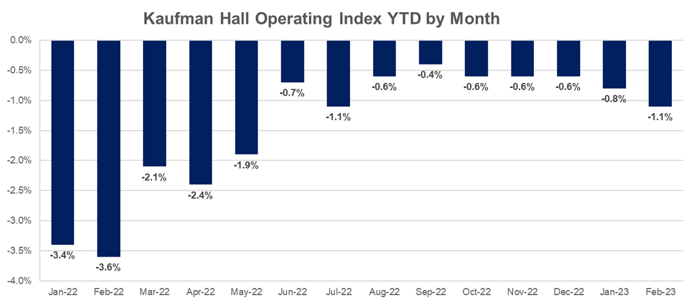
Hospitals Are Facing Historic Financial Headwinds
Source: Adapted from the March 2023 Kaufman Hall National Hospital Flash Report

Slide 7
Skyrocketing Costs Have Outpaced Revenue Growth for Many Hospitals
The prices hospitals pay for drugs, labor, and supplies have increased dramatically over pre-pandemic levels
Medicare and Medicaid rates do not keep pace with costs
Return of full Medicare sequester
Medicare and Medicaid make majority of hospital payments
Inflation has outpaced hospital price growth while commercial insurer policies increase costs and reduce cash flow
Rising cost of capital is a growing concern for many hospitals and health systems

Slide 8
Significant Uncertainty Persists Around Federal Regulatory Landscape
340B litigation (outpatient, contract pharmacy) and regulation (administrative dispute resolution)
Unwinding of the public health emergency
Medicaid redeterminations begin
Medicaid supplemental payment and provider tax policies
State or federal legislative proposals on price transparency, billing policies

Slide 9
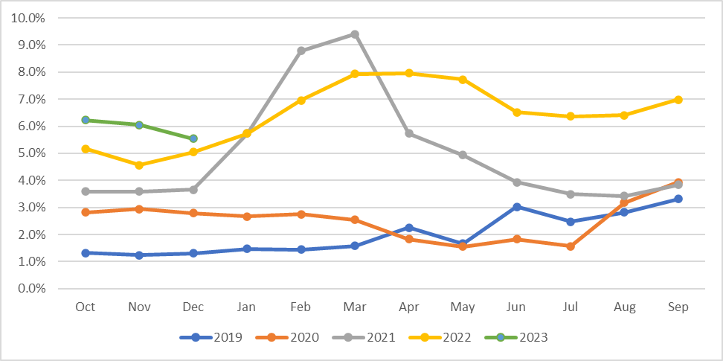
Contract Labor as % of Salary and Benefits
Source: Ponder client

Slide 10
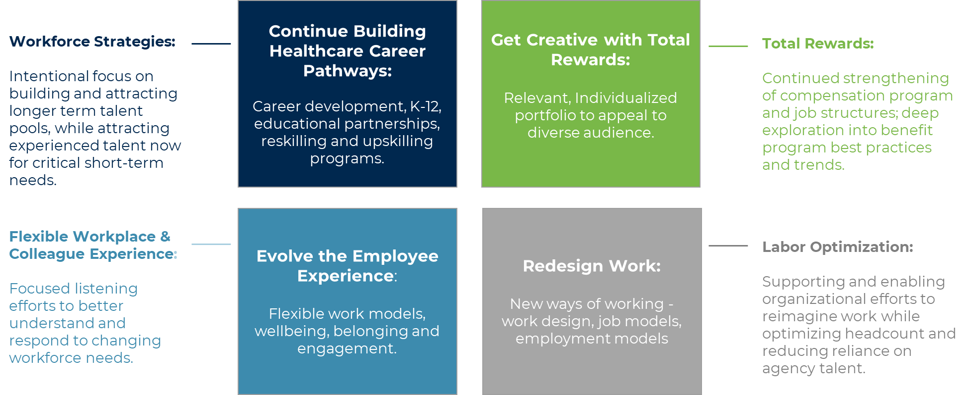
Common Labor Strategies
Holistic strategies required to navigate labor supply demands and attract/retain top talent.
Source: Ponder client

Slide 11
Negative Cash Flow Causes DSCR Concerns for Many
Negative operations coupled with investment losses in 2022 led many healthcare organizations to feel pressure relative to debt service coverage, with several breaching covenants
While a public default has limited and complicated remedies, private credit partners are generally willing to work with hospitals to avoid accelerating debt due to an event of default
Typical Private Debt Covenant
Typical Public Debt Covenants
1.0x DSCR in any quarter/year triggers EOD
1.0x DSCR in any year triggers EOD
1.0x DSCR in any year triggers EOD, carve out force majeure
1.0x DSCR 2 years in a row triggers EOD
1.0x DSCR 2 years in a row + min. DCOH triggers EOD
Least flexible
Most flexible
Potential Solutions to Default
1
2
3
4
Offer “covenant holiday” or waiver of covenant – can be one quarter at a time or for longer period
Modify DSC formula to remove one-time negative impacts (avoids need for waiver)
Amend document to avoid EOD altogether for specified period of time
Amend document to replace DSCR covenant with cash to debt or another debt ratio

Slide 12
State Regulatory Challenges
Not all State Regulatory initiatives are bad, but strong 2021 performance has some states trying to reign in healthcare costs
Indiana
Stop or significantly reduce hospital based billing at non-hospital locations
Cap charges at a % of Medicare regardless of payor
Provide tax-credit to independent physicians to encourage competition
Eliminate non-compete clauses between employers and primary care physicians
Reduce investment portfolios and require a portion to be invested within the State
Colorado
Target a minimum Community Investment Threshold
Potentially limit the ability to transfer reserves out of state (i.e. to a parent health system)
A ban on hospitals charging “facility fees”
Idaho
Can’t consider ESG factors in contracts with governmental entities (Idaho has a large number of governmental hospitals)
Others?

Slide 13
Capital Access Today

Slide 14
Rating Agency Comments

Slide 15
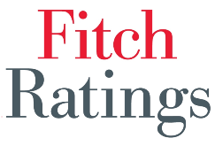
Rating Agency – Healthcare Reports
April 13th, 2023 Preliminary Medians - Financial performance deteriorated in fiscal 2022
Operating results fell to five-year lows.
Expense growth reached historic highs while outpacing revenue growth.
Absolute and relative liquidity metrics reverted to pre-pandemic levels.
Leverage metrics moderated following operating losses.
Volume trends remained uneven.
February 28th, 2023 Acute Health Care Rating Actions
S&P Global Ratings’ portfolio rating actions in 2022 were more negative compared with the previous year’s rating actions, which were relatively evenly split.
A dramatic shift began in the summer where downgrades far outpaced upgrades. This was mainly due to operating pressures associated with labor and supplies coupled with weakening balance sheets as investment markets declined and government stimulus funding largely ended.
March 2nd, 2023 Early NFP hospital medians show expected deterioration; will worsen
The decline in operating results are likely to be even more pronounced in our full-year medians later this year.
Fitch does not expect a rapid financial recovery for most providers, although hospitals under operational pressure will begin to see breakeven results on at least a month-to-month basis at some point in 2023.
Salary and other expense reduction remain key to improving margins, as expense growth is outpacing revenue growth.

Slide 16
Capital Markets Update

Slide 17
Fed Participant’s Assessment of “Appropriate” Monetary Policy
Source: Federal Reserve Meeting Minutes (03/21/23- 03/22/23)

Slide 18
Historical Rates Taxable & Tax Exempt rates as of 4/12/2023
Source: PFM Municipal Market Center

Slide 19
Historical Long Term and Short Term MMD vs. Treasury Taxable & Tax Exempt rates as of 4/12/2023
30Y MMD is currently down from year end highs - current AAA MMD = 3.16%
Source: PFM Municipal Market Center & National Bureau of Economic Research.

Slide 20
Healthcare Credit Spreads Tax Exempt as of 4/12/2023
Source: Bloomberg & National Bureau of Economic Research.

Slide 21
Education Credit Spreads Tax Exempt as of 4/12/2023
150
Source: Bloomberg & National Bureau of Economic Research.

Slide 22
Borrowing Rates have increased significantly Tax Exempt as of 4/12/2023
Benchmark Rates
Maturity | AAA MMD (Tax-exempt) | US Treasury | LIBOR | SIFMA (Tax-exempt)
Weekly | -- | -- | -- | 2.17%
30-day | -- | -- | 4.94% | --
2 yr | 2.18% | 3.95% | 4.32% | 2.88%
5 yr | 2.03% | 3.46% | 3.53% | 2.63%
10 yr | 2.08% | 3.41% | 3.38% | 2.68%
20 yr | 2.94% | 3.75% | 3.38% | 2.77%
30 yr | 3.16% | 3.64% | 3.19% | 2.71%
Source: PFM Municipal Market Center
YTM – Yield to Maturity

Slide 23
Municipal Funds – Periodic, Event-driven Severe Outflows Tax Exempt as of 3/31/2023
Healthcare Issuance
Through Mar. 23 (Mar. 22)
22 Issues (84)
$2.1B ($6.6B)
Fed begins to raise rates due to inflation
COVID 19
Outbreak
Source: TM3 and ICI

Slide 24
Alternative Capital Strategies
Energy as a Service
Leasing energy operations and equipment to an energy company in exchange for operational savings and capital investment
The energy services contract will have a component of the fee paying back the capital invested in the plant
Monetization of non-core assets
Health Systems are looking at real estate portfolios to see if they are using assets efficiently, determining what is a core asset, and considering selling those that are not necessary
Private Placements
Historically directly placed with large insurance companies looking for highly rated bonds
Investment banks are entering the market to buy bonds without an Appendix A, relying on public disclosure.
Others?

Slide 25
Announced M&A Change of Control Transactions
58
88
111
127
111
93
112
88
118
117
86
80
73
57
Date Announced | Target | State | Target Tax Status | Acquirer | Acquirer Tax Status | Target Beds | Total Revenue ($ MMs)
01/05/23 | Olathe Health | KS | NFP | University of Kansas Health System | NFP | 300 | 406.1
01/10/23 | Habersham Medical Center | GA | NFP | Northeast Georgia Health System | NFP | 53 | 47.3
01/11/23 | San Ramon Regional Medical Center (Tenet Health 51%) | CA | FP | John Muir Health | NFP | 123 | 169.2
01/12/23 | Plateau Medical Center (CHS) | WV | FP | Vandalia Health | NFP | 25 | 41.9
01/12/23 | Welch Community Hospital | WV | NFP | WVU Health System | NFP | 25 | 21.7
01/25/23 | Parkview Health | CO | NFP | UCHealth | NFP | 350 | 532.7
02/14/23 | Centura Health (CommonSpirit/Advent Health JOA) | CO & KS | NFP | AdventHealth (5 hospitals), CommonSpirit Health (15 hospitals) | NFP | 2,994 | 3,198.2
02/15/23 | Five Utah hospitals (Steward Health Care) | UT | FP | Centura (CommonSpirit Health) | NFP | 551 | 665.7
02/23/23 | Houston Healthcare (minority investment) | GA | NFP | Atrium Health | NFP | 276 | 277.5
03/01/23 | Two North Carolina hospitals (CHS) | NC | FP | Novant Health | NFP | 123 | 190.0
03/01/23 | Genesis Health System | IA | NFP | MercyOne (Trinity Health) | NFP | 784 | 721.6
03/01/23 | Regional Medical Center of Orangeburg & Calhoun | SC | NFP | MUSC Health | NFP | 286 | 214.2
03/27/23 | Perry County Memorial Hospital | MO | NFP | Mercy | NFP | 25 | 59.6
03/31/23 | Augusta University Health System | GA | NFP | Wellstar Health System | NFP | 716 | 1,133.6

