Slide 1
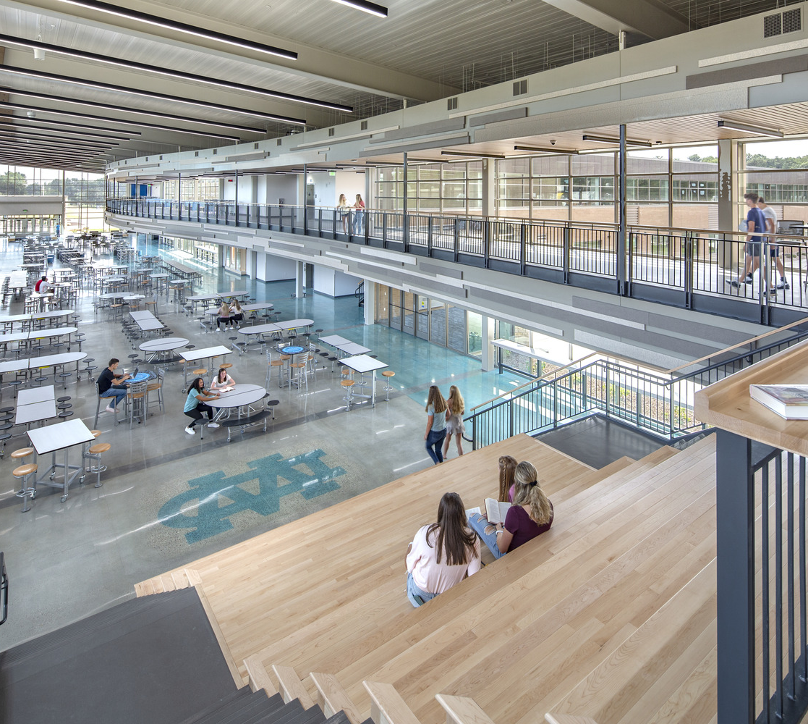
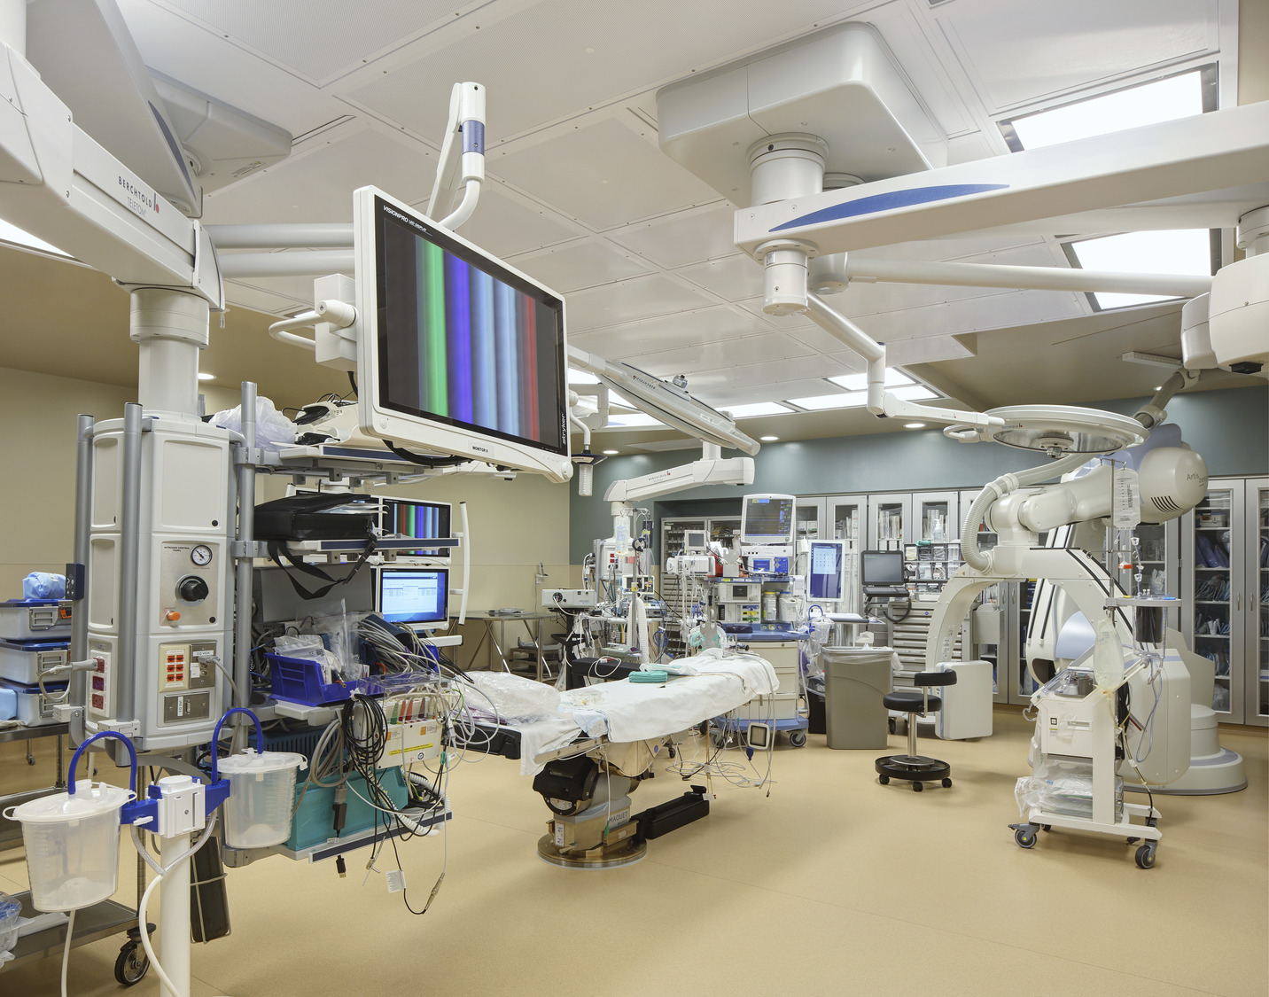
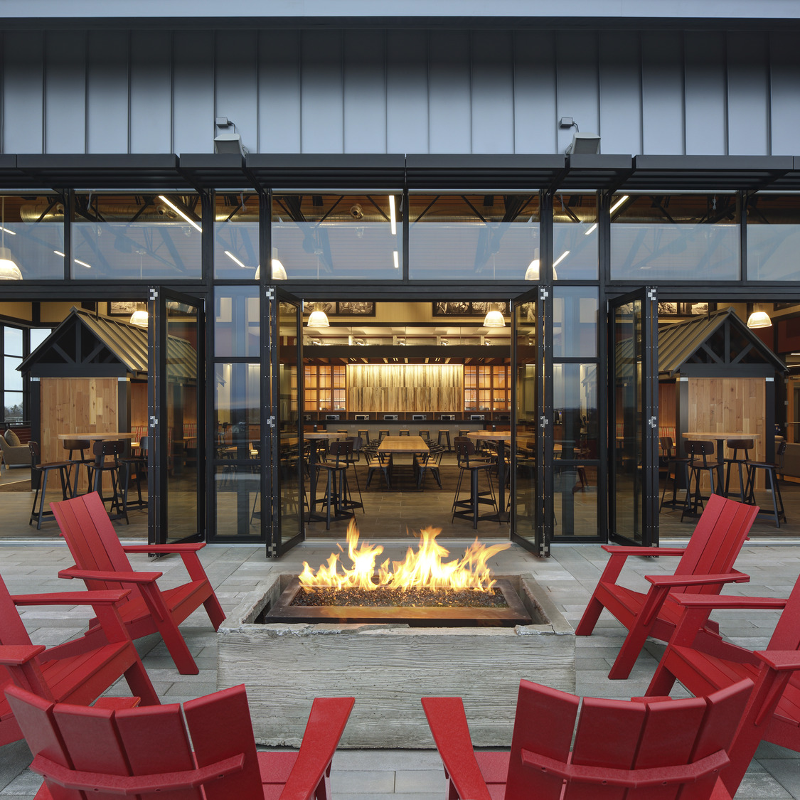
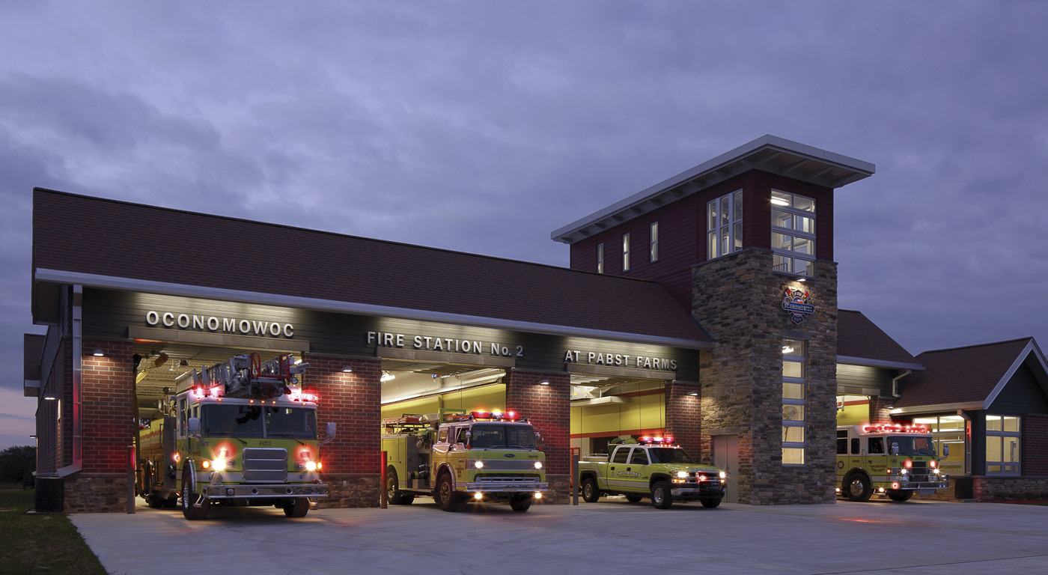
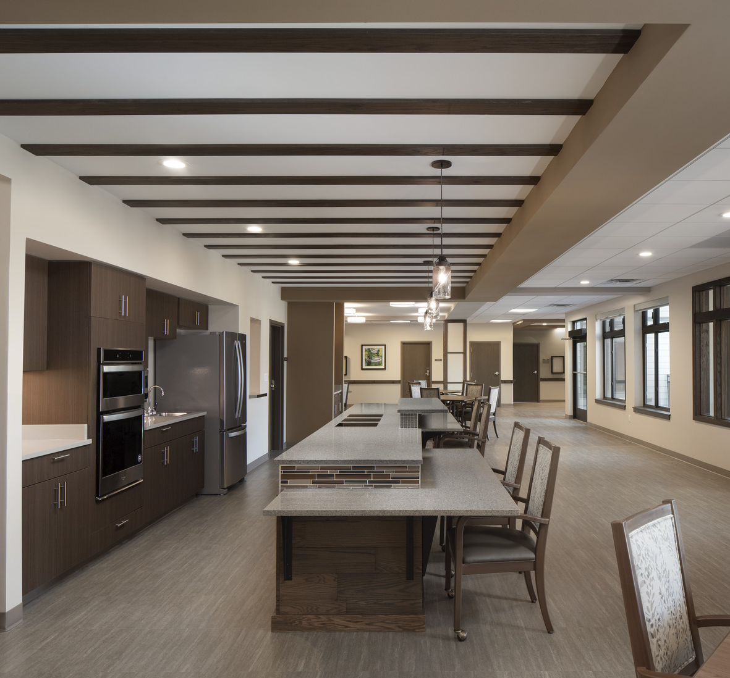
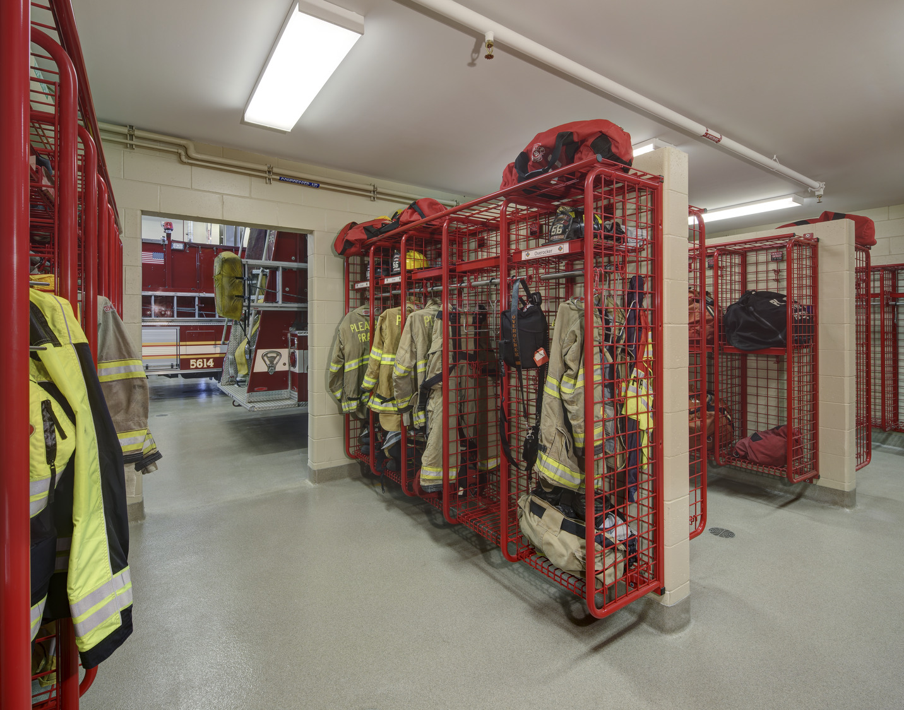
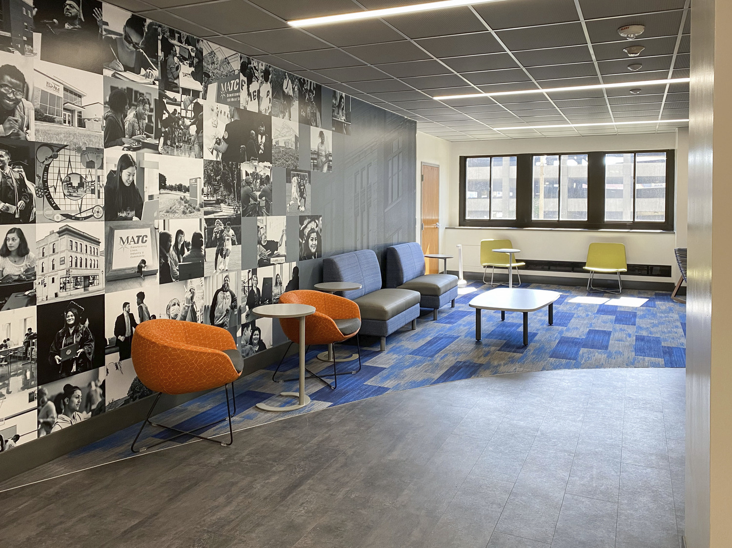
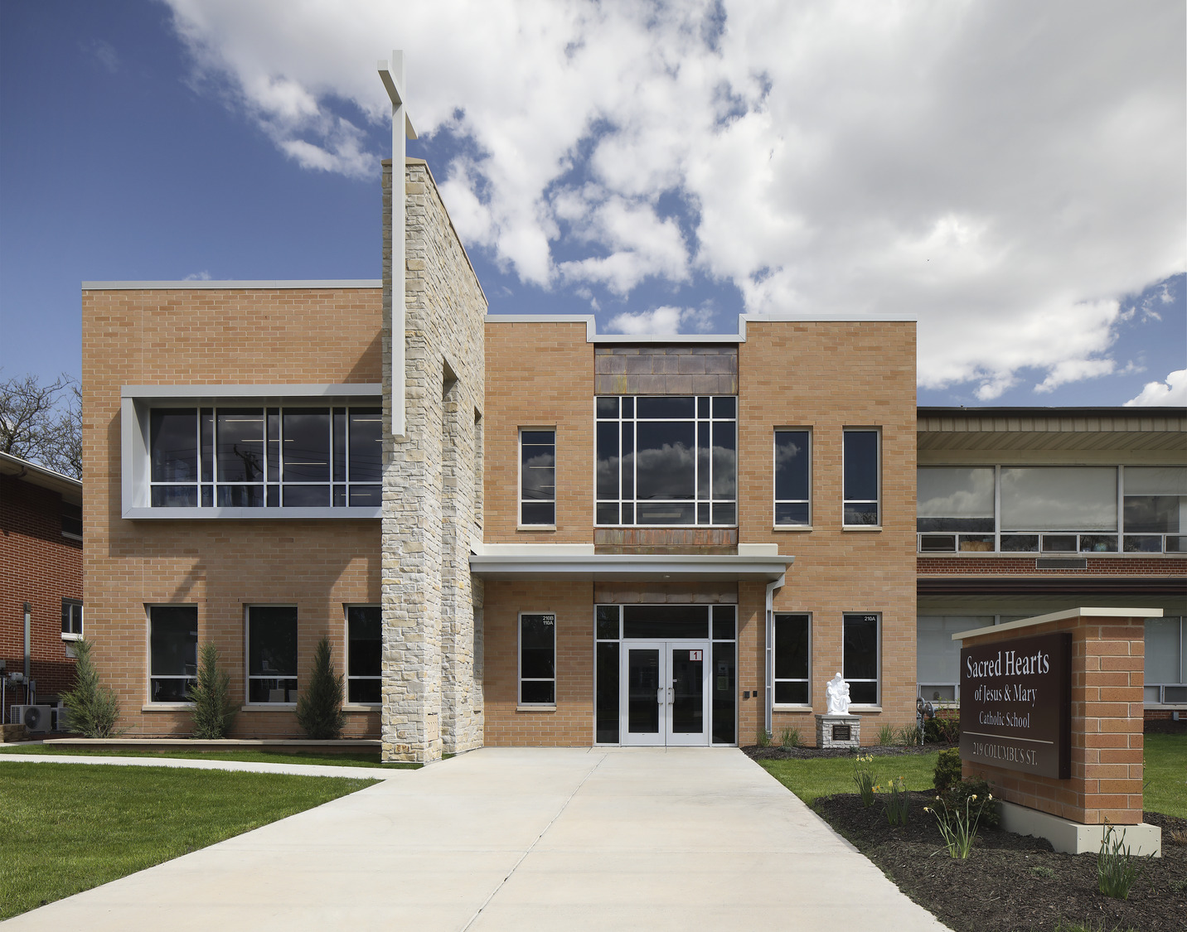
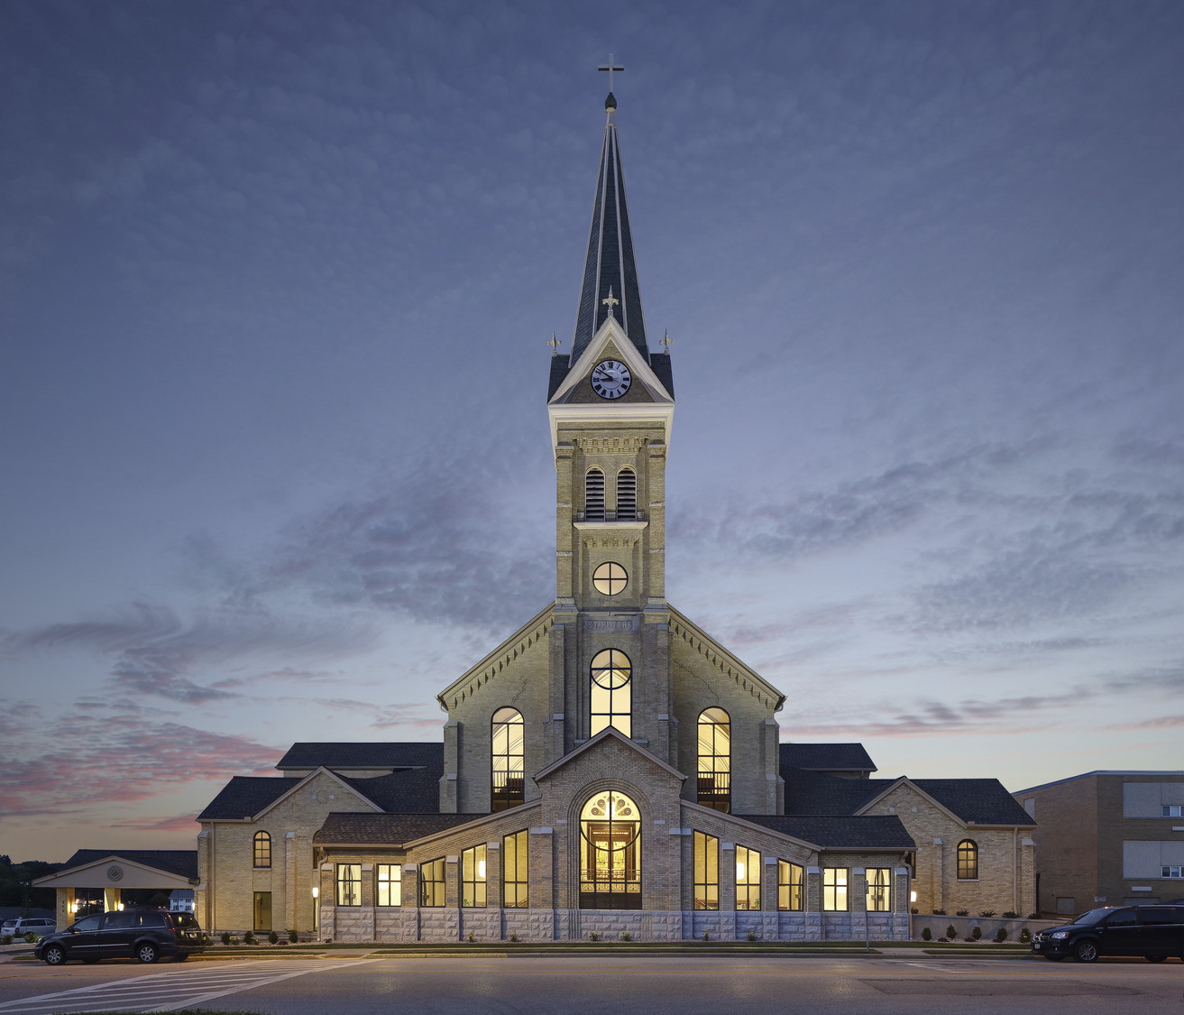
ARCHITECTURAL TRENDS
Plunkett Raysich Architects
Kevin Broich, AIA, NCARB
PARTNER

Slide 2
OUTLINE
HIGHER EDUCATION TRENDS
HEALTHCARE TRENDS
1
3
MODULAR DESIGN + CONSTRUCTION
SENIOR LIVING TRENDS
2
4

Slide 3
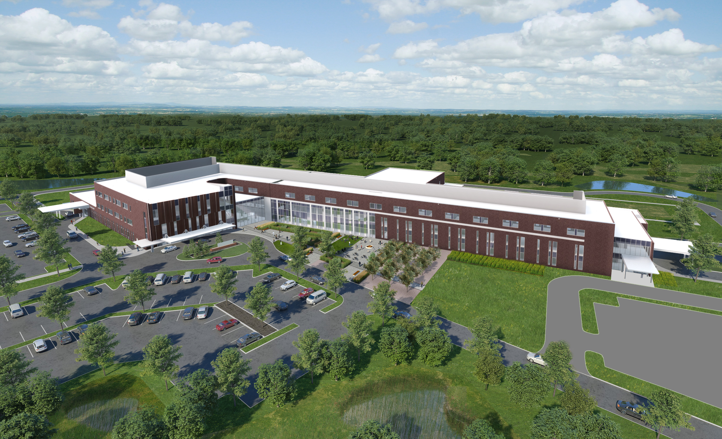
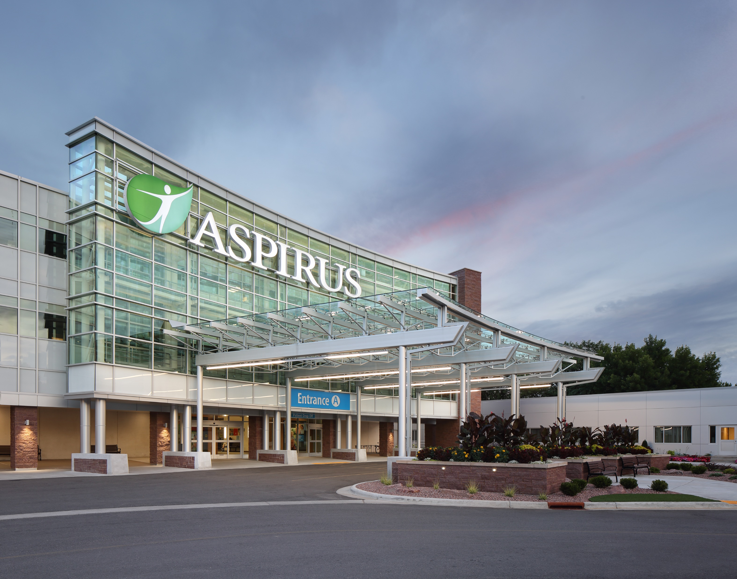
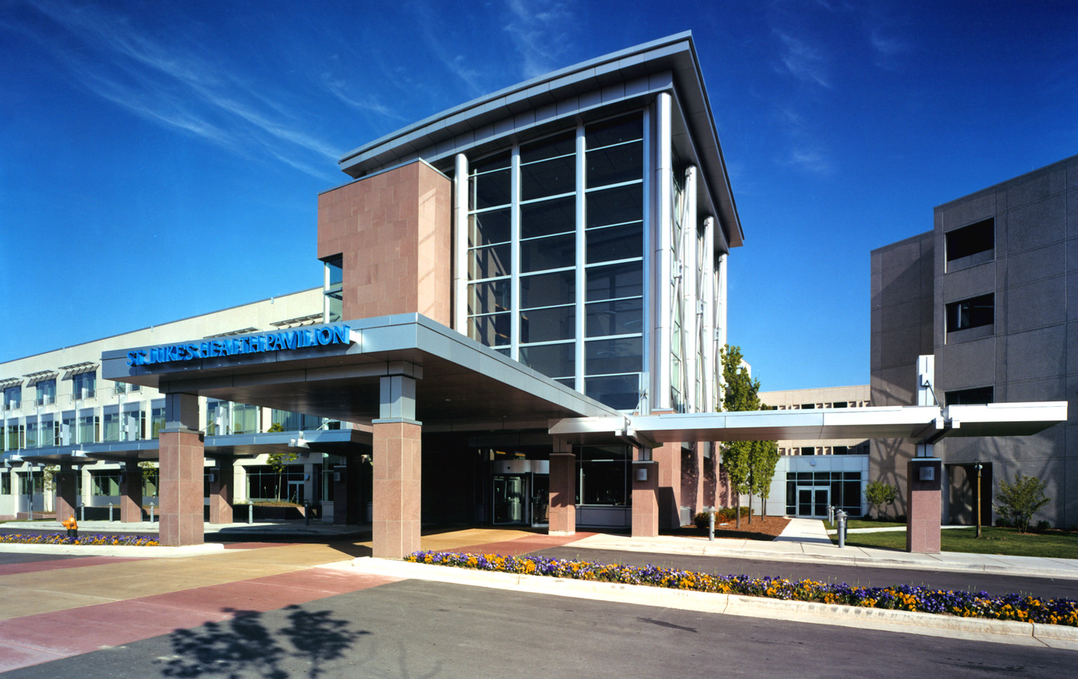
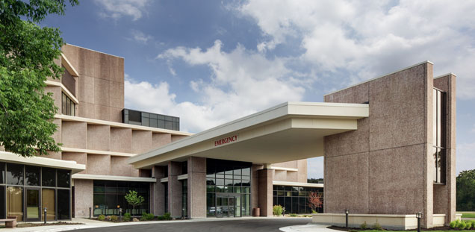
Healthcare
HEALTHCARE
Aurora Bay Area Medical
Aspirus Wausau
All Saints
Beloit Health System Hospital
Notes:
All saints
Aurora Bay Area Medical
Aspirus wausua
Belior health system

Slide 4
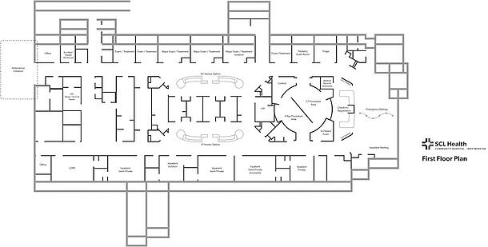
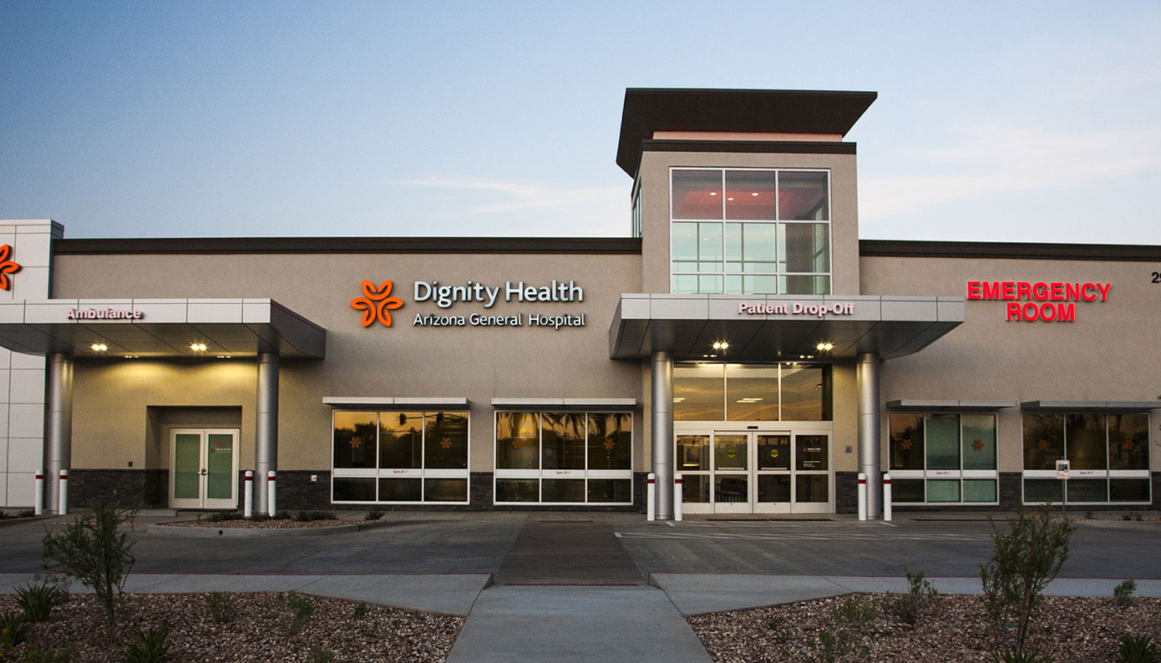
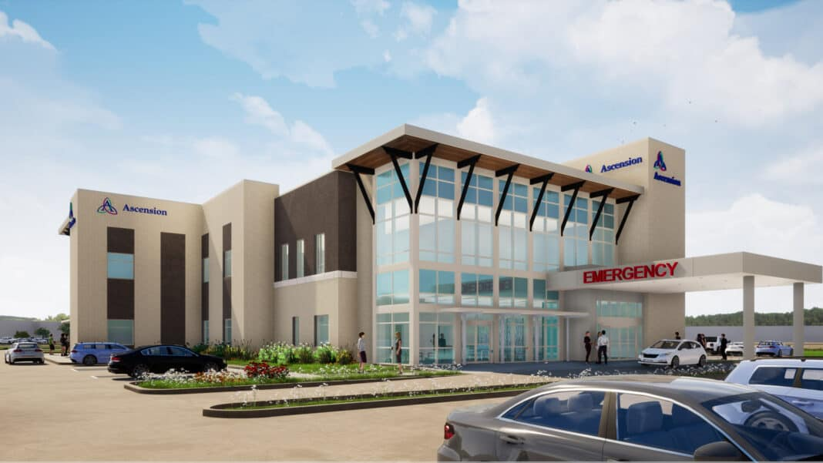
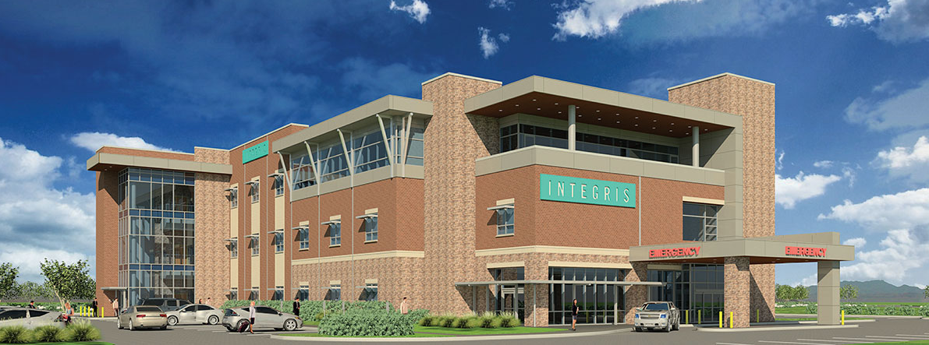
MINI HOSPITAL
Notes:
The lower left photo of Ascension is planned for Menomonee Falls and it is 33,000 sq. ft.

Slide 5
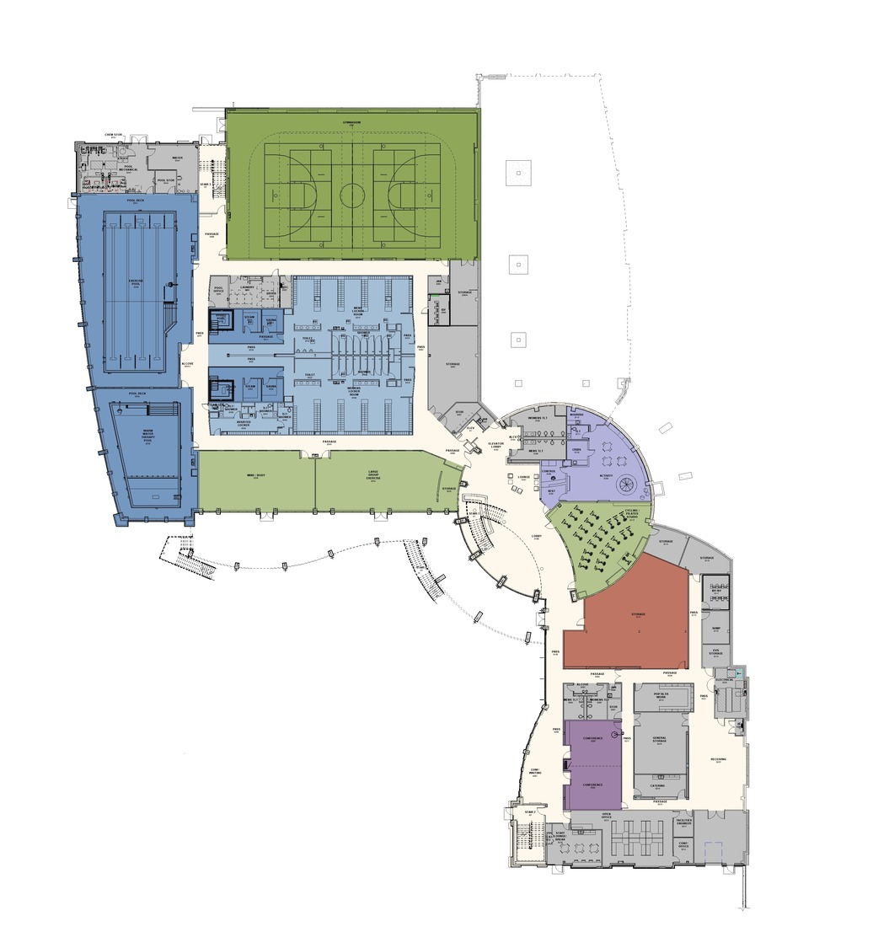
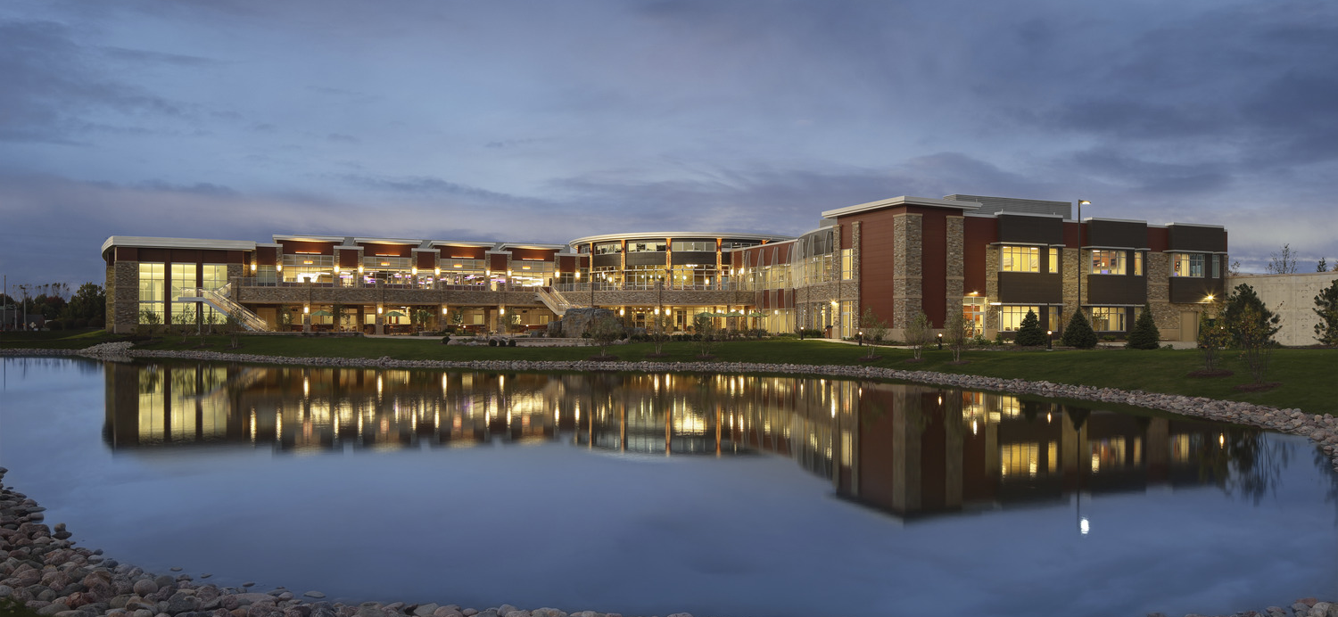
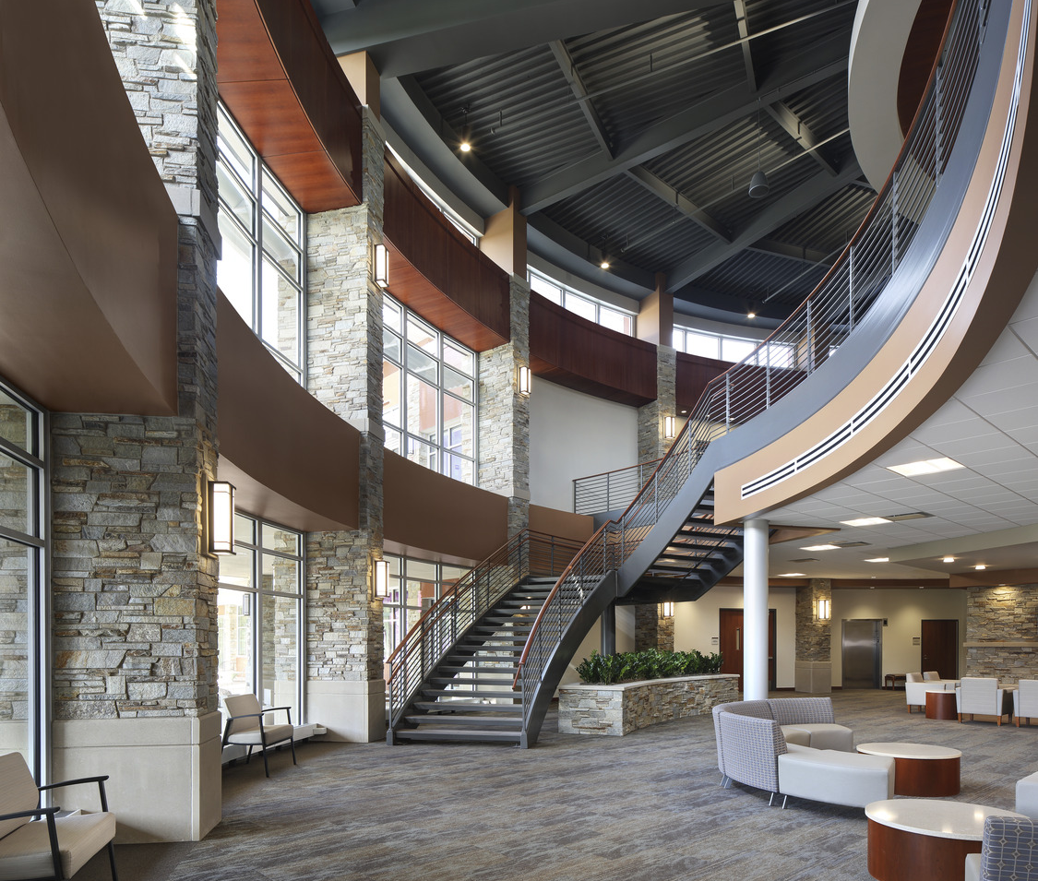
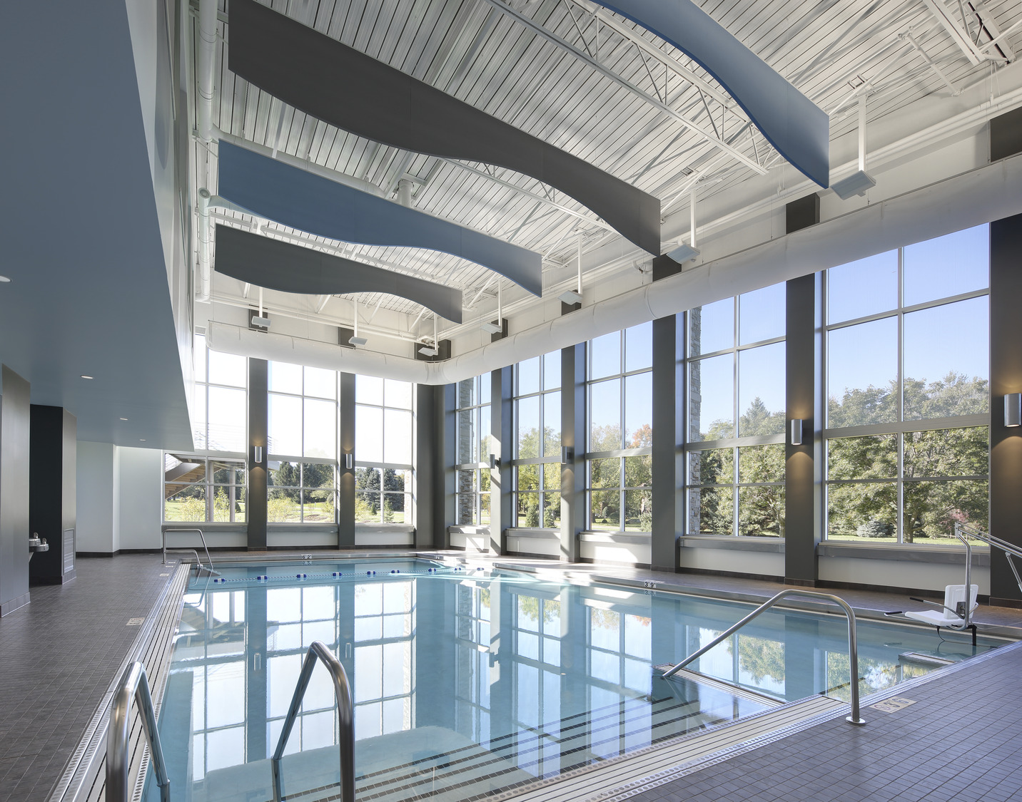
WELLNESS CENTERS
Kishwaukee Health & Wellness Center
Kishwaukee Health & Wellness Center
Kishwaukee Health & Wellness Center
Kishwaukee Health & Wellness Center
Notes:
Kishwaukee

Slide 6
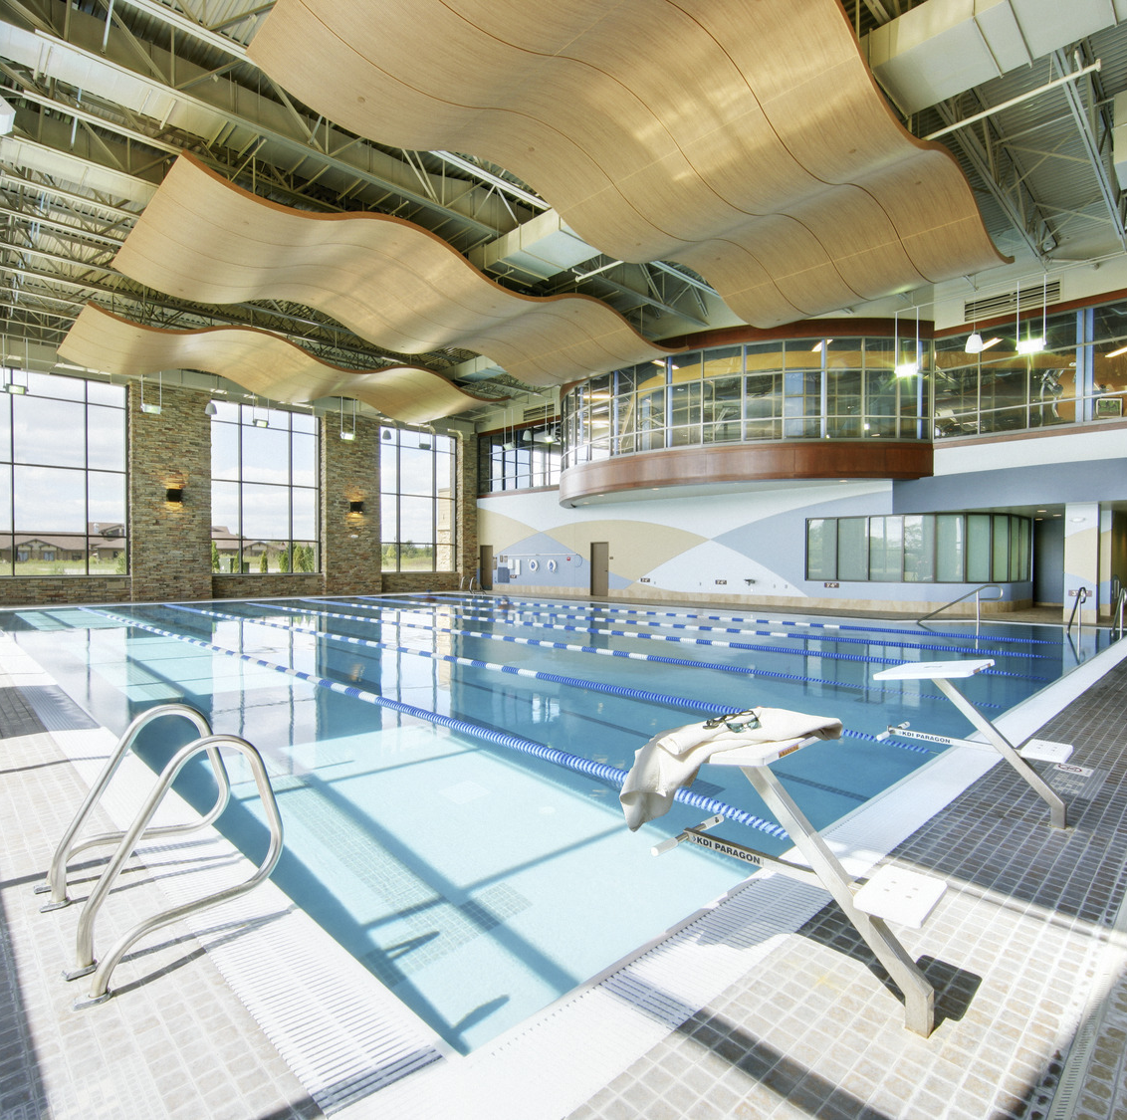
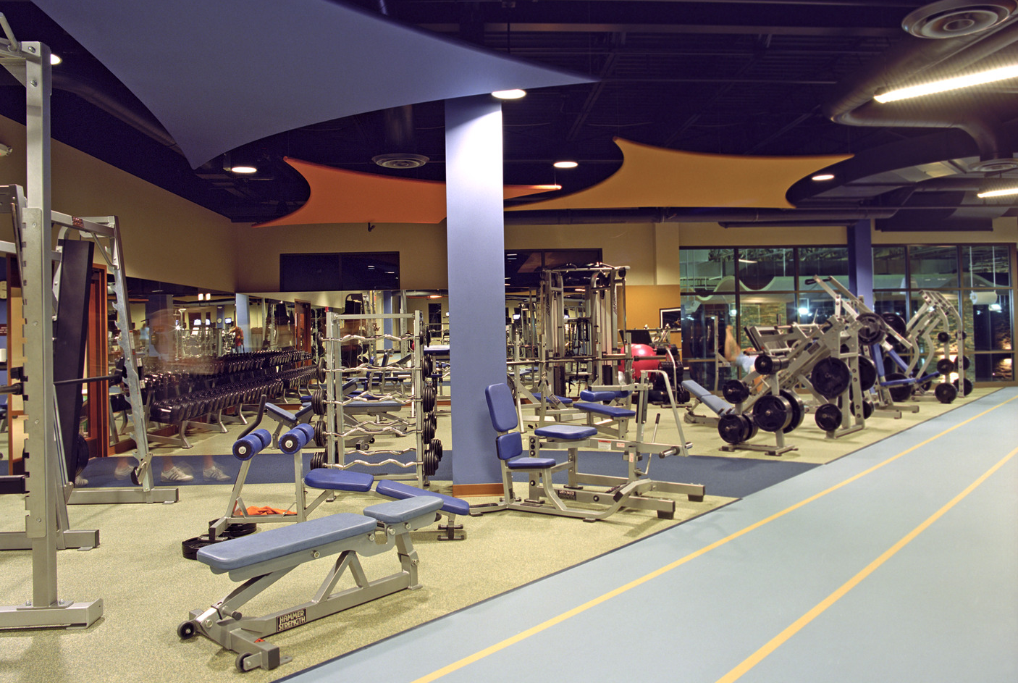
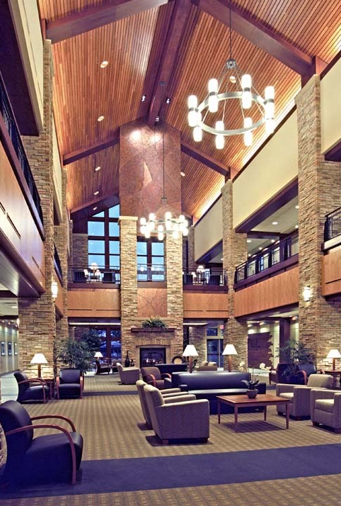
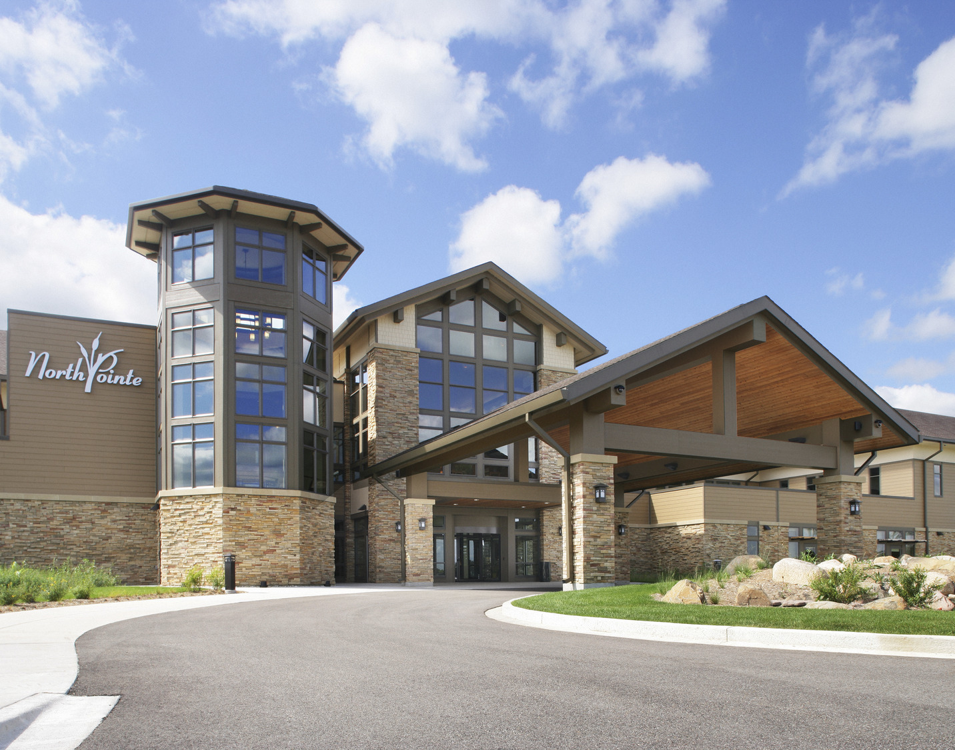
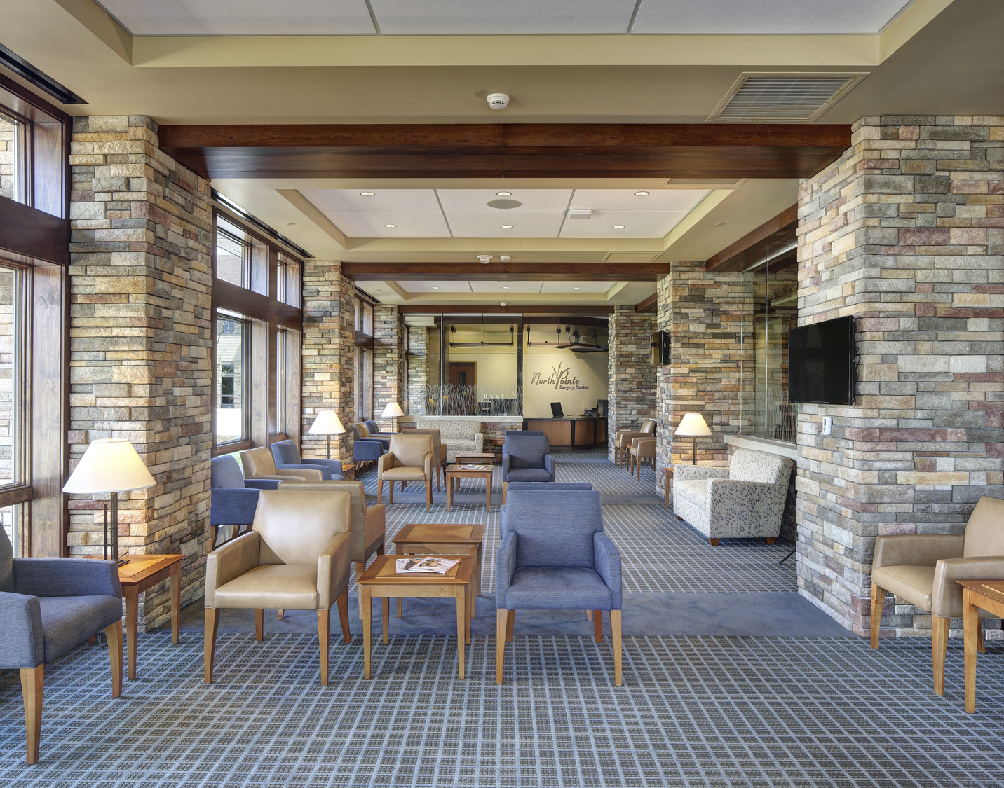
WELLNESS CENTERS
Beloit Health System - NorthPointe
Beloit Health System - NorthPointe
Beloit Health System - NorthPointe
Beloit Health System - NorthPointe
Beloit Health System - NorthPointe
Notes:
Get the floor plan of ASC for NorthPointe

Slide 7
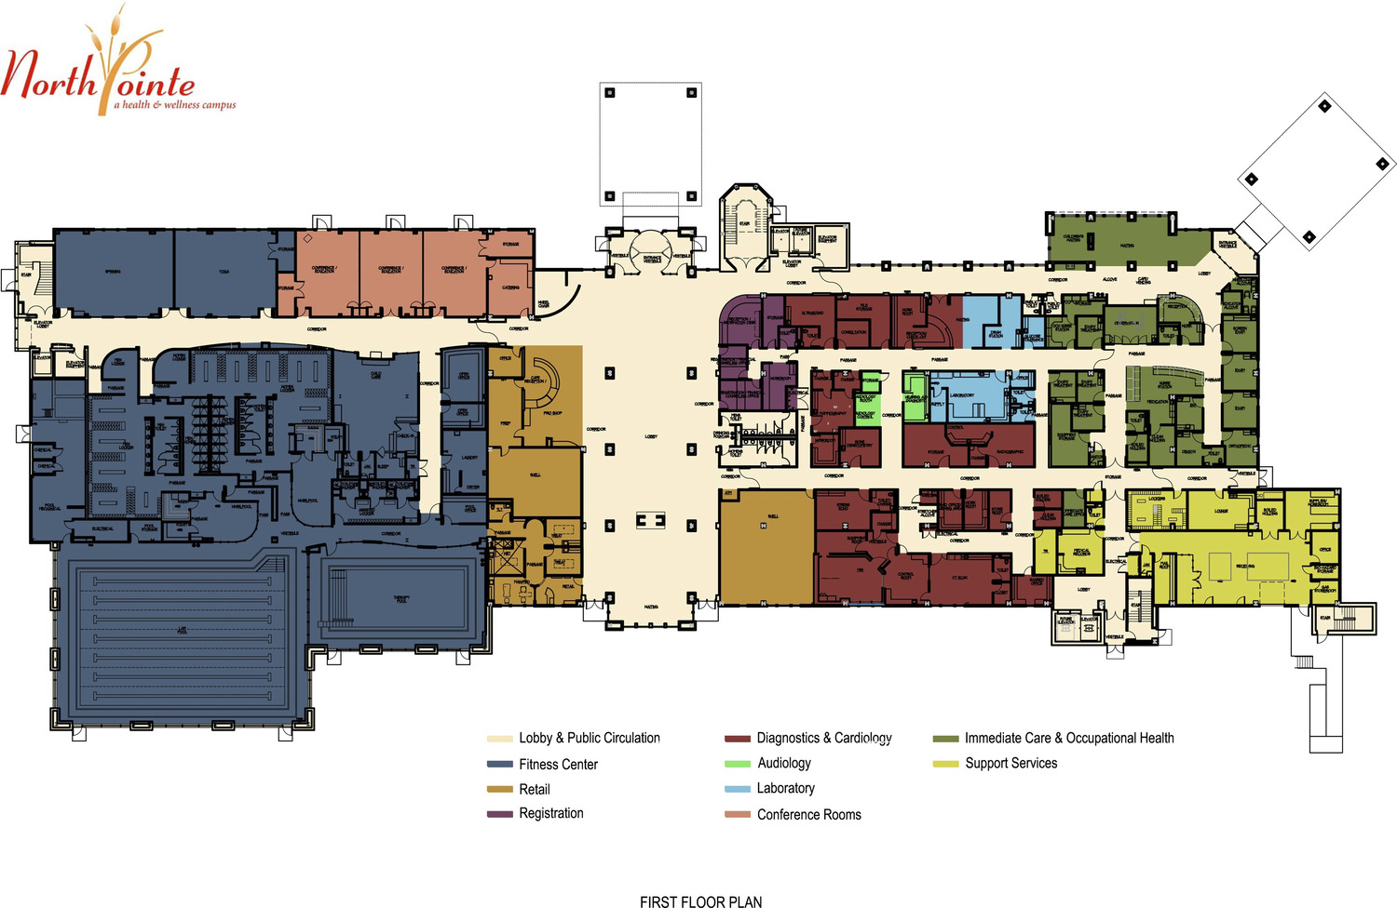
WELLNESS CENTERS
Notes:
Get the floor plan of ASC for NorthPointe

Slide 8
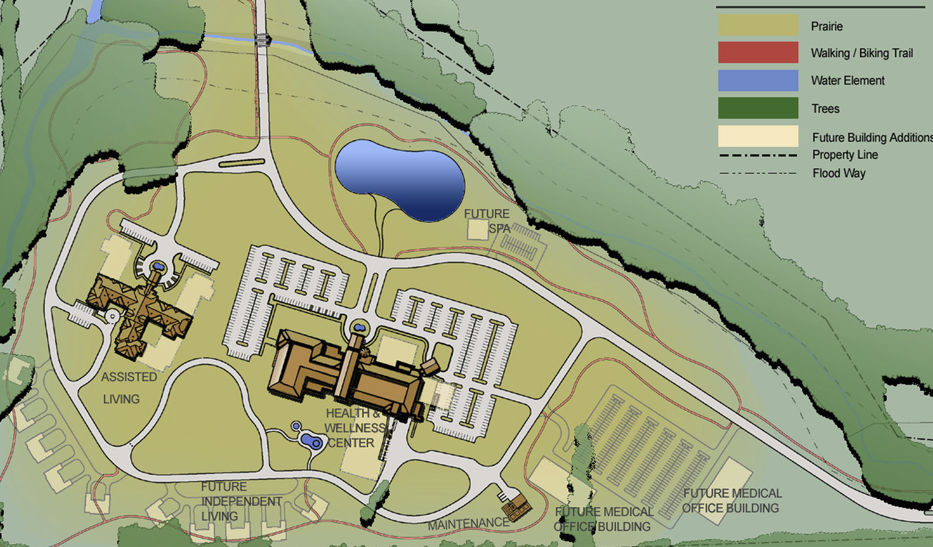
WELLNESS CENTERS
Notes:
Wellness Center with Assisted Living – this is how things are evolving

Slide 9
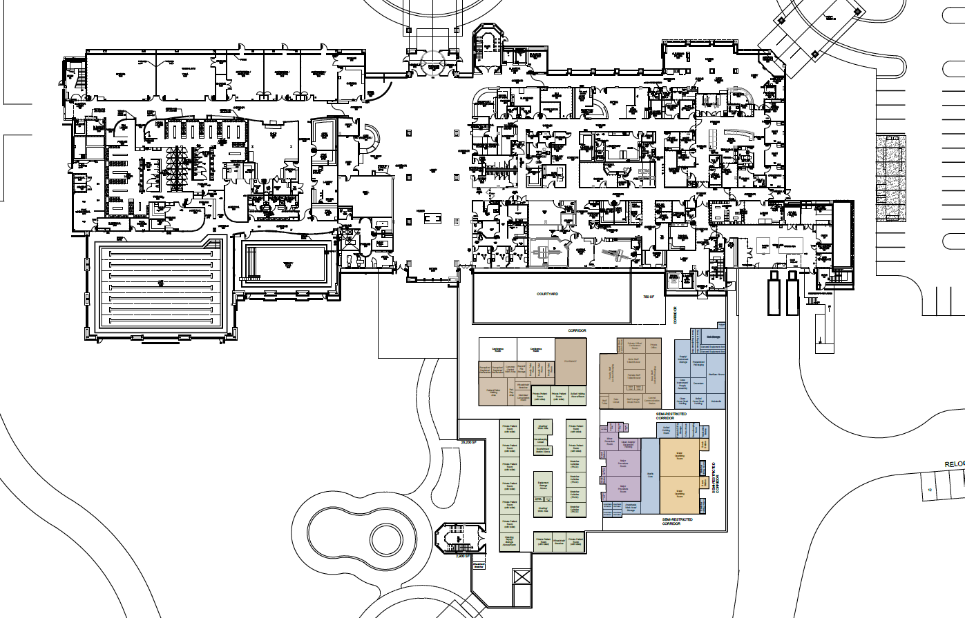
AMBULATORY SURGERY CENTERS
Notes:
Get the floor plan of ASC for NorthPointe

Slide 10
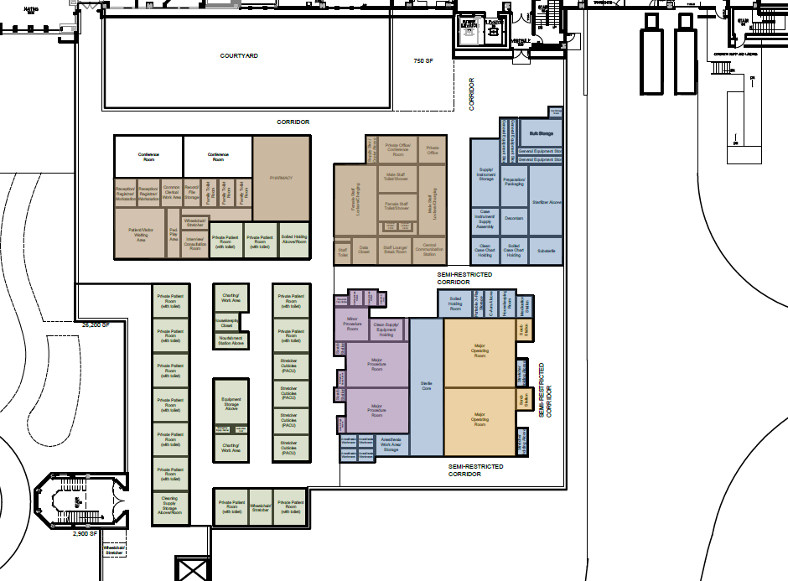
AMBULATORY SURGERY CENTERS
Notes:
Get the floor plan of ASC for NorthPointe

Slide 11
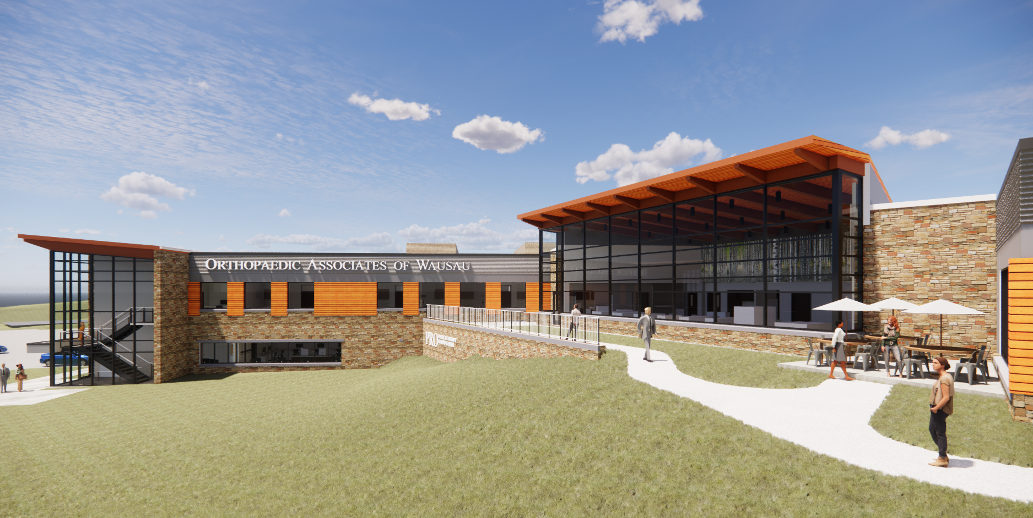
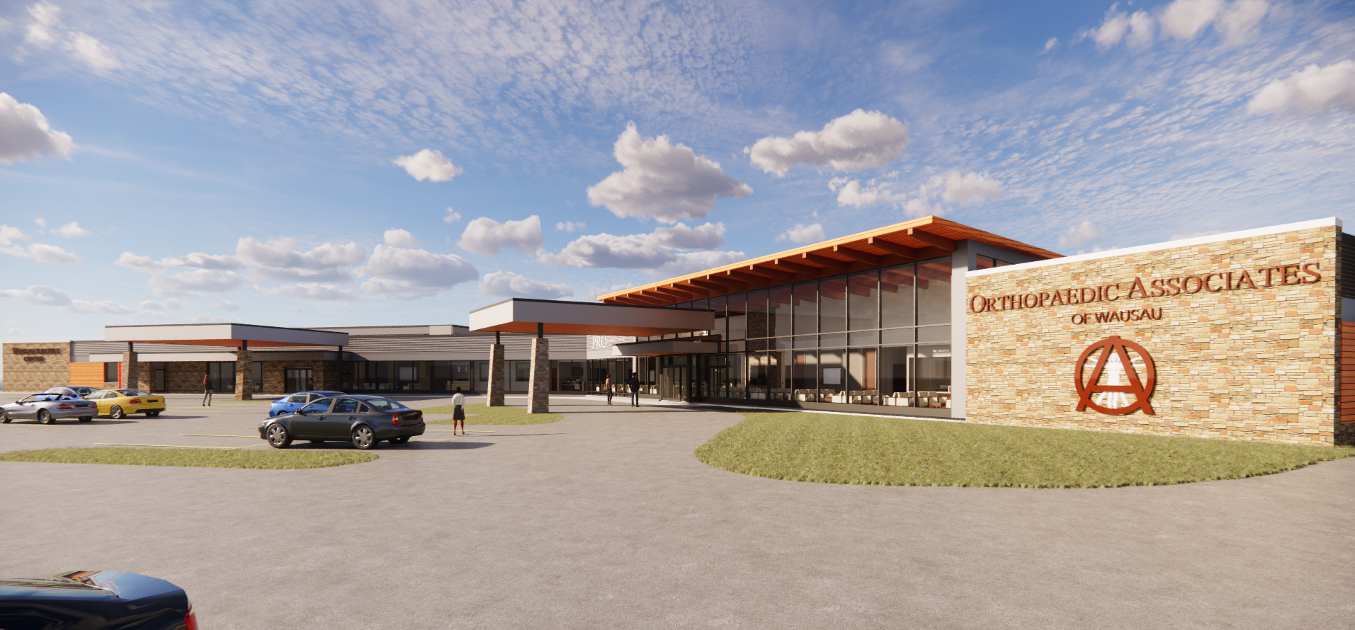
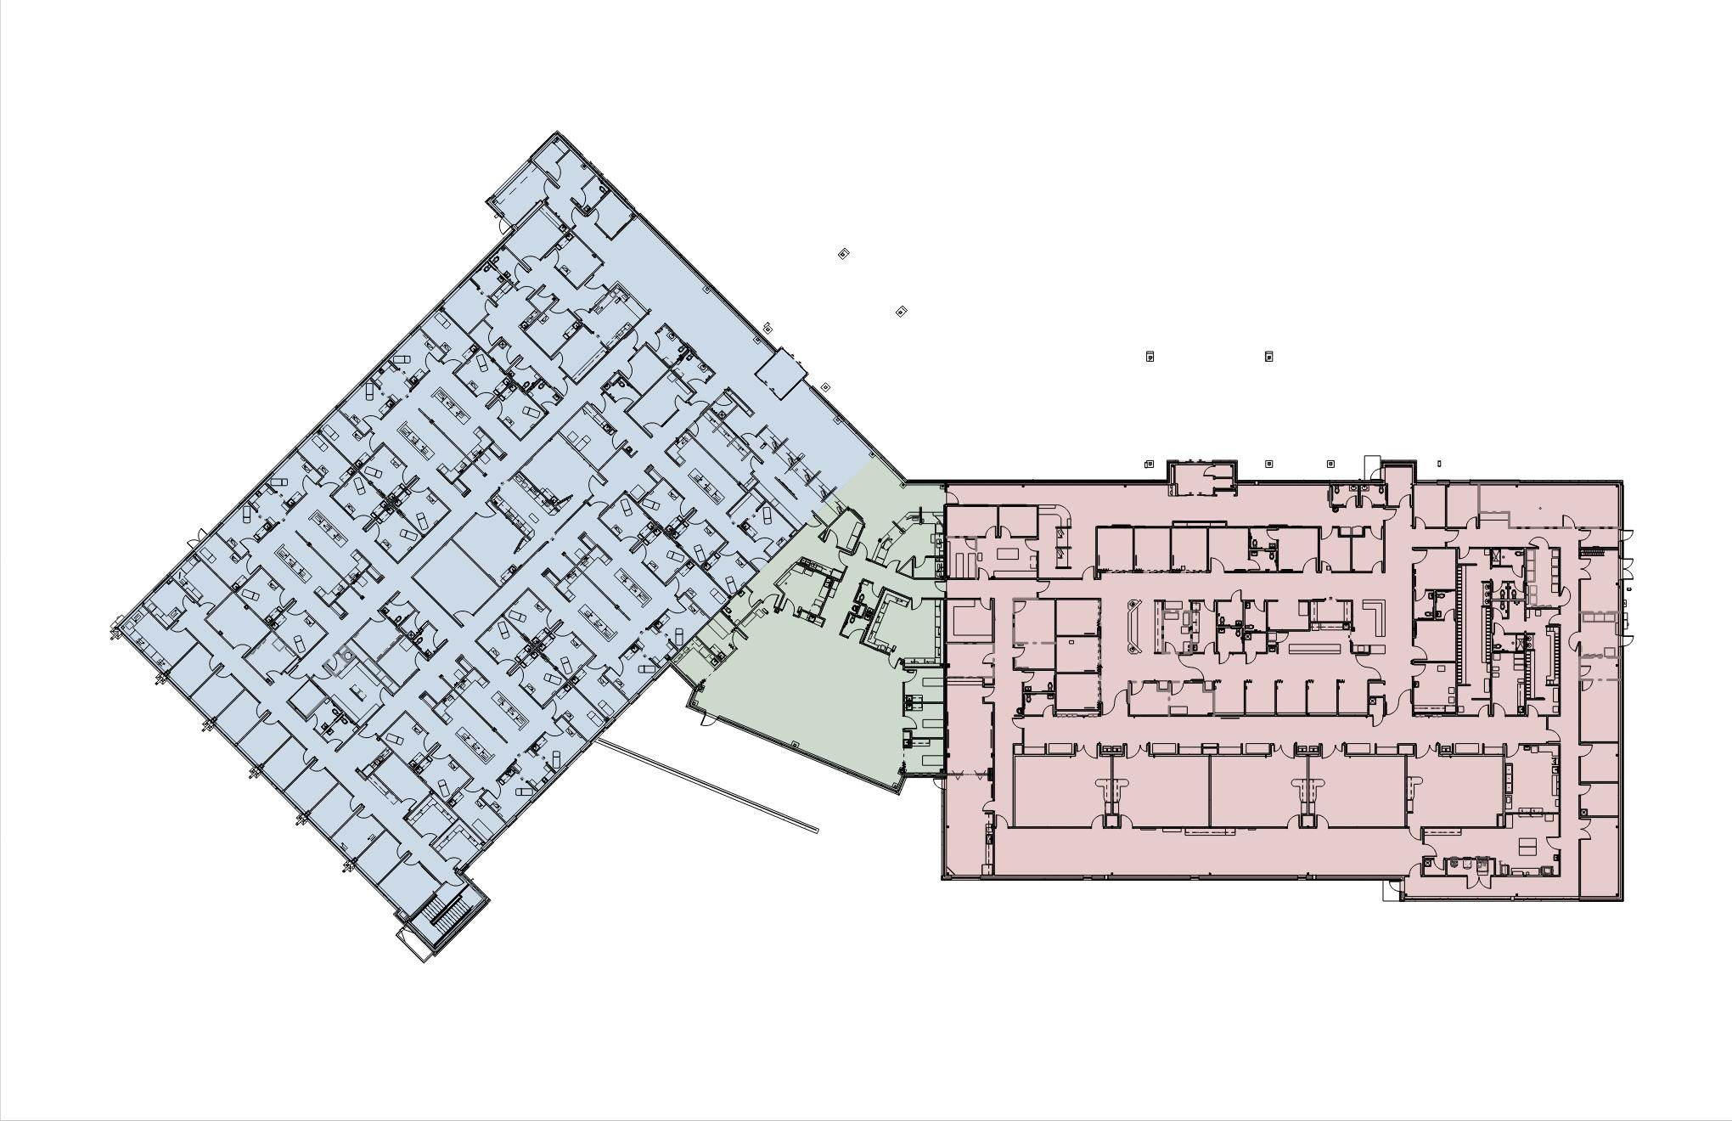
AMBULATORY SURGERY CENTERS
Orthopaedic Associates of Wausau
Orthopaedic Associates of Wausau
Notes:
Orthopedic of Wausau – plan and exetior shot

Slide 12
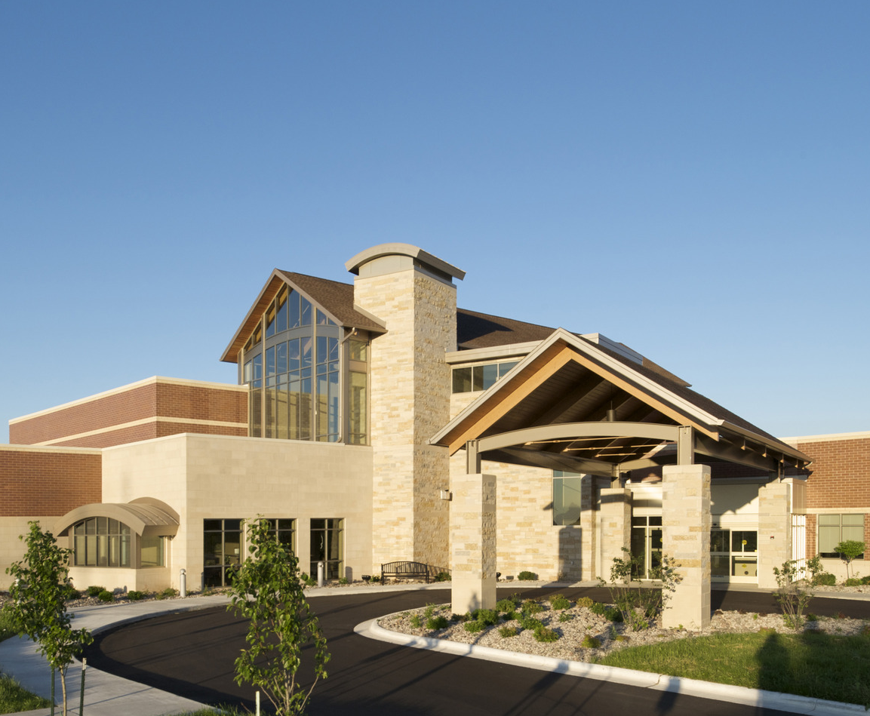
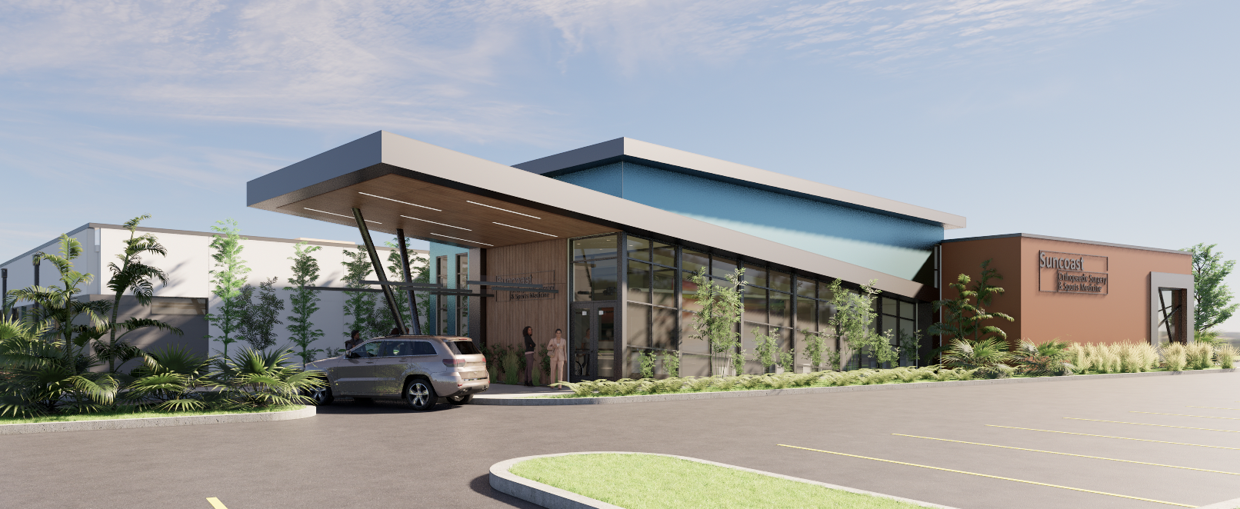
SPECIALTY CLINICS
Neuroscience Center
Suncoast Orthopedics
Beloit Cancer Care Center
Notes:
Rendering of Suncoast

Slide 13
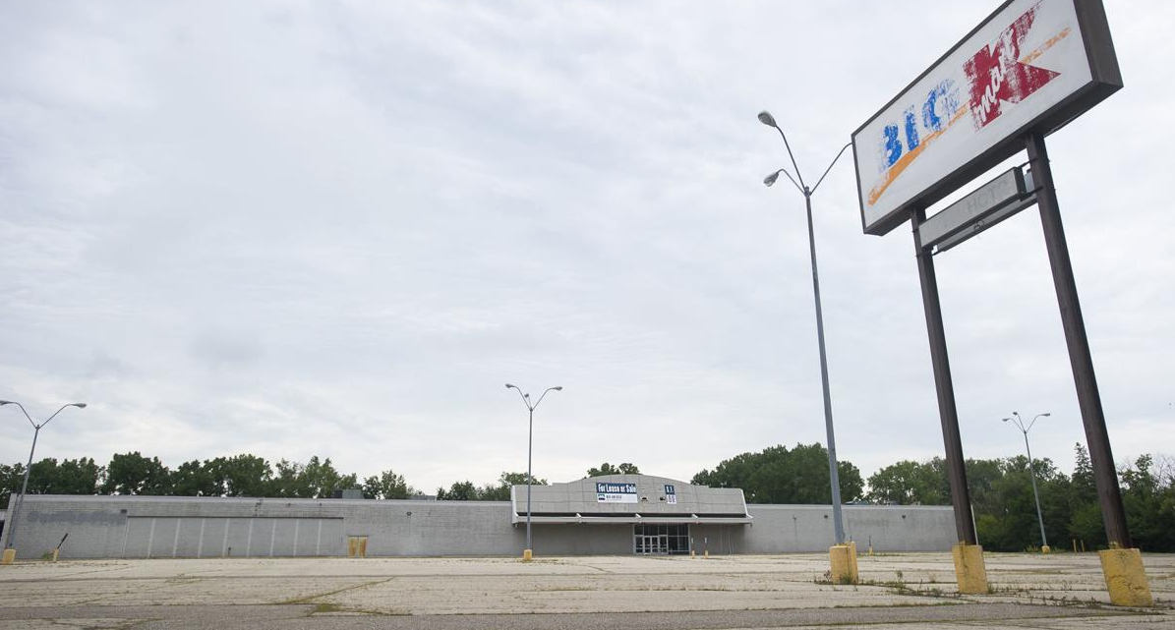
ADAPTIVE REUSE
Notes:
Add animation of this and then the sendicks images
Look for the old Walmart in minona MN by HSR architects

Slide 14
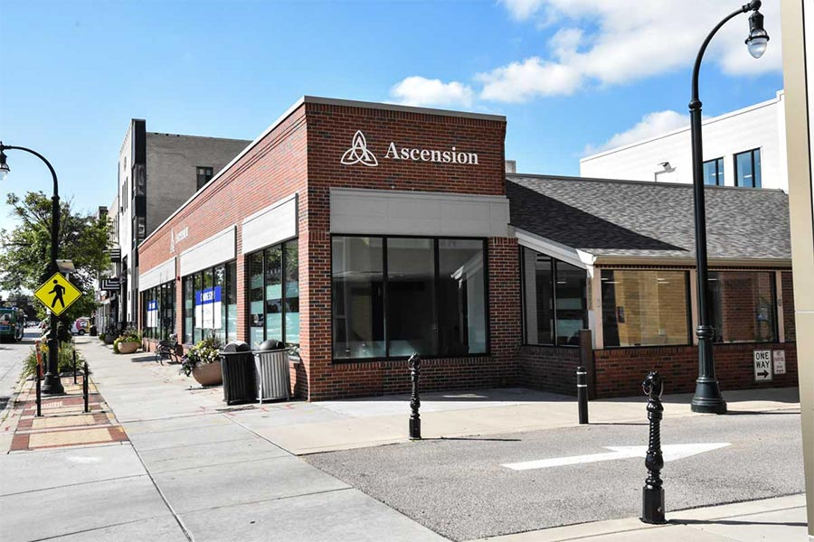
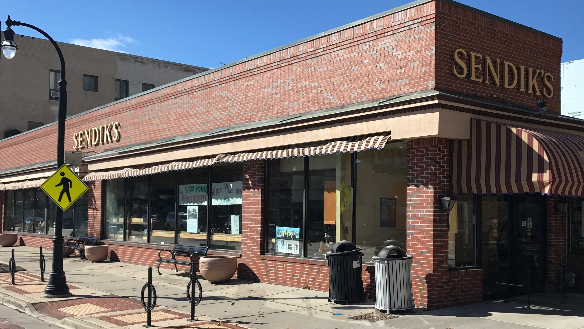
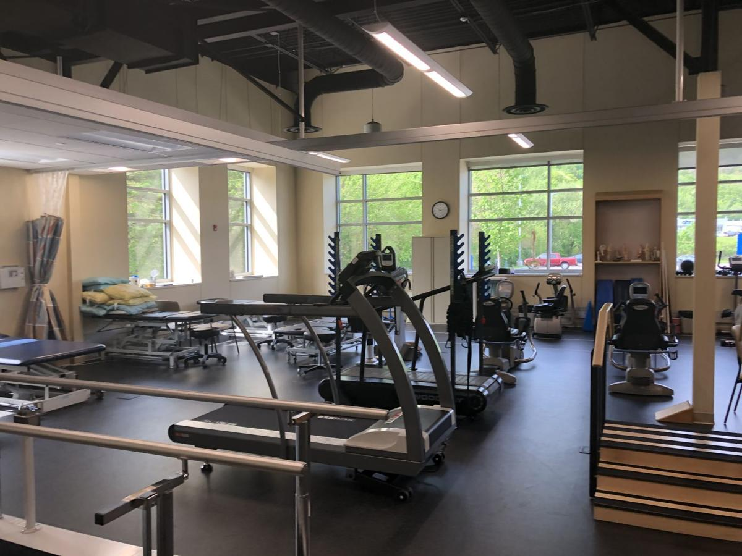
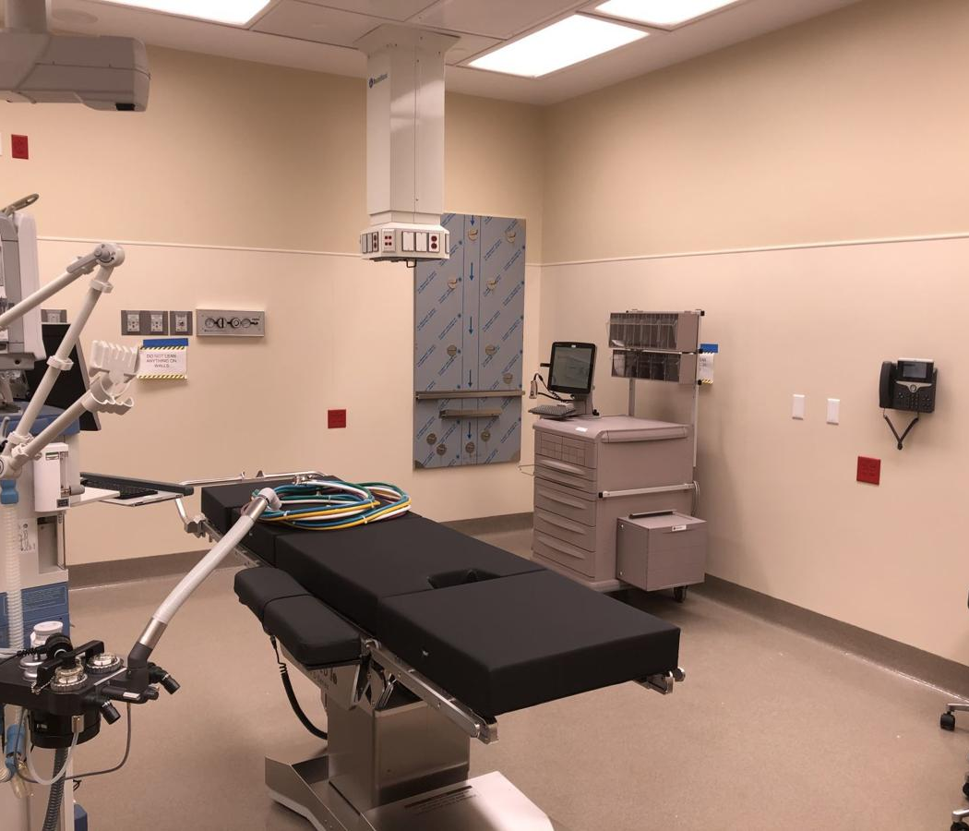
ADAPTIVE REUSE
https://www.winonadailynews.com/news/local/gundersen-winona-campus-second-phase-ready-to-welcome-patients/article_dd3ab2df-90c6-504d-aef9-bfffd1ac898d.html
Notes:
Add animation of this and then the sendicks images
Look for the old Walmart in minona MN by HSR architects

Slide 15
ADAPTIVE REUSE
Notes:
Add animation of this and then the sendicks images
Look for the old Walmart in minona MN by HSR architects

Slide 16
ADAPTIVE REUSE
Notes:
Add animation of this and then the sendicks images
Look for the old Walmart in minona MN by HSR architects

Slide 17
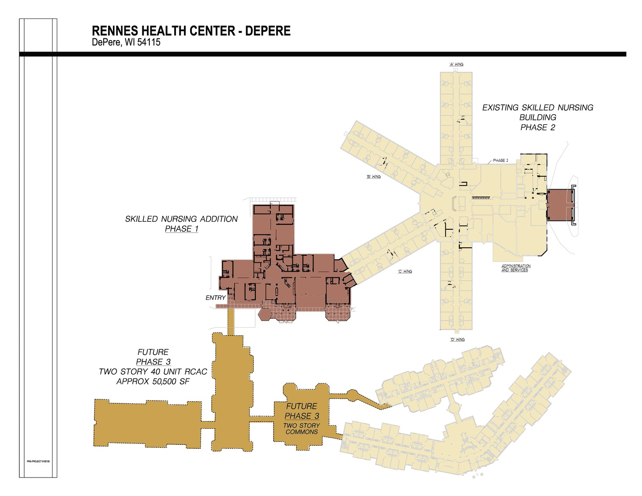
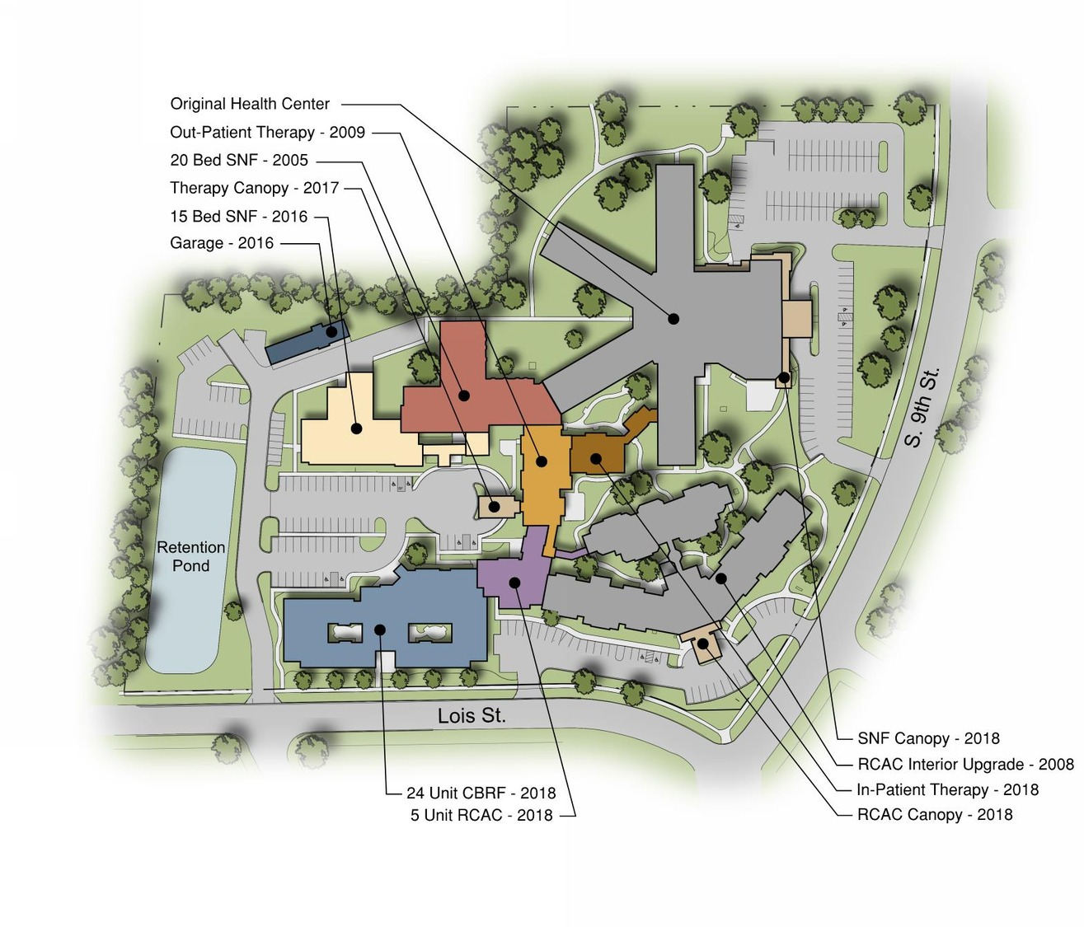
SENIOR LIVING
Rennes Group Depere Campus

Slide 18
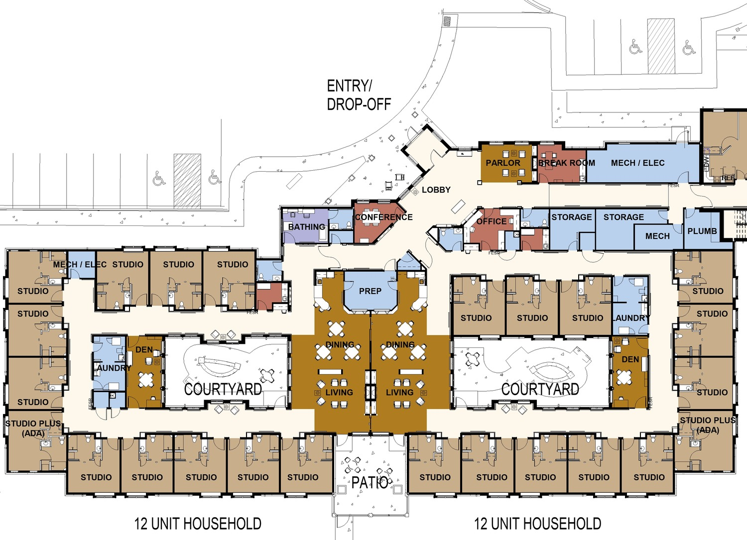
SENIOR LIVING

Slide 19
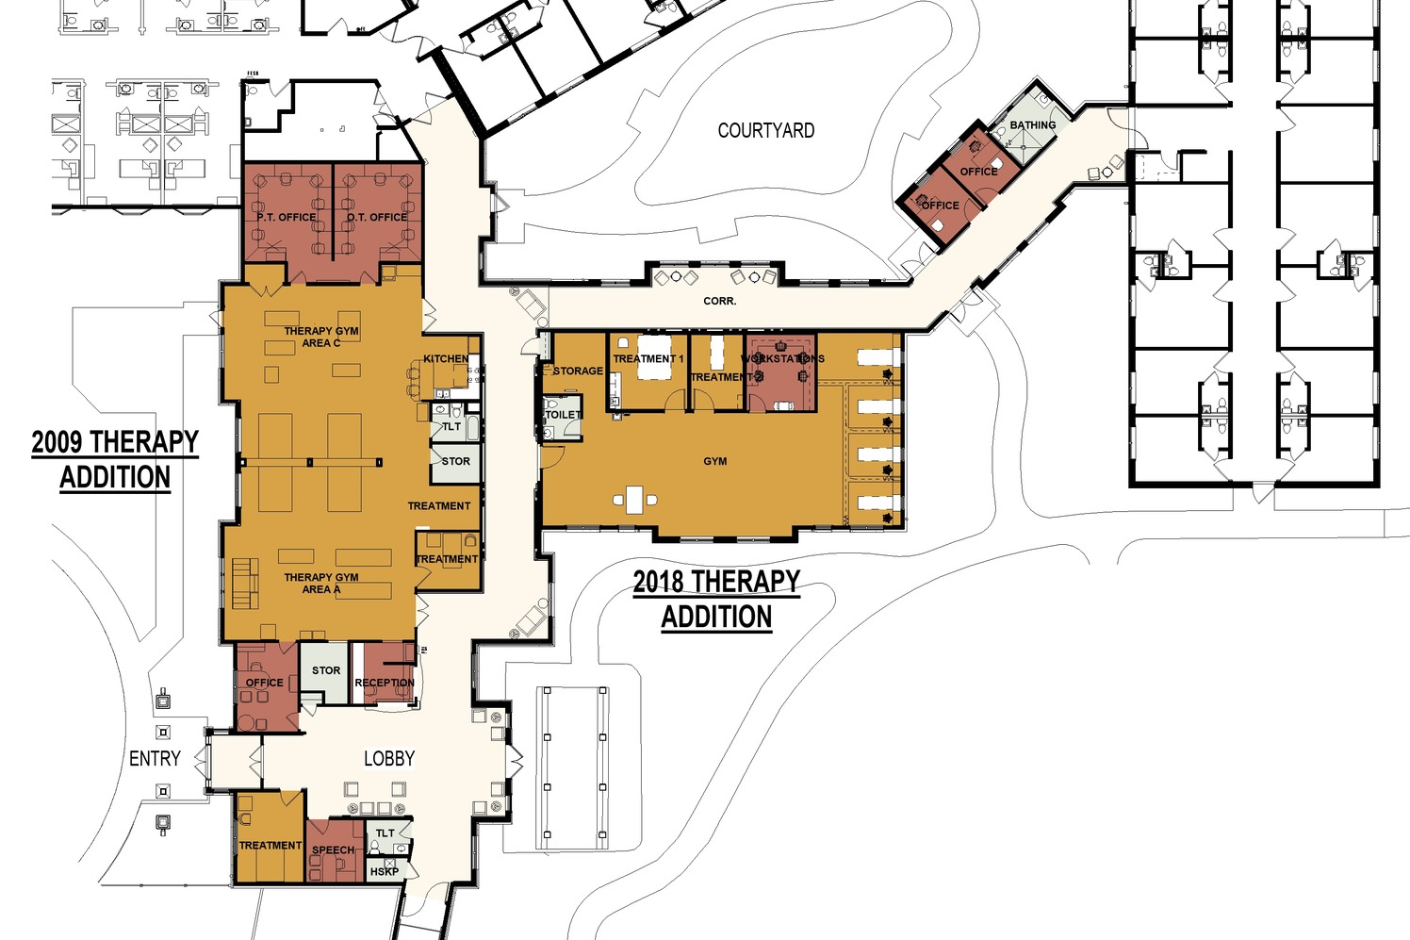
SENIOR LIVING

Slide 20
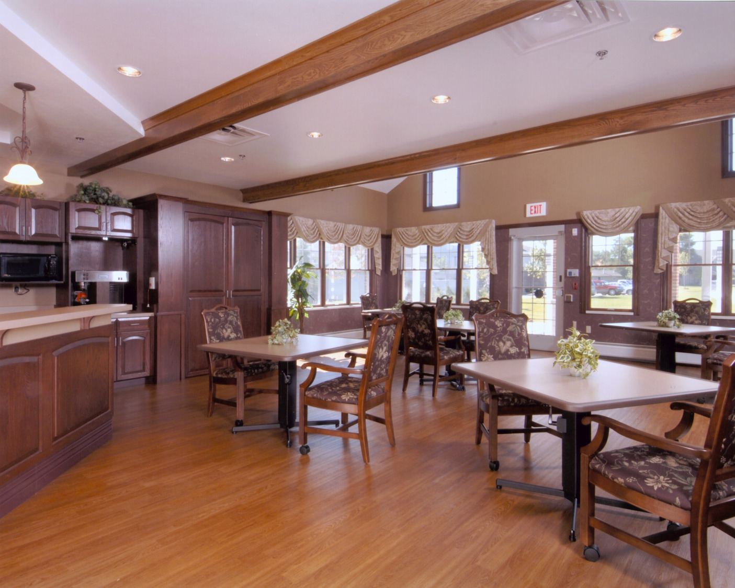
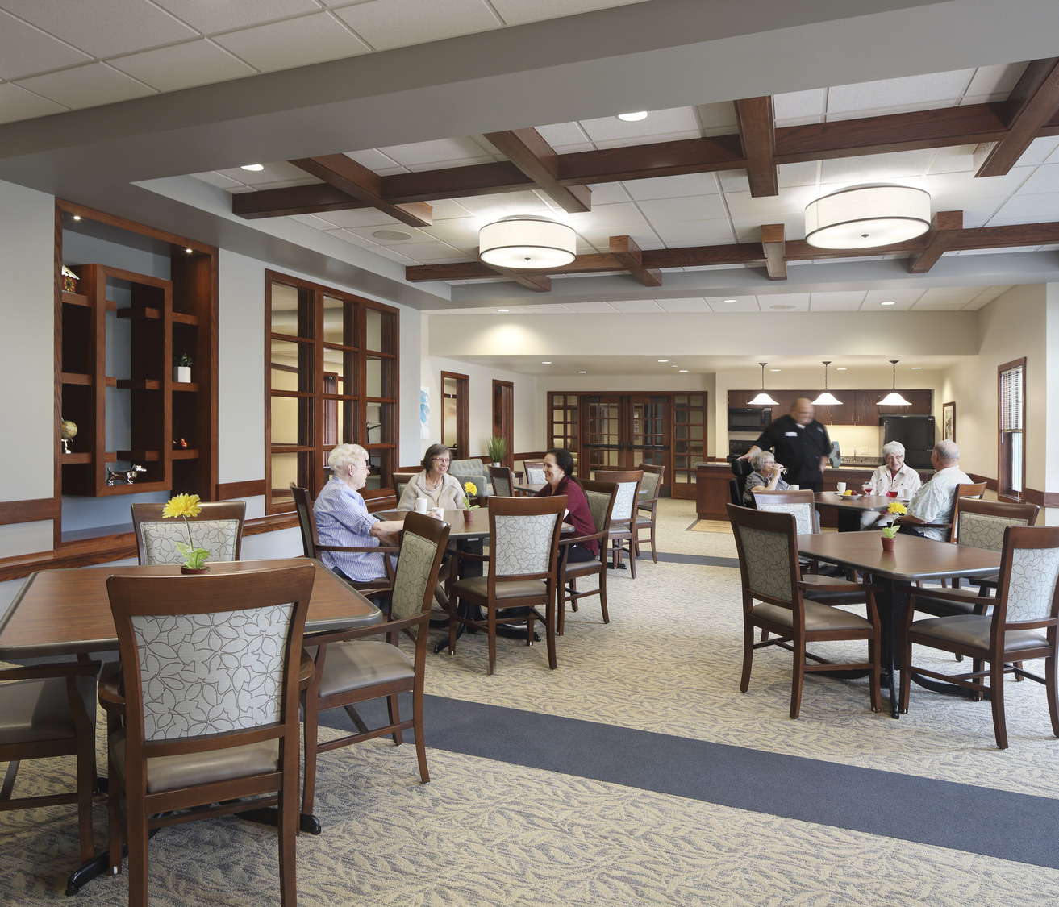
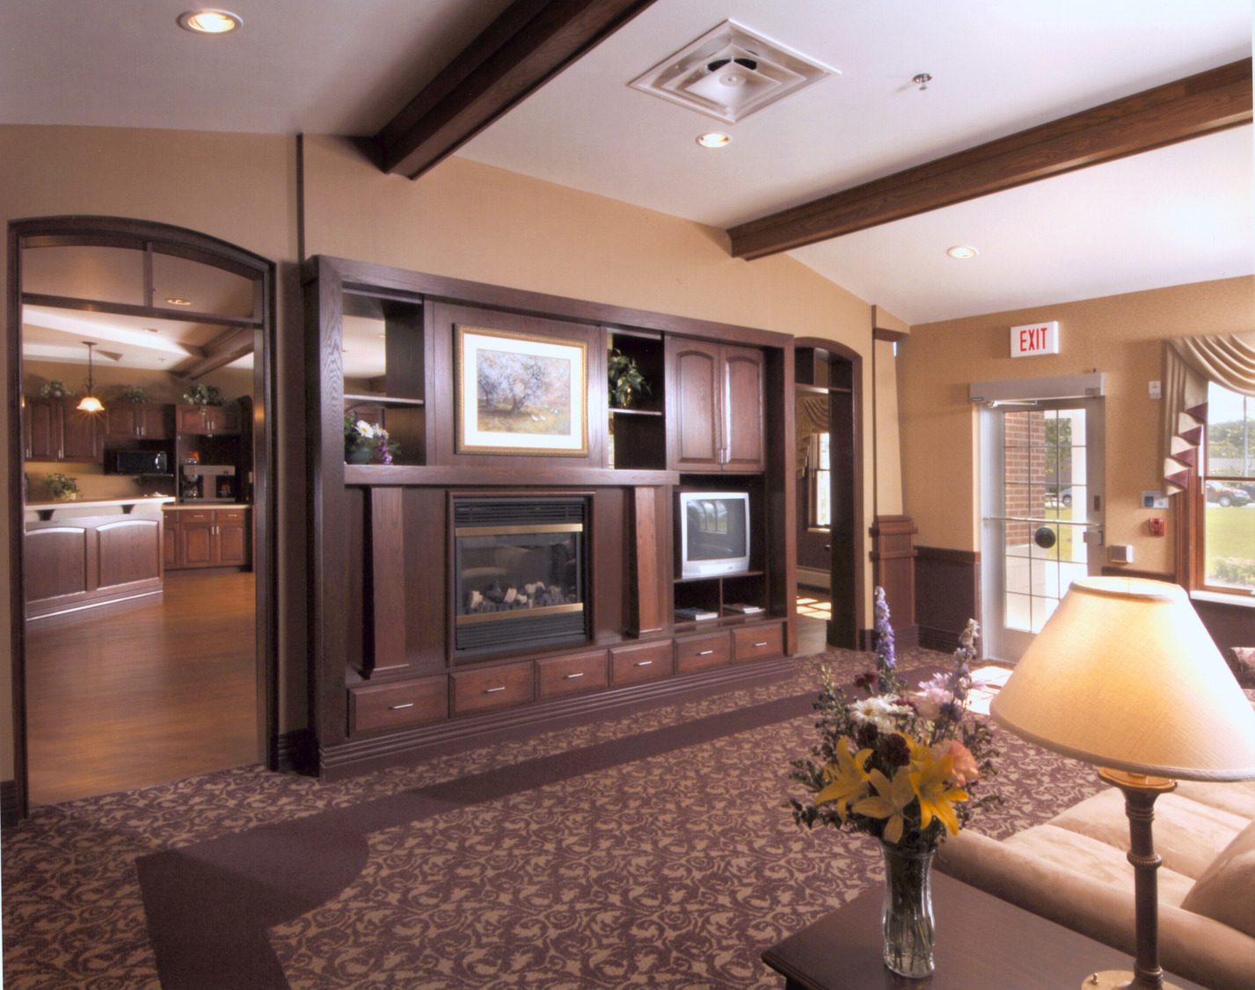
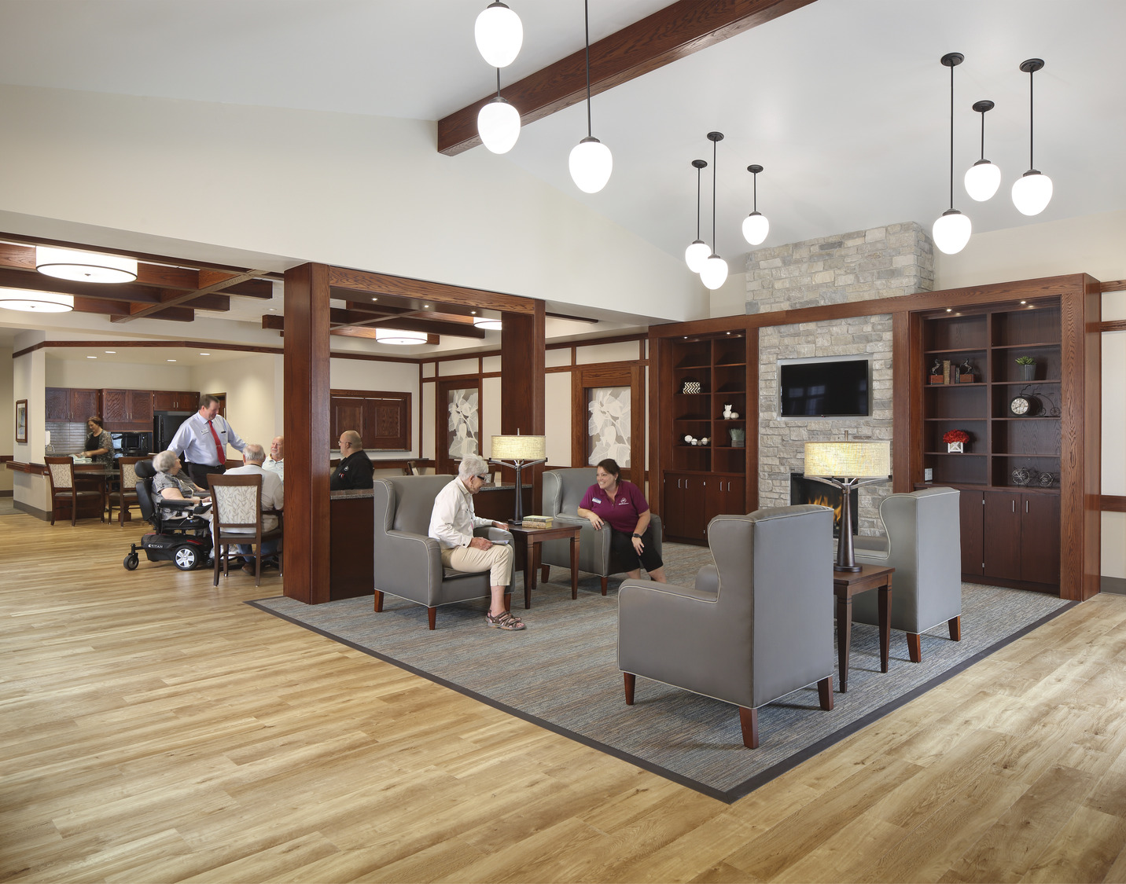
SENIOR LIVING
OLD:
NEW:
Older traditional style of institutional look has transitioned into residential look
Notes:
Transition from institutional – Pinwheel to households and neighborhoods
Transition into modern, improving the aesthetics and the amenities
Pubs – get some images - lounges, pubs

Slide 21
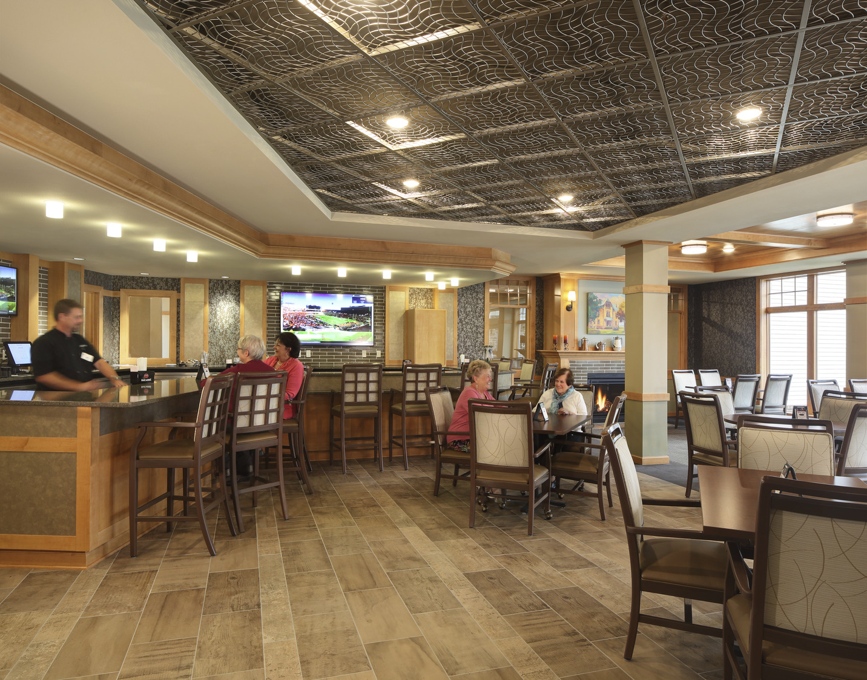
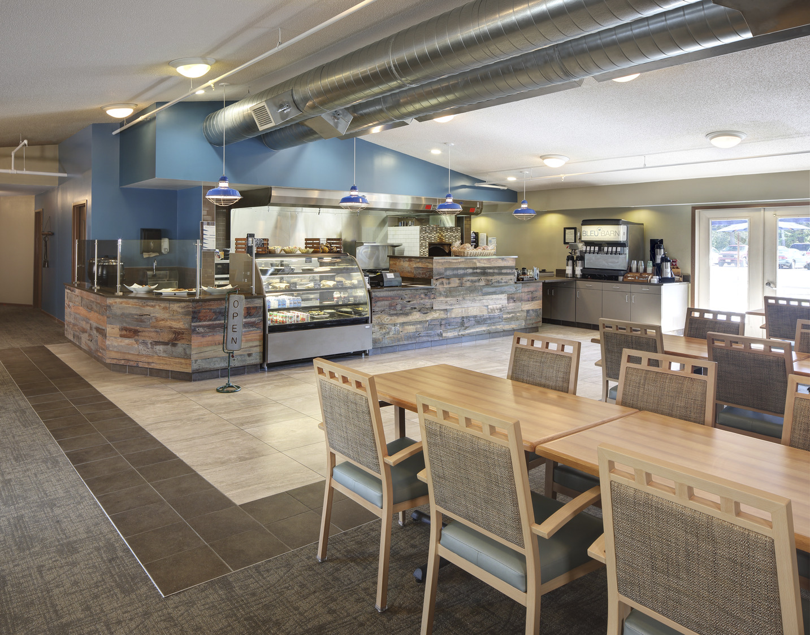
BISTROS + BARS
Maine Veterans’ Homes
Lutheran Homes of Oconomowoc North Side Catered Living
Bethany Home
HarborChase
Cascadia Fieldstone
Cascadia Fieldstone
Notes:
Get old images of town square pictures – store front inside of atrium

Slide 22
SENIOR LIVING
Rennes Group Depere Campus
Maine Veterans’ Homes
Lutheran Homes of Oconomowoc - Shorehaven
St. Camillus
Milwaukee Catholic Home
Notes:
Look for old Lasata images – P Folder adventure
Look for old ugly buildings

Slide 23
SENIOR LIVING
Rennes Group Depere Campus
Maine Veterans’ Homes
Lutheran Homes of Oconomowoc - Shorehaven
St. Camillus
Notes:
Look for old Lasata images – P Folder adventure
Look for old ugly buildings

Slide 24
HIGHER EDUCATION
Madison College Truax Campus
Notes:
Truax was in 2013

Slide 25
HIGHER EDUCATION
Madison College Goodman South Campus
Notes:
Goodman south was in 2018

Slide 26
HIGHER EDUCATION
OLD:
NEW:
New models embracing innovation, responsivity + adaptation
Student interactions are a priority
Transition to multi-purpose spaces
Furniture and technology integration considerations

Slide 27
HIGHER EDUCATION
Madison College Goodman South Campus
Madison College Truax Campus
Madison College Truax Campus
Milwaukee Area Technical College
Forest Park
Milwaukee Area Technical College
Notes:
Its not boxes within boxes – there are a lot of open spaces and

Slide 28
HIGHER EDUCATION
Madison College Truax Campus
Madison College Goodman South Campus

Slide 29
MODULAR DESIGN + CONSTRUCTION

Slide 30
MODULAR DESIGN + CONSTRUCTION

Slide 31
MODULAR DESIGN + CONSTRUCTION

Slide 32
MODULAR DESIGN + CONSTRUCTION

Slide 33
MODULAR DESIGN + CONSTRUCTION

Slide 34
MODULAR DESIGN + CONSTRUCTION

Slide 35
MODULAR DESIGN + CONSTRUCTION

Slide 36
MODULAR DESIGN + CONSTRUCTION

Slide 37
QUESTIONS &
ANSWERS

